Slide 1

CO₂ Geological Storage Pilots in Strategic Territories
H2020-LC-SC3-NZE-6-2020: Geological Storage Pilots
Fernanda M.L. Veloso (project coordinator and French team leader)
2nd European Underground Energy Storage Workshop
23/05/2023 - Paris

Slide 2

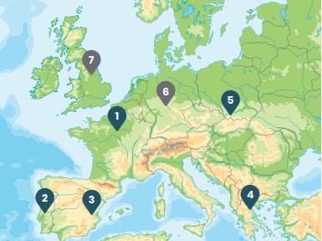

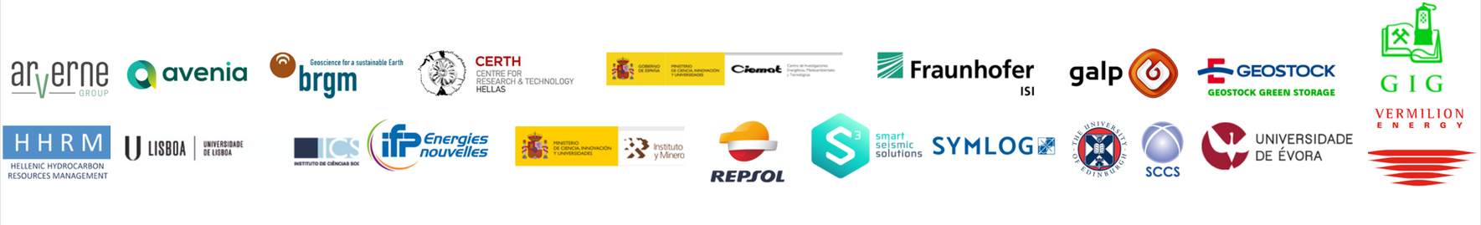
Built from STRATEGY CCUS (H2020, CSA 2019-2022)
CCUS economic plans: technical, economical (TEA), environmental (LCA) and societal aspects (Regional Stakeholder Committees)
Upper Silesia
Paris Basin
Lusitania Basin
Ebro Basin
Macedonia
16 partners (+ 3 FR third parties)
Budget: € 10,022,547.50
Duration: 5 years (from May 2021 to April 2026)
Notes:
Detailed studies will be carried out on deep saline aquifers in the Paris Basin in France, the Lusitanian Basin in Portugal and the Ebro Basin in Spain. We will also enhance our knowledge of CO₂ storage options in West Macedonia in Greece and Upper Silesia in Poland.
Pre-investment proposal: detail studies to support it, that is, deep geological characterization, clear understanding the risks,environmental impact assessment, concept development proposal and economic-evaluation, permits and regulations obligations,… everything needed for the decision of going ahead with next step on development or not.
Deep saline aquifer: porous rock formations filled with brine several kilometres below ground.

Slide 3
PilotSTRATEGY Objectives and Multi-criteria approach
Technical evaluation
Social acceptance
Economic evaluation
Environmental risks
Social-economic evaluation
Legal frame and incentives
Project goals
Detailed study of Deep saline aquifers for CO₂ geological storage pilot sites to support development of carbon capture and storage (CCS)
Class IV Economic evaluation of CCS concept for storage sites in FR, PT and ES
Pre-investment proposal for the 3 pilots in France, Portugal and Spain, and development concept proposal for Poland and Greece regions.

Slide 4
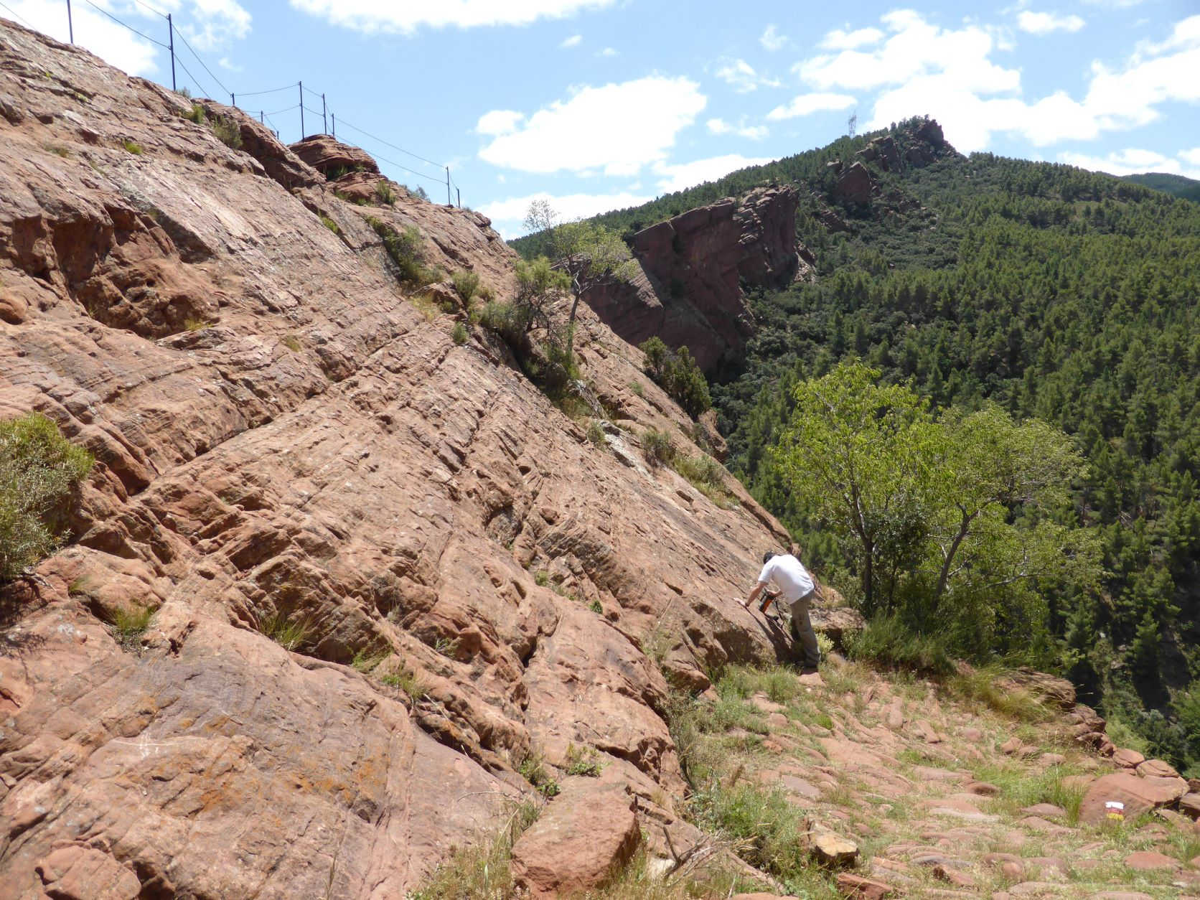
Were we are in 2023
Portugal and Spain decision on storage site: Portugal offshore and Spain onshore
Storage complex characterization: sampling, log analysis, experimental data, geophysical data
Launching numerical models: models purposes and software
Building CCS concept for the storage pilot
Risk identification and Risk register
Community profile & Regional Stakeholder Committees
Picture: Fieldwork commences south of Aragon in Spain's Ebro Basin.
Credit: IGME

Slide 5
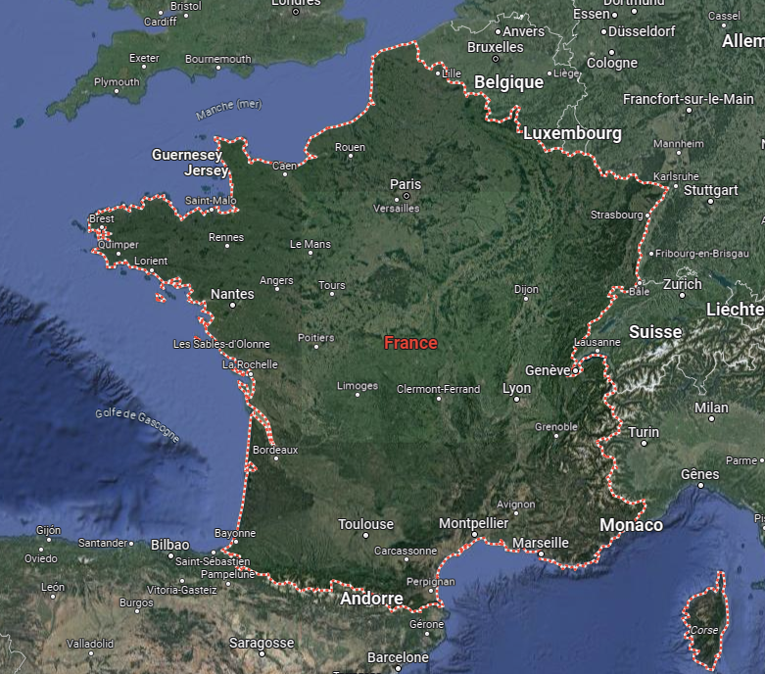
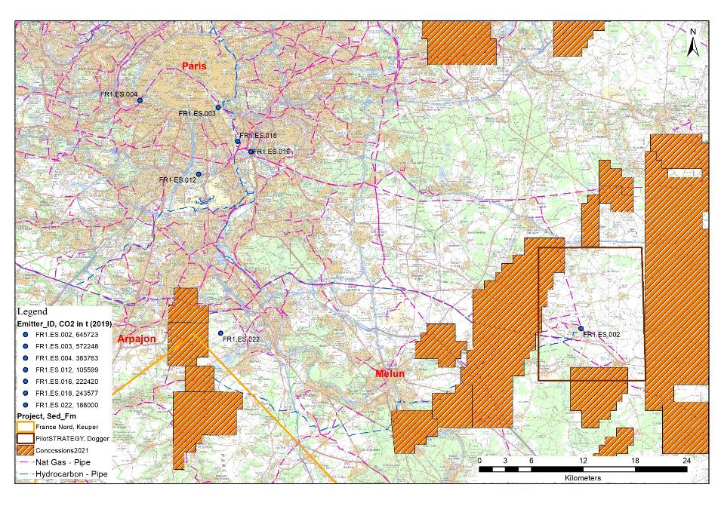
CCS pilot – Fertilizer plant > 300 kt/CO2 per year
Paris Basin Grandpuits - French region

Slide 6
Paris Basin Grandpuits (France)
Dogger Reservoir
intensely exploited reservoir :
  geothermal for decades,
  Oil & gas exploration/production
  Dynamic data (geothermal)
  Cores and petrophysics (oil reservoir)
New knowledge, new data of the storage complex,
  3D seismic acquisition in June 2022
  Geochemical experimental data
  Geomechanical tests
Mas et al., 2022

Slide 7
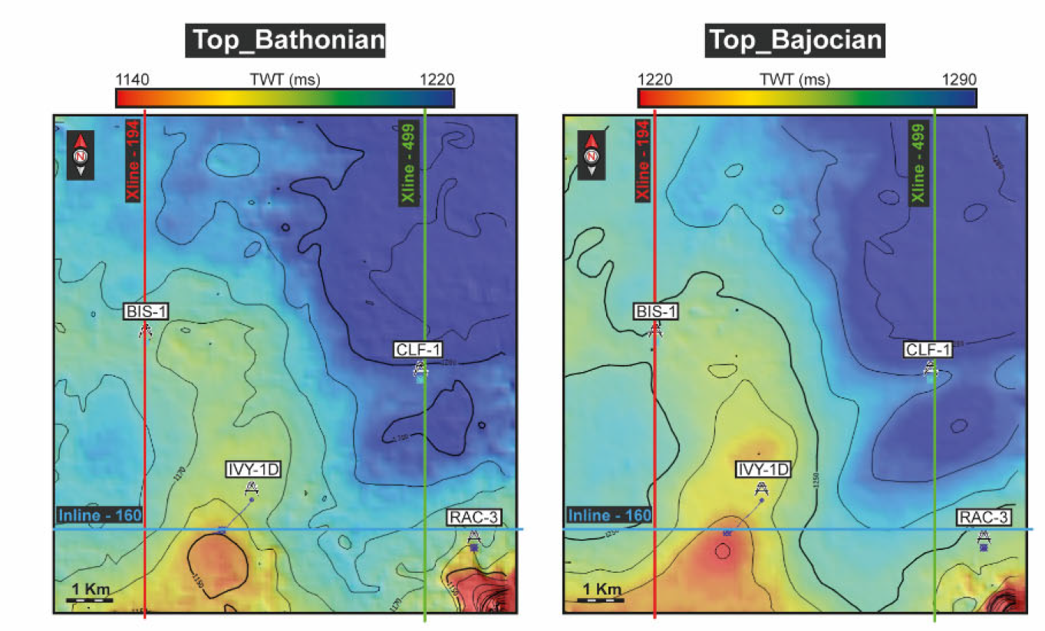
Paris Basin Grandpuits - French region
CCS concept and pilot design
  CO₂ source: Fertilizer plant
  Transport: new pipeline or truck (economic and societal insights)*
  Wellbore design: location, equipment, profile
Risk Register and likelihood calculation,
  Technical risks
  Quantitative approach (and qualitative)
  Stakeholder consultation

Slide 8
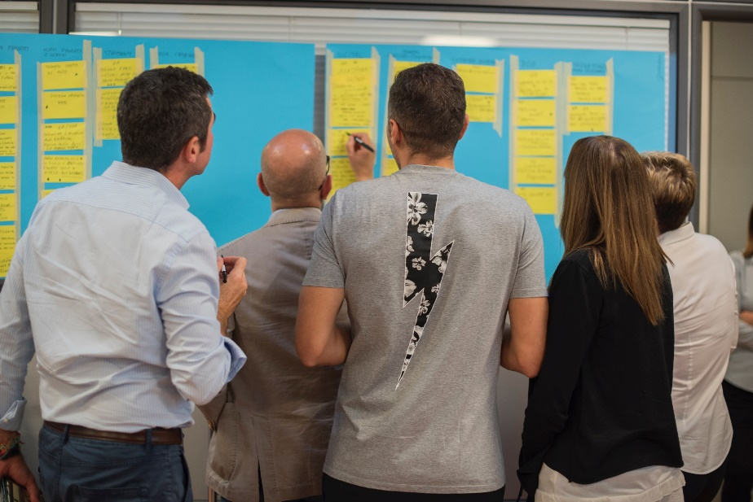



Overview on societal participation and engagement in PilotSTRATEGY
Trans- and interdisciplinary dialogue within consortium: manifesto
Analysis of European and national policy alignment
Stakeholder engagement through regional stakeholder committees
Recommendations for future engagement pathways
Regional profiles based on interviews, media, documents
Citizen engagement in the regions
Monitoring public acceptance through surveys
Photos by FORTYTWO, by Christin Hume by Markus Winkler by Ave Calvar on Unsplash

Slide 9
Preliminary findings for France
Regulatory framework is in an advanced stage, past and ongoing CCUS project activities, relevant industries
Societal discussion
  Regular and increasing media coverage, comprehensive content, balanced content of online media analysed
  CCS is partly perceived by societal stakeholders as clashing with other mitigation strategies, but also as a benefit for industry to decarbonize and to prosper
  Positive overall evaluation of CCS and high to medium acceptance on a potential regional project in survey study
Current conclusion: several developments are observable towards a pathway for CCS, but societal tensions around the topic exist as well that could connect with other debated societal issues

Slide 10
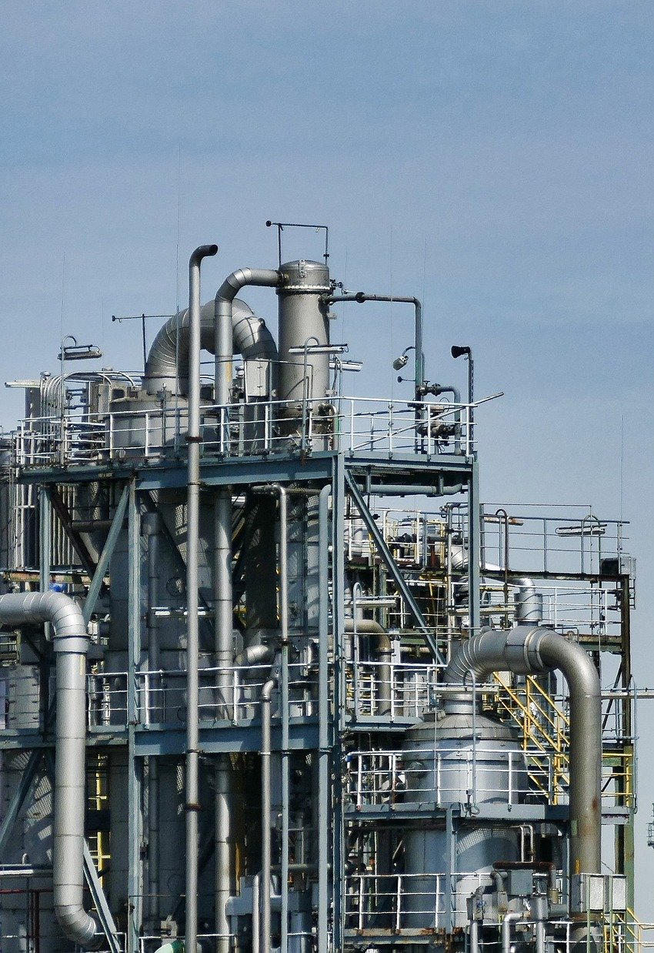
Perspectives
Have a pilot scale CCS operating by 2027
Research permit
  Drilling the appraisal well by 2026
  Inject 100 kt of CO₂
Challenges
  Permitting: update of environmental code
  Funding schema not defined

