Slide 1
Identification of promising CCUS clusters in the Baltic and Mediterranean regions
Cathrine Ringstad, SINTEF
2nd European Underground Energy Storage workshop
Paris 23/05/2023

Slide 2
Identification of promising CCUS clusters in the Baltic and Mediterranean regions
Zero Emission Network to facilitate CCUS uptake in industry
Objectives
To enable faster development of CCUS projects in
industrial clusters across Europe
Identify potential new Project of Common Interest (PCI)
projects for transport and storage
Contribute to knowledge sharing on key issues relevant
to industrial deployment of CCUS
HORIZON EUROPE
CSA – Coordination and Support Action
September 2022 – February 2025

Slide 3
Identification of promising CCUS clusters in the Baltic and Mediterranean regions
Baltic Sea region
Denmark including the easternmost North Sea
Sweden
Finland
Germany
Estonia
Latvia
Lithuania
Poland
Baltic Sea
Baltic Sea region

Slide 4
Identification of promising CCUS clusters in the Baltic and Mediterranean regions
Baltic Sea region
Denmark including the easternmost North Sea
Sweden
Finland
Germany
Estonia
Latvia
Lithuania
Poland
Baltic Sea
Baltic Sea region
Mediterranean Sea region
Spain
France
Italy
Greece
Türkiye
Mediterranean Sea
Mediterranean Sea region

Slide 5
Identification of promising CCUS clusters in the Baltic and Mediterranean regions
Framework for CCUS value chain development
Regional screening
CCUS value chains selection
CCUS value chain development
Baltic Sea region
Technical Mapping
Emission sources
Storage sites
Transport infrastructure
Utilization options
Renewables
Value chain scenarios
Value chain integration
Transport solutions
Cross-border aspects
SWOT analysis
Local business models
Case 1: Baltic Sea
Case 2: Mediterranean Sea
Non-technical Mapping
Stakeholders needs
Regulations
Climate policies
Funding opportunities
Mediterranean Sea region

Slide 6
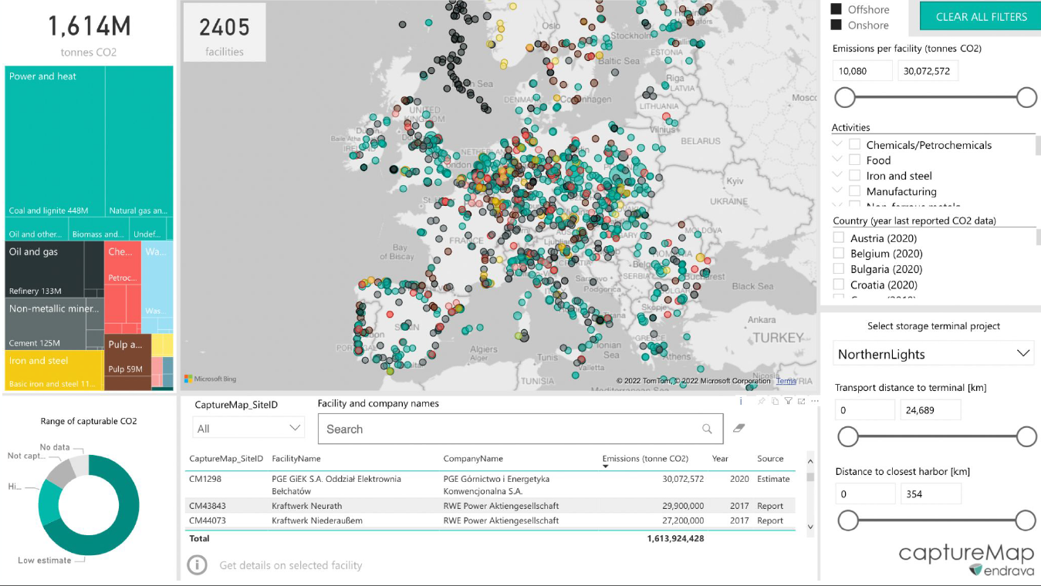
Identification of promising CCUS clusters in the Baltic and Mediterranean regions
Technical mapping
Emission sources
EU ETS (EU Emissions Trading System)
E-PRTR (European Pollutant Release and Transfer Register)
QA by Endrava
QA by CCUS ZEN partners
Denmark, Sweden, Finland, Estonia, Latvia, Lithuania, Poland and France
Türkiye
Middle East Technical University (CCUS ZEN partner)

Slide 7
Identification of promising CCUS clusters in the Baltic and Mediterranean regions
Technical mapping
Emission sources
Attributes
Location
Total emissions
Emission trend
Longlivety
ARC (https://a-r-c.dk/english/visit-arc/)

Slide 8
Identification of promising CCUS clusters in the Baltic and Mediterranean regions
Technical mapping
Geological storage sites
Baltic Sea region
European projects
National projects
Short name | Year
GESTECO | 2000 - 2003
GeoCapacity | 2006 - 2008
CO2Stop | 2012 - 2014
NORDICCS | 2012 - 2015
Strategy CCUS | 2019 - 2022
Strategy Pilot | 2021 - 2026
Country | Year
Sweden | 2021
Denmark | 2020
Spain | 2015
Poland | 2014
Mediterranean Sea region
Projects by universities and research institutions

Slide 9
Identification of promising CCUS clusters in the Baltic and Mediterranean regions
Technical mapping
Geological storage sites
Baltic Sea region
Attributes
Contour
On-shore or off-shore
Storage type (aquifer or hydrocarbon field)
Storage capacity
Storage Readiness Level (SRL)
Mediterranean Sea region
Contour of prospective storage sites

Slide 10
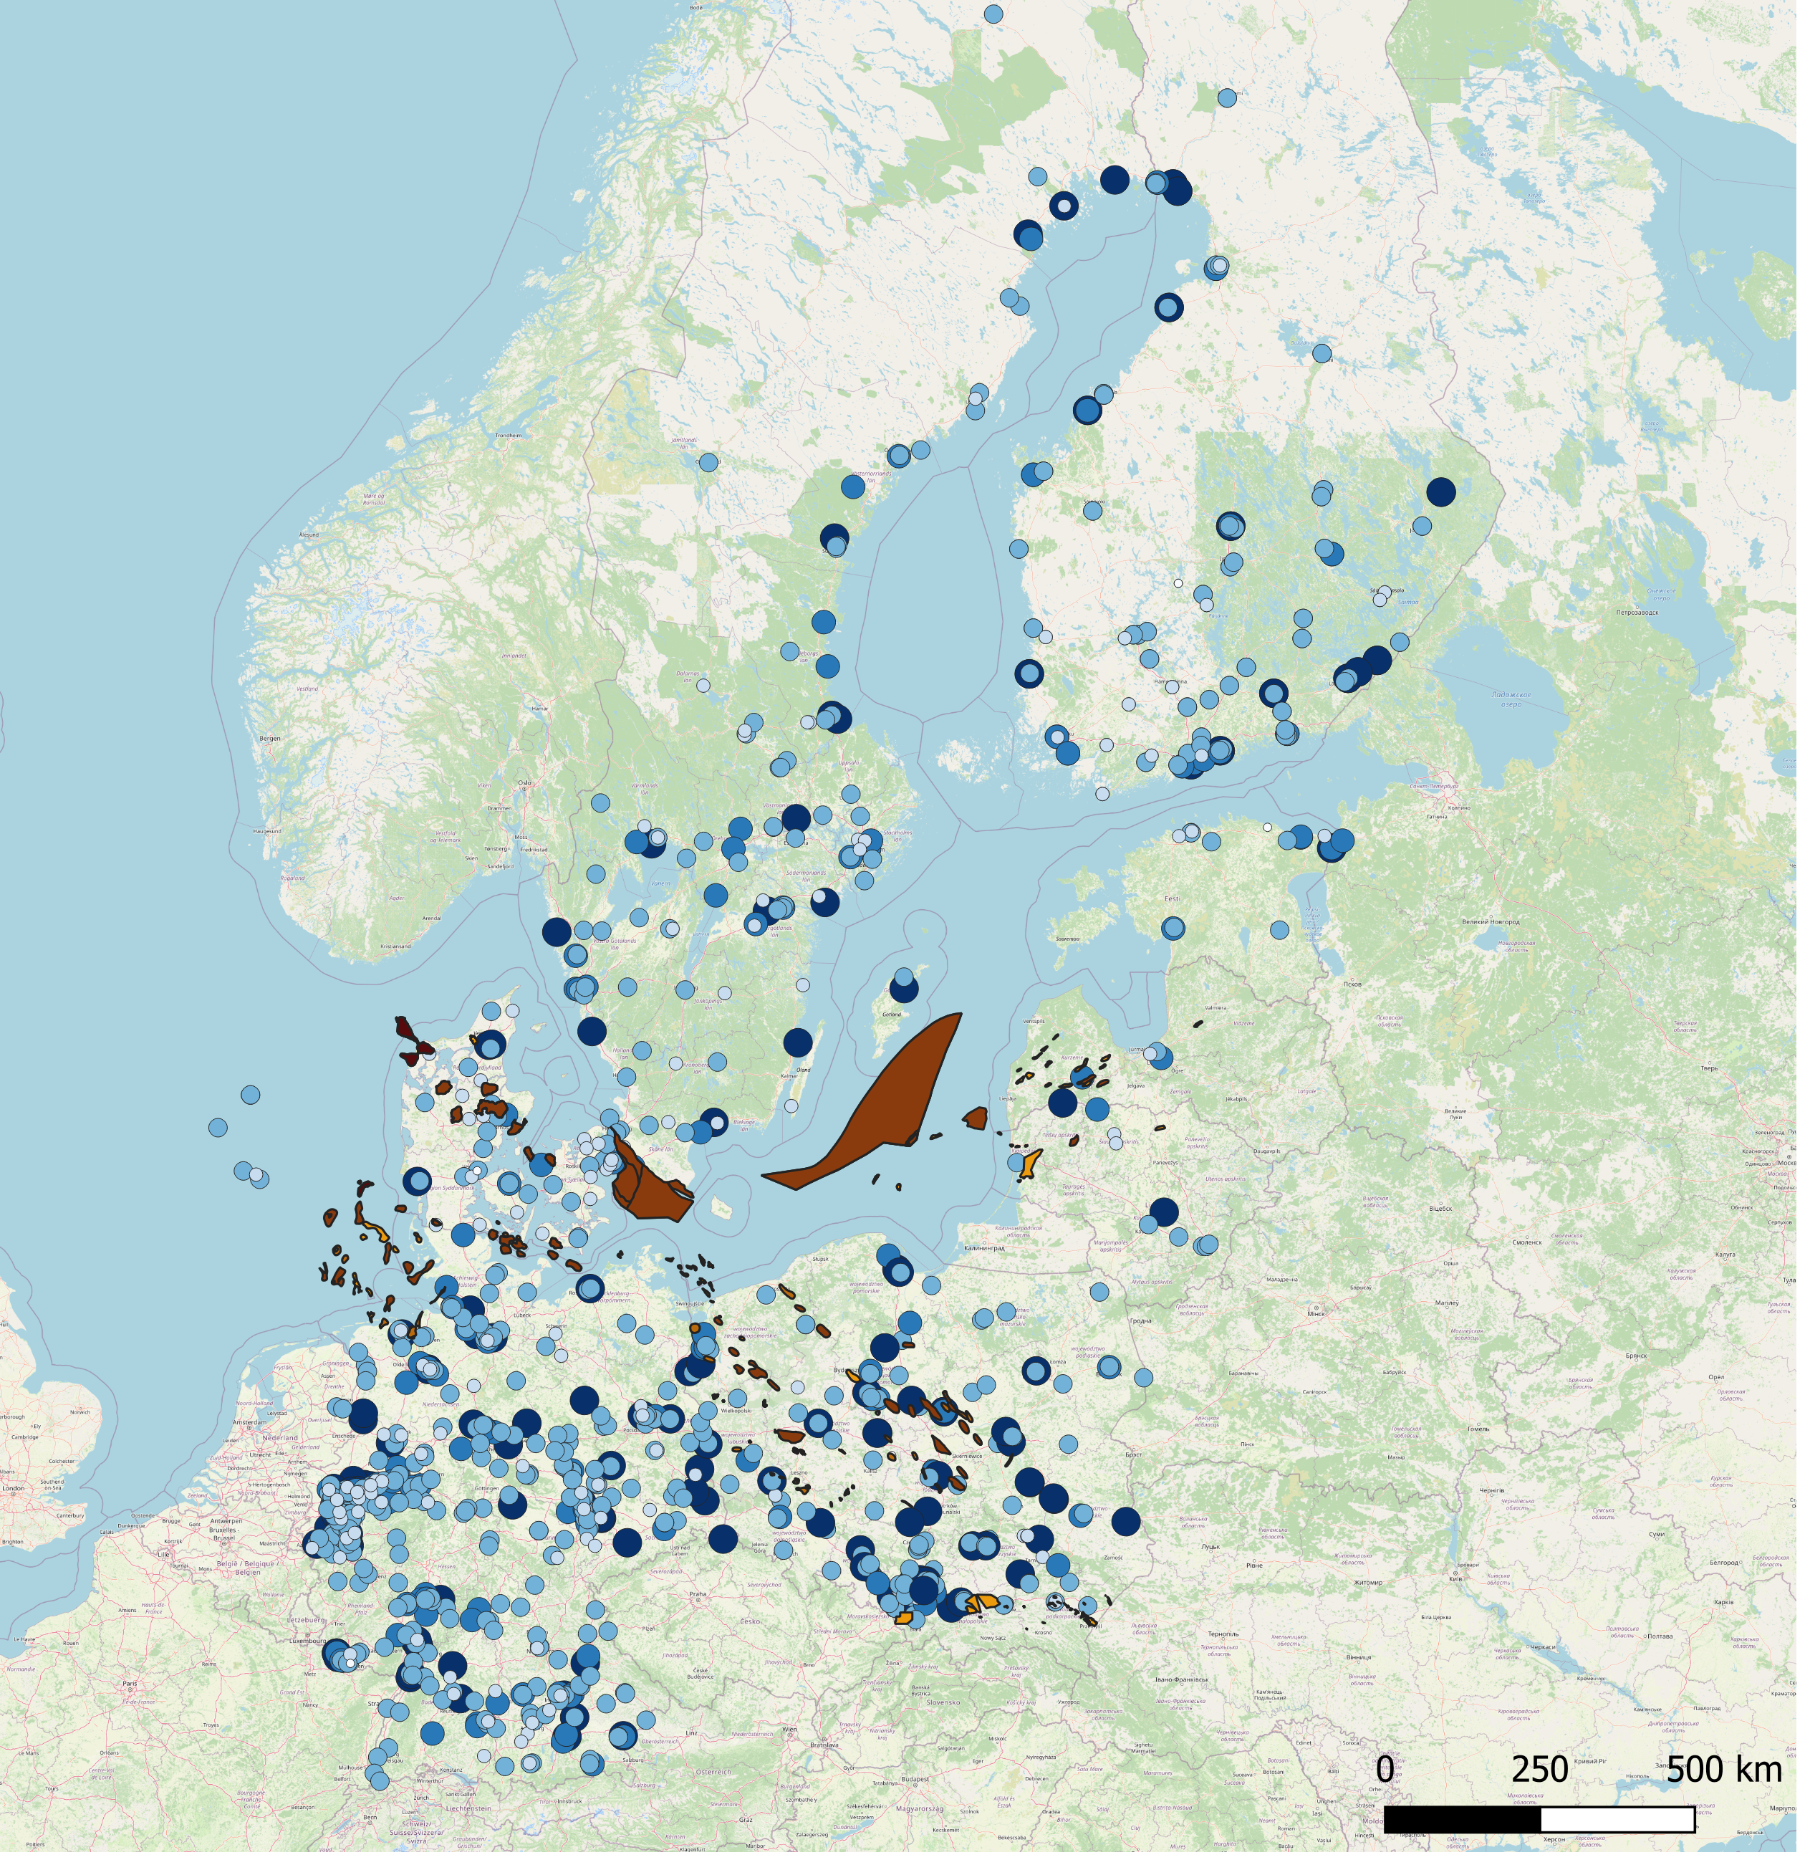
Identification of promising CCUS clusters in the Baltic and Mediterranean regions
Connecting emission sources with geological storage sites
Eastern part of the Baltic Sea
Baltic Sea region
Denmark including the easternmost North Sea
Sweden
Finland
Germany
Estonia
Latvia
Lithuania
Poland
Baltic Sea
Denmark and
south-west of Sweden
Poland and sources in western part of Germany

Slide 11
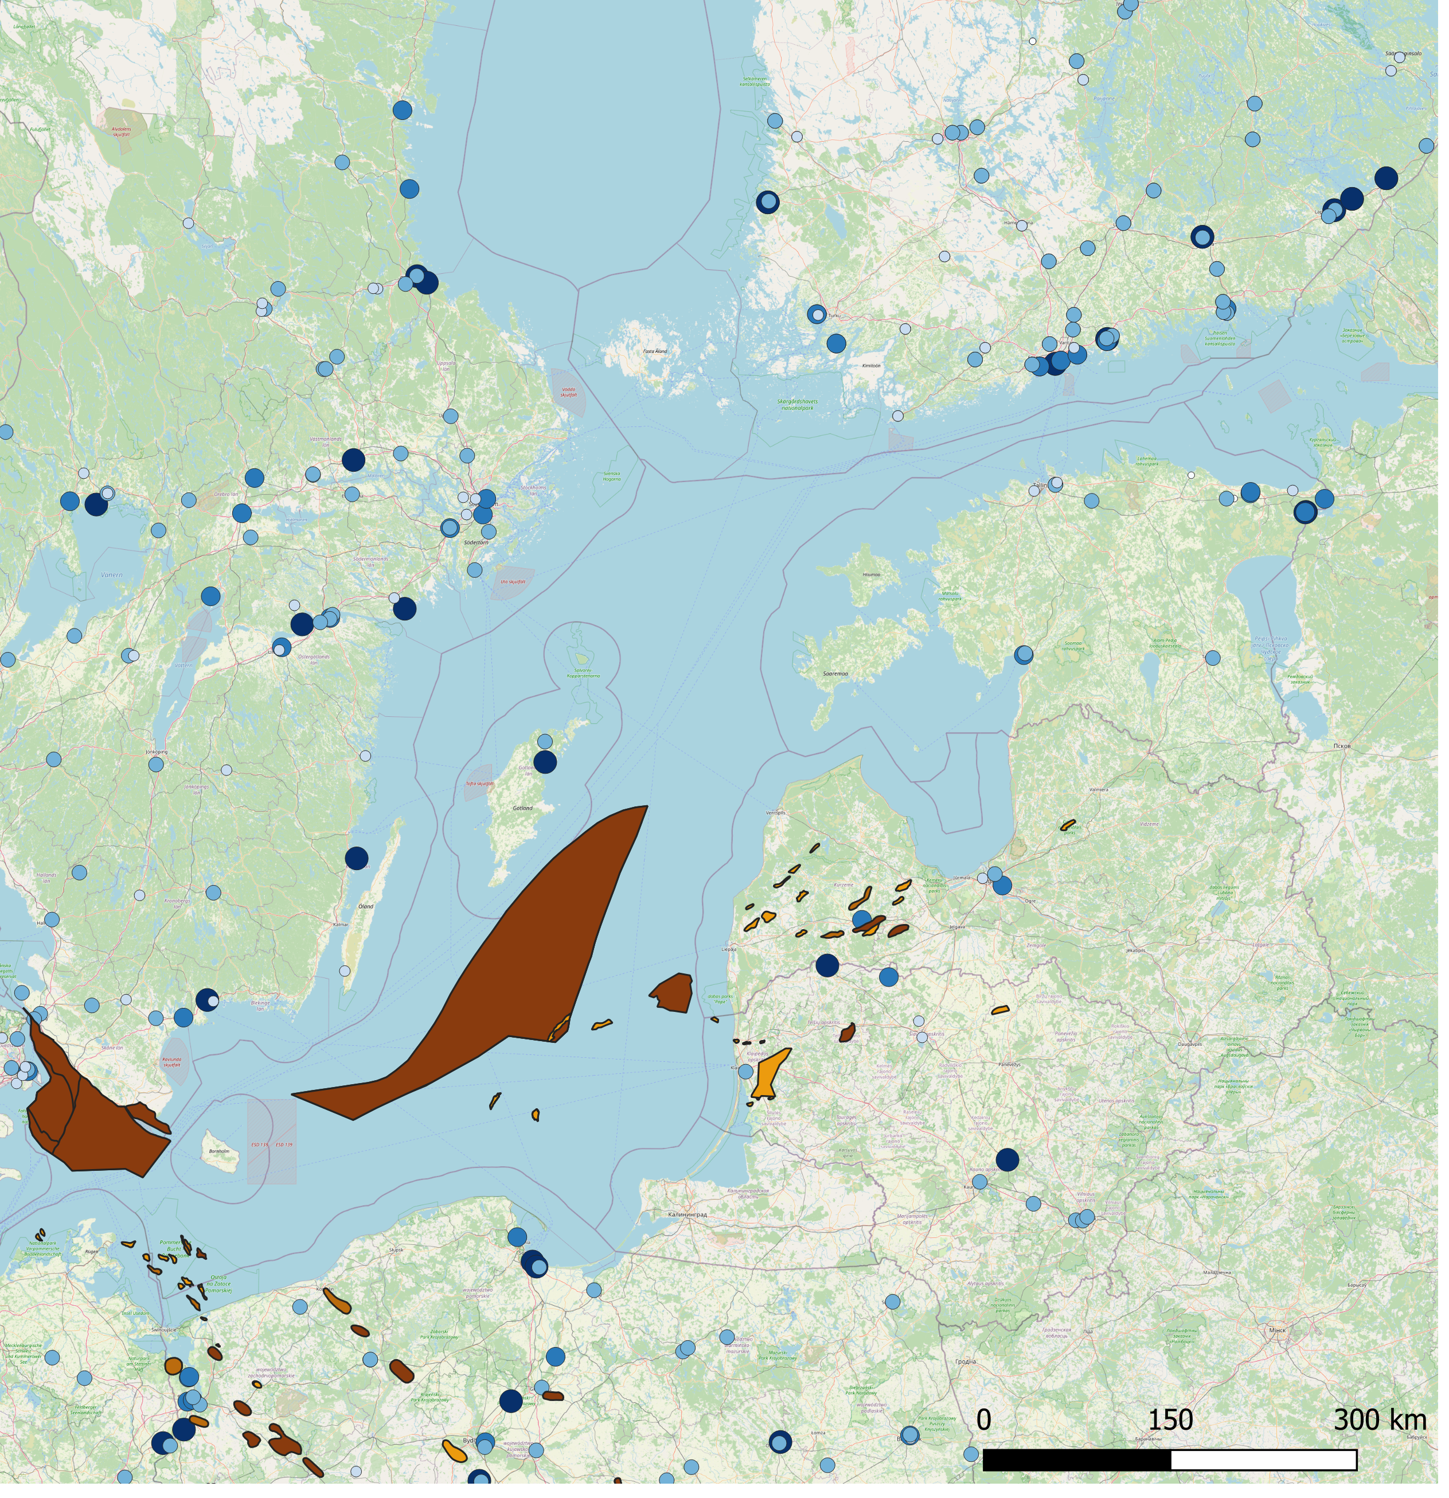
Identification of promising CCUS clusters in the Baltic and Mediterranean regions
Connecting emission sources with geological storage sites
Sweden
Finland
Baltic Sea region
Denmark including the easternmost North Sea
Sweden
Finland
Germany
Estonia
Latvia
Lithuania
Poland
Baltic Sea
Estonia
Latvia
Lithuania
Eastern part of the Baltic Sea
Poland

Slide 12
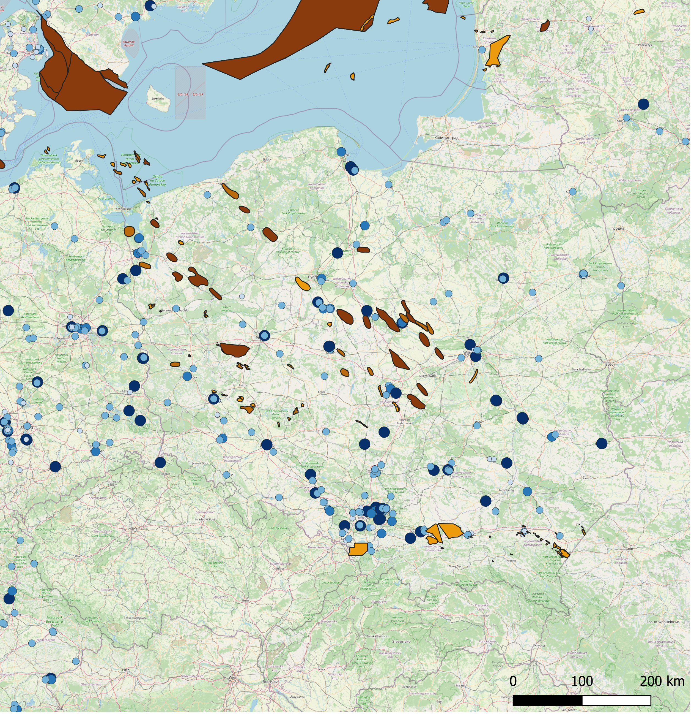
Identification of promising CCUS clusters in the Baltic and Mediterranean regions
Connecting emission sources with geological storage sites
Baltic Sea region
Denmark including the easternmost North Sea
Sweden
Finland
Germany
Estonia
Latvia
Lithuania
Poland
Baltic Sea
Poland and sources in western part of Germany

Slide 13
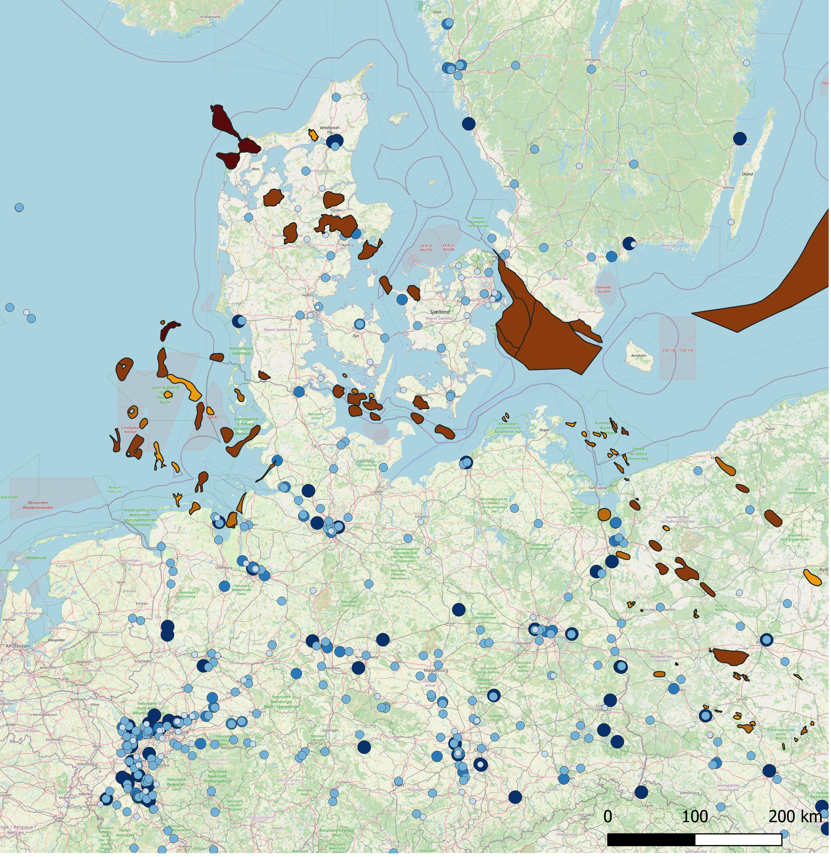
Identification of promising CCUS clusters in the Baltic and Mediterranean regions
Connecting emission sources with geological storage sites
Baltic Sea region
Denmark including the easternmost North Sea
Sweden
Finland
Germany
Estonia
Latvia
Lithuania
Poland
Baltic Sea
Denmark and south-west of Sweden

Slide 14
Identification of promising CCUS clusters in the Baltic and Mediterranean regions
Connecting emission sources with geological storage sites
Italy
Sources in west Türkiye and
storage sites in Greece
Mediterranean Sea region
Spain
France
Italy
Greece
Türkiye
Mediterranean Sea
South-east France and east Spain

Slide 15
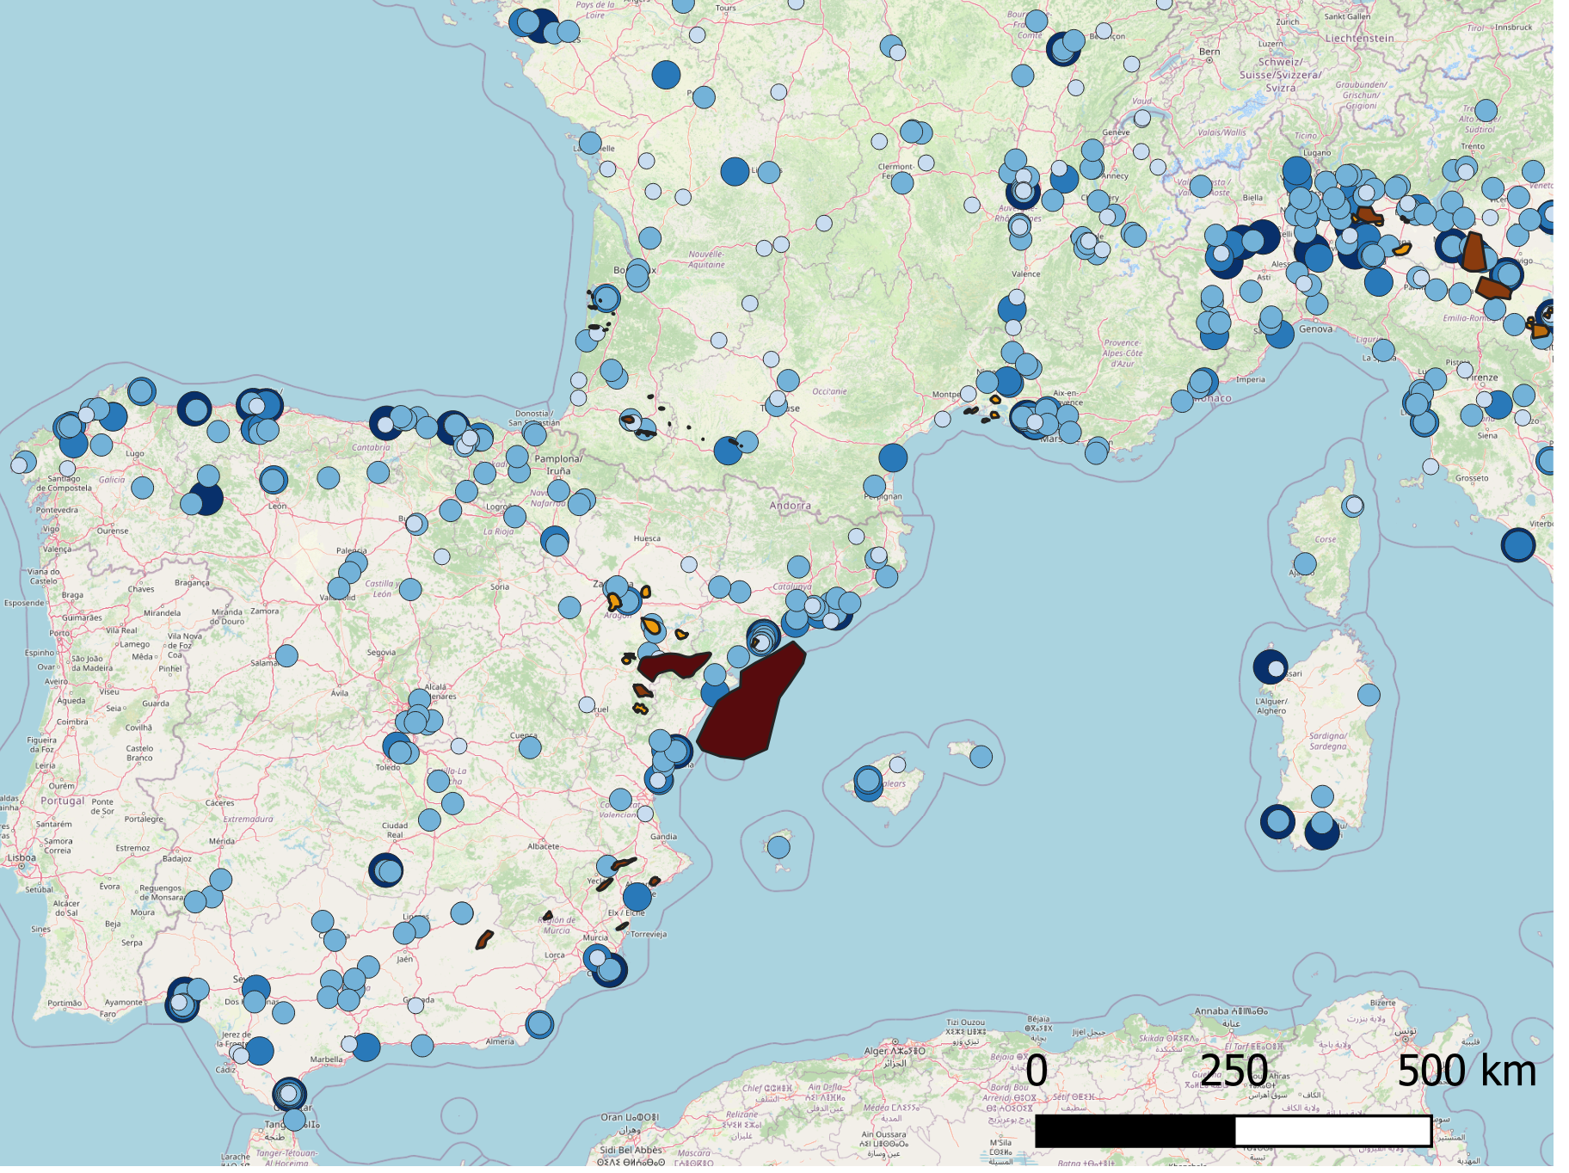
Identification of promising CCUS clusters in the Baltic and Mediterranean regions
Connecting emission sources with geological storage sites
Mediterranean Sea region
Spain
France
Italy
Greece
Türkiye
Mediterranean Sea
PYCASSO
South-east France and east Spain

Slide 16
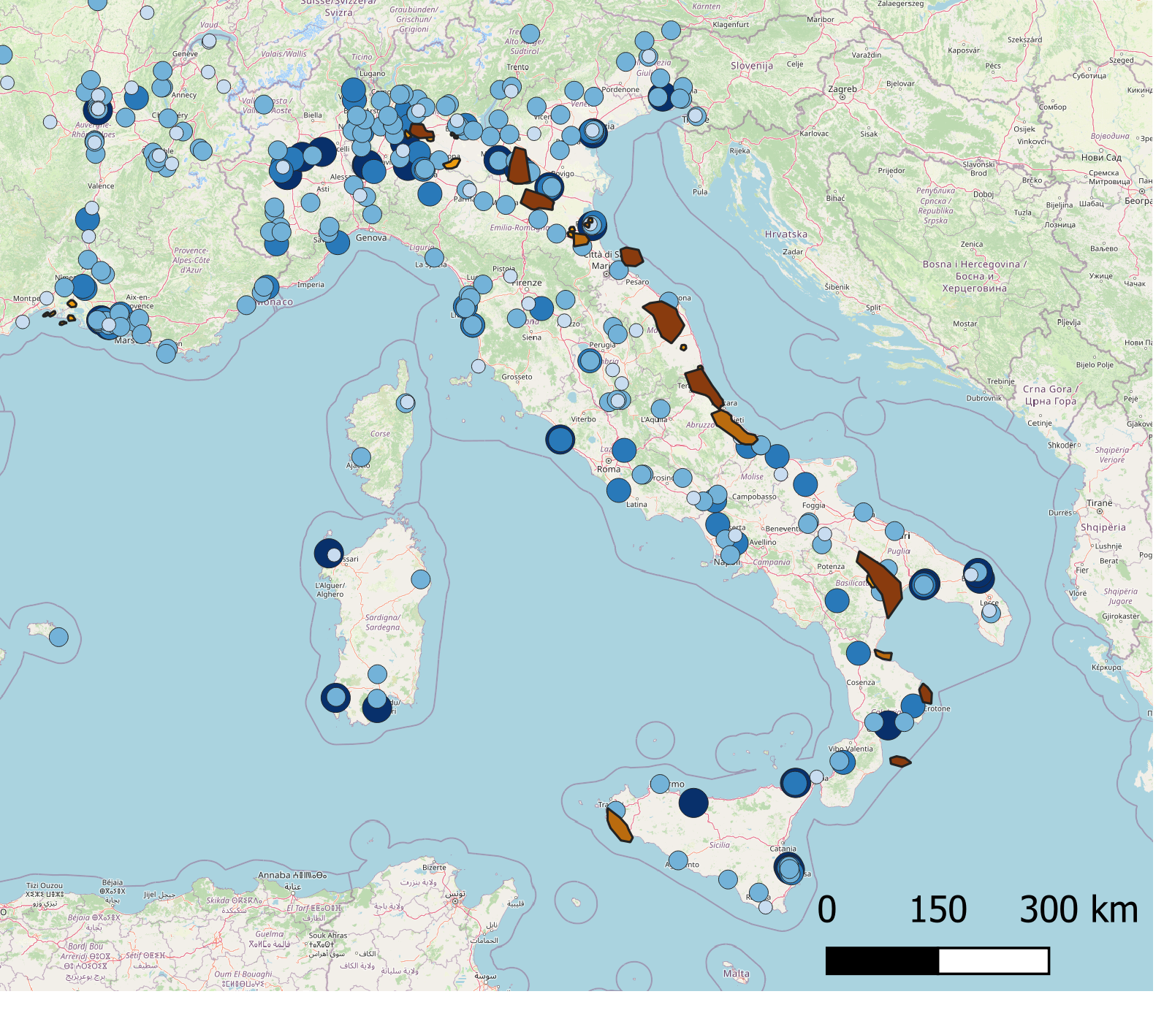
Identification of promising CCUS clusters in the Baltic and Mediterranean regions
Connecting emission sources with geological storage sites
Ravenna CCS
Mediterranean Sea region
Spain
France
Italy
Greece
Türkiye
Mediterranean Sea
Italy

Slide 17
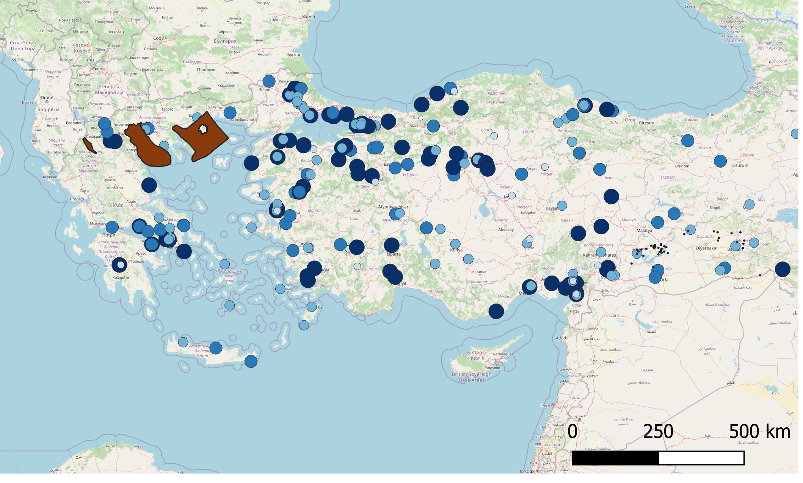
Identification of promising CCUS clusters in the Baltic and Mediterranean regions
Connecting emission sources with geological storage sites
Mediterranean Sea region
Spain
France
Italy
Greece
Türkiye
Mediterranean Sea
Sources in west Türkiye and storage sites in Greece

Slide 18
Identification of promising CCUS clusters in the Baltic and Mediterranean regions
Non-technical mapping
Topics
Policy and public support
Market readiness and financial aspects
Legal and regulatory aspects

Slide 19
Identification of promising CCUS clusters in the Baltic and Mediterranean regions
Non-technical mapping
Topics Webinars
Policy and public support Wednesday 14 June 10:00 – 12:00
Market readiness and financial aspects Friday 24 June 10:00 – 12:00
Legal and regulatory aspects Tuesday 2 May 10:00 – 12:00

Slide 20
Identification of promising CCUS clusters in the Baltic and Mediterranean regions
Non-technical mapping
Topics Webinars
Policy and public support Wednesday 14 June 10:00 – 12:00
Market readiness and financial aspects Friday 24 June 10:00 – 12:00
Legal and regulatory aspects Tuesday 2 May 10:00 – 12:00
London Protocol
Helsinki Convention
Protection of the Marine Environment of the Baltic Sea Area
Barcelona Convention
Protection of the Mediterranean Sea against Pollution

Slide 21
Identification of promising CCUS clusters in the Baltic and Mediterranean regions
Framework for CCUS value chain development
Regional screening
CCUS value chains selection
CCUS value chain development
Baltic Sea region
Technical Mapping
Emission sources
Storage sites
Transport infrastructure
Utilization options
Renewables
Value chain scenarios
Value chain integration
Transport solutions
Cross-border aspects
SWOT analysis
Local business models
Case 1: Baltic Sea
Case 2: Mediterranean Sea
Non-technical Mapping
Stakeholders needs
Regulations
Climate policies
Funding opportunities
Mediterranean Sea region

Slide 22
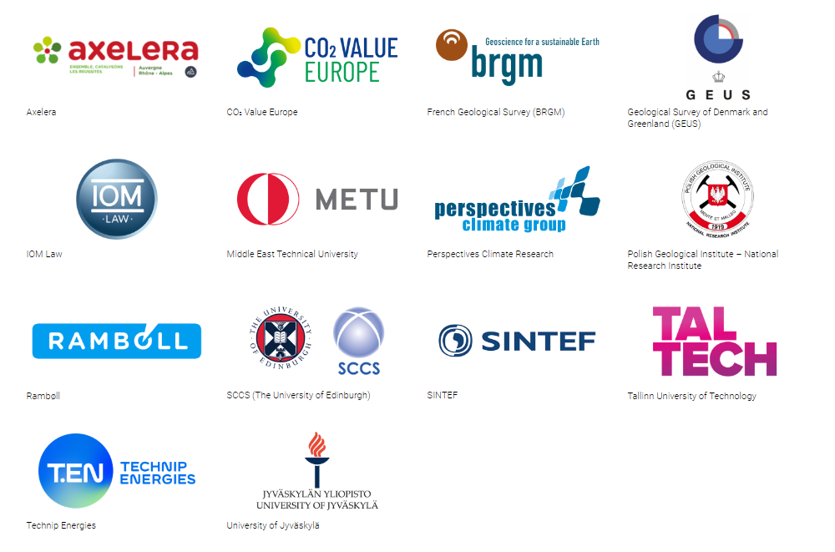
Identification of promising CCUS clusters in the Baltic and Mediterranean regions
Partners
Internship at SINTEF: Cécile Biragnet from l'Ecole Polytechnique (Palaiseau, France)

Slide 23
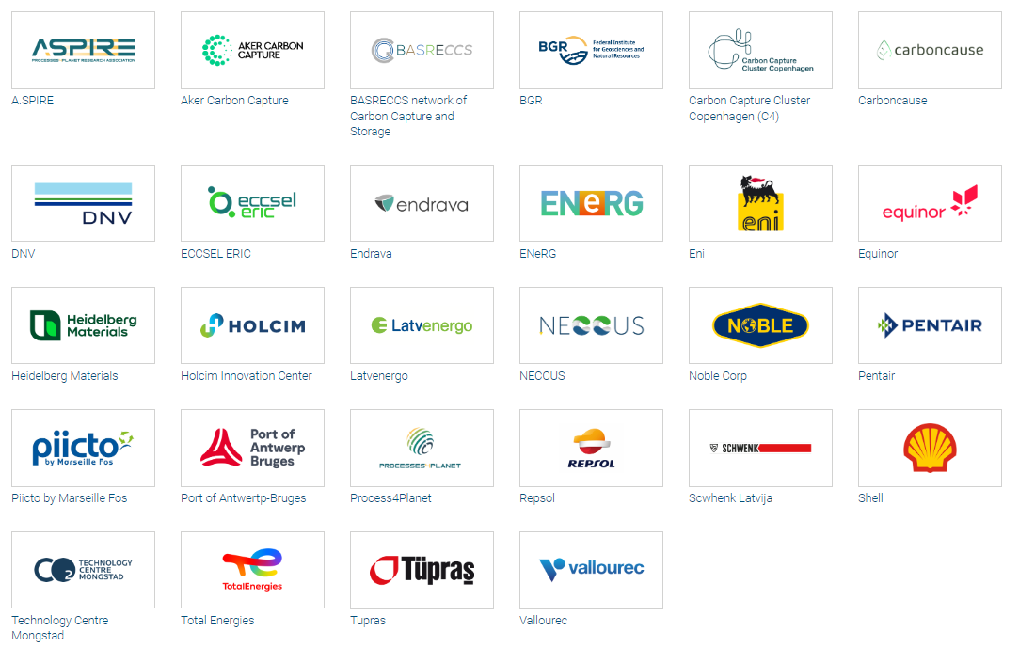
Identification of promising CCUS clusters in the Baltic and Mediterranean regions
Networking partners
Geological and Mining Institue of Spain (IGME), Spanish National Research Council
AkerBP
Global CCS Institute
Celsio
INEOS
Municipality of Thisted
Geological Survey of Sweden
CEA Liten
Port of Hanstholm
Ventspils nafta terminals SIA
Chemical Business Association of Tarragona
The Carbon Capture and Storage Association
Lhoist
Storaensio
Latvian Hydrogen Association
CGG
Gassnova
Porthos
Pôle AVENIA
Bellona

Slide 24
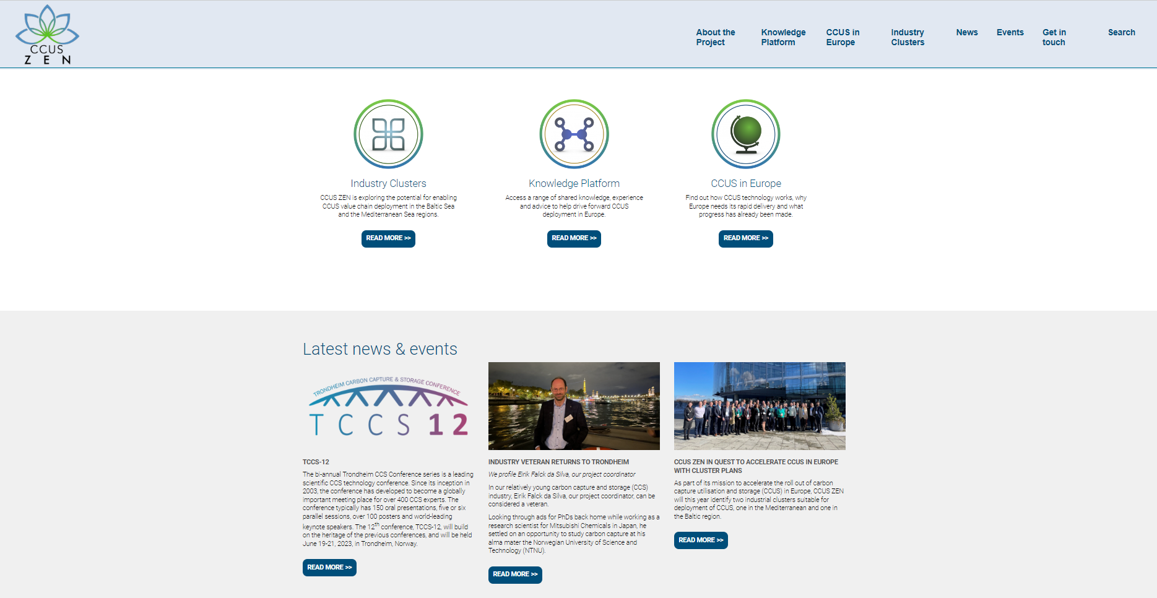
Identification of promising CCUS clusters in the Baltic and Mediterranean regions
www.ccuszen.eu

Slide 25
Identification of promising CCUS clusters in the Baltic and Mediterranean regions
Workshop 7 – 8 March in Copenhagen hosted by Rambøll
Next Workshop: noon 9 – noon11 October in Madrid to be hosted by carboncause/nexwell

