Slide 1







Storing H2 in Aquifers using CO2 as Cushion Gas, the Thermodynamic Behavior of the System
BEN RHOUMA Sabrine – PhD candidate

Slide 2

Introduction
Storing H₂ in aquifers
Cushion gas represents 30-60% of total gas
Using H₂ increases investment costs
Other cushion gases
  would mix with H₂ and increase operational costs
  would react with H₂ assisted by microbial activity (or other catalysers)
CO₂ as cushion gas
  Environmental benefits
  Decreases investment costs
  Interesting physical properties around critical point

Slide 3
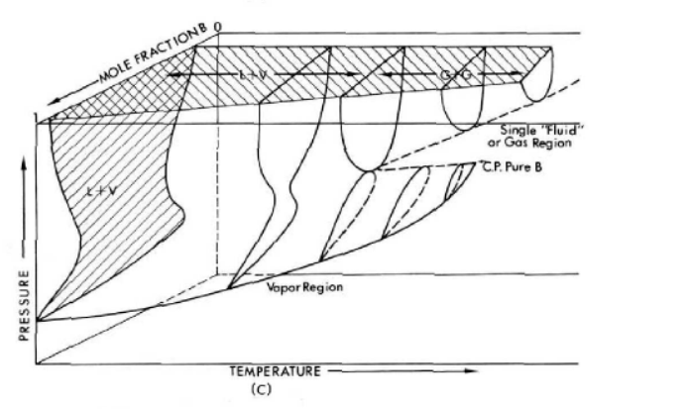
Streett et al., 1983 « Phase Equilibria in Hydrogen Binary Mixtures From 63 to 280 K and Pressures to 6000 Bars ».
Introduction
CO₂ as cushion gas
What about H₂ - CO₂ mixing and reaction?
Mixing
thermodynamic behaviour of the system H₂ - CO₂;
Reservoir conditions and reservoir quality;
Injection and withdraw rates
Reaction (not studied here but)
Examples of methanation in situ involve other gases, not only pure CO₂
Sabatier reaction occurs at high temperature (300°C to 400°C)
Uncertainty of microbial activity kinetic
CO₂ - H₂ system
Type III Phase Diagram
Gordon,1972 « A Supercritical Phase Separation ».

Slide 4
Property | Hydrogen | CO2 | CO2 critical (32°C at 73 bars)
Density (gaseous) at 0°C, 1 bar (kg/m3) | 0.089 | 1.951
Density at 25° C, 100 bar (kg/m3) | 7.67 | 813.9 | 434.87
Density at 50° C, 100 bar (kg/m3) | 7.1 | 384.4
Boiling point (1bar) | -252.76°C | -78,6°C
Viscosity at 25° C, 100 bar (µPa-s) | 9.15 | 75.29 | 35.103
Viscosity at 50° C, 100 bar (µPa-s) | 9.638 | 28.34
Coefficient of compressibility at 25° C, 100 bar (Z) | 1.06 | 0.2186 | 0.37149
Coefficient of compressibility at 50° C, 100 bar (Z) | 1.056 | 0.4262
CO₂ – H₂ system
Phase diagram
Interesting properties of CO₂ around its critical point
Density
Derived from Equation of states;
High density contrast between CO₂ and H₂ at CO₂ critical point and around
“Contaminants” sensitivity in pure CO₂ phase
  a concentration of H₂ as low as 2% could lower the density by as much as 25% compared to pure CO₂ at “CCS conditions” (Sanchez-Vicente et al, 2013)
Difference in physical parameters for H2 and CO2 at same P/T conditions
(data from Peace and NITS databases, 2021)
EoS capacities and limitations:
H2 % mol EoS | 2 | 7,5 | 10
GERG 2008 | 4% | 17,5% | 14%
Peng Robinson | 16% | 10,5% | 9%
SRK | 16% | 12% | 10,5%
The maximum relative error between the experimental and calculated densities using different EoS

Slide 5
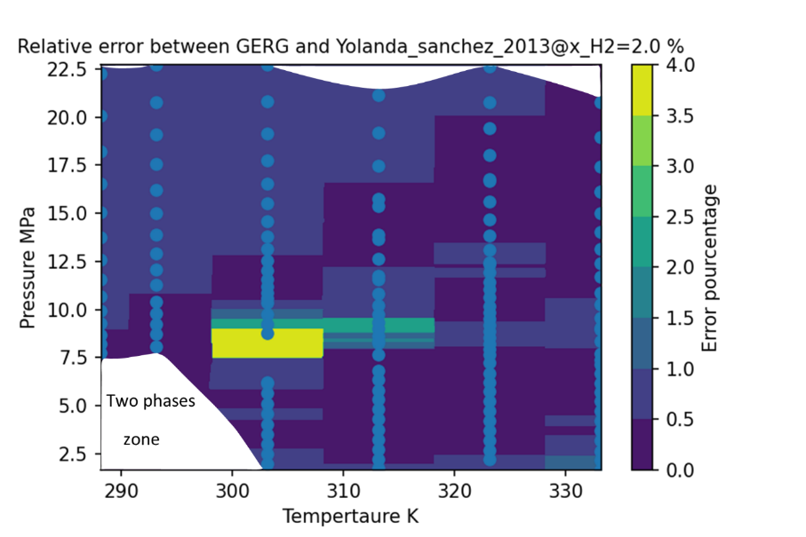
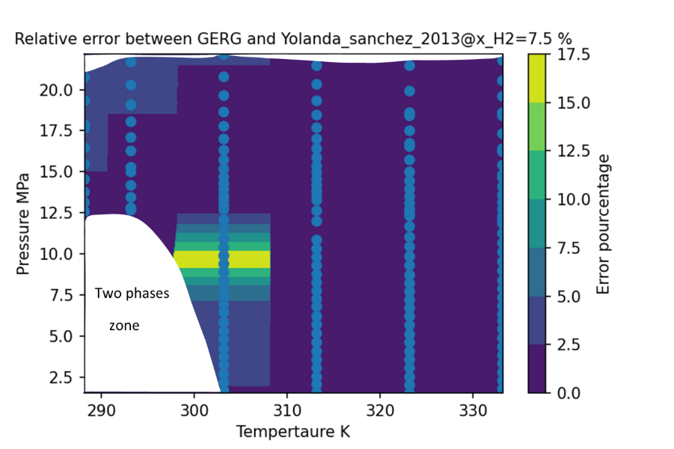
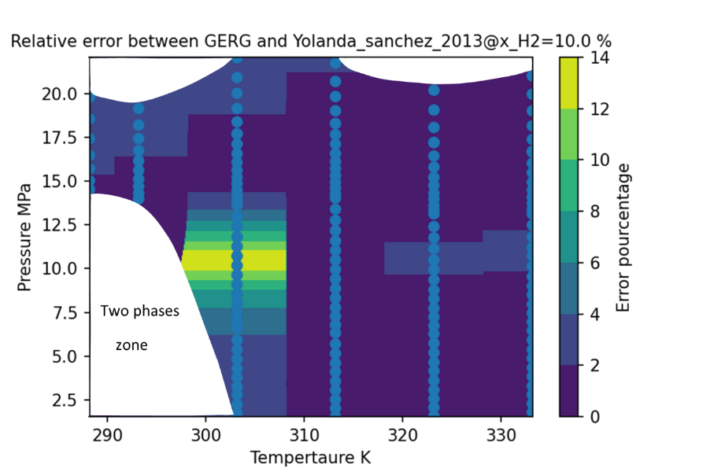
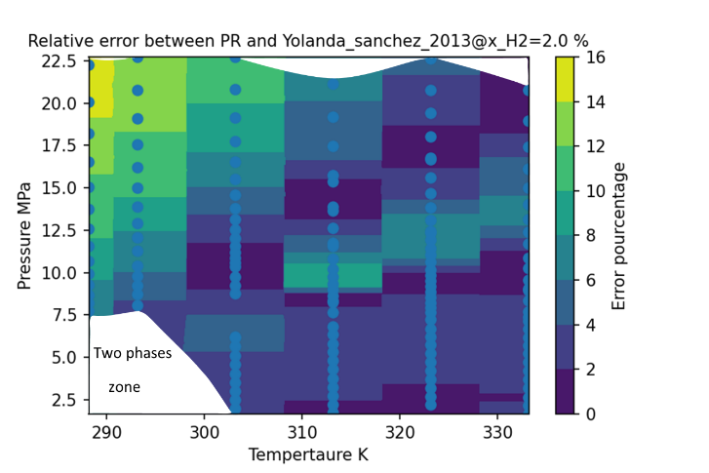
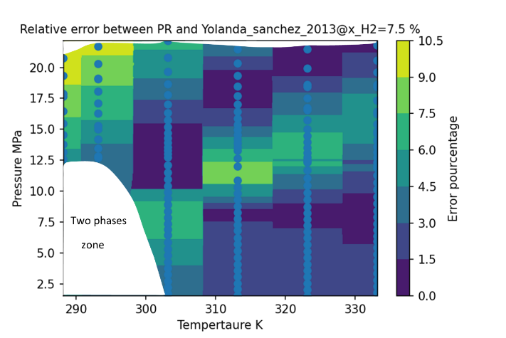
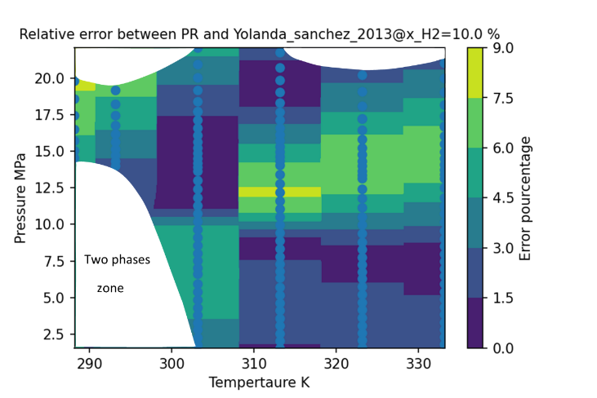
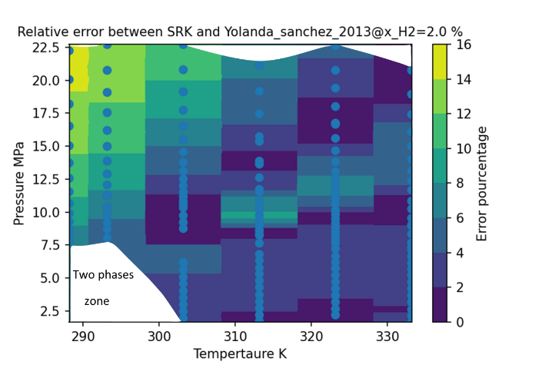
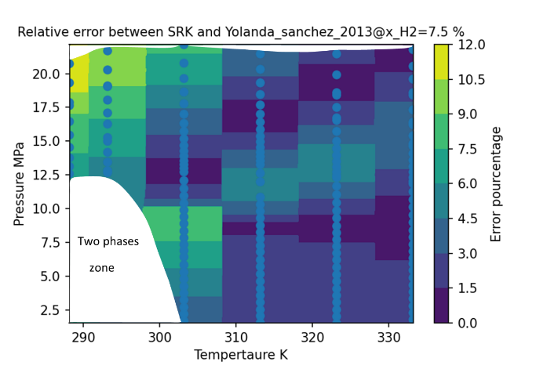
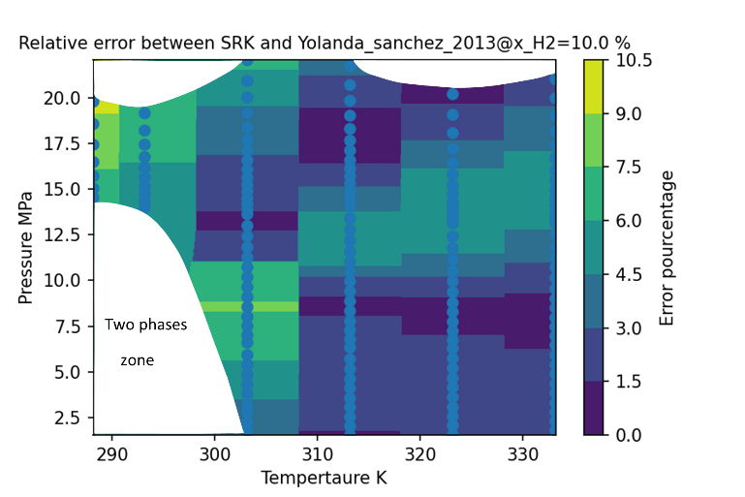
EoS capacities and limitations:
relative error between the experimental and calculated densities using different EoS
GERG -
2008
Notes:
The dot points here represent the calculated values but also the experimental ones, on x we have T and for Y pressure and the three figures are for different hydrogen mole fractions 2%, 7,5% and 10%.
we can note that for GERG the highest error is really located around “the critical point of the CO2” but with increasing pressure?

Slide 6






EoS capacities and limitations:
relative error between the experimental and calculated densities using different EoS
PR
Notes:
Whereas for the cubic EoS PR using the translation volume of peneloux ,the error is distributed over a wider range of temperature and pressure

Slide 7


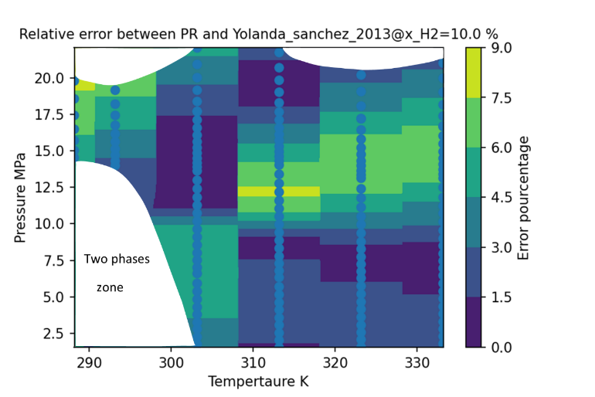


EoS capacities and limitations:
relative error between the experimental and calculated densities using different EoS
SRK
Notes:
The same interpretation is applied to SRK
The choice here is between cubic EoS with average results at the overall or being more specific but with high located error,
Now besides the discussion about the different EoS, it is also valuable to discuss the phases evolution. Here we notice that the diphasic zone exhibit higher pressure for increasing hydrogen fraction

Slide 8
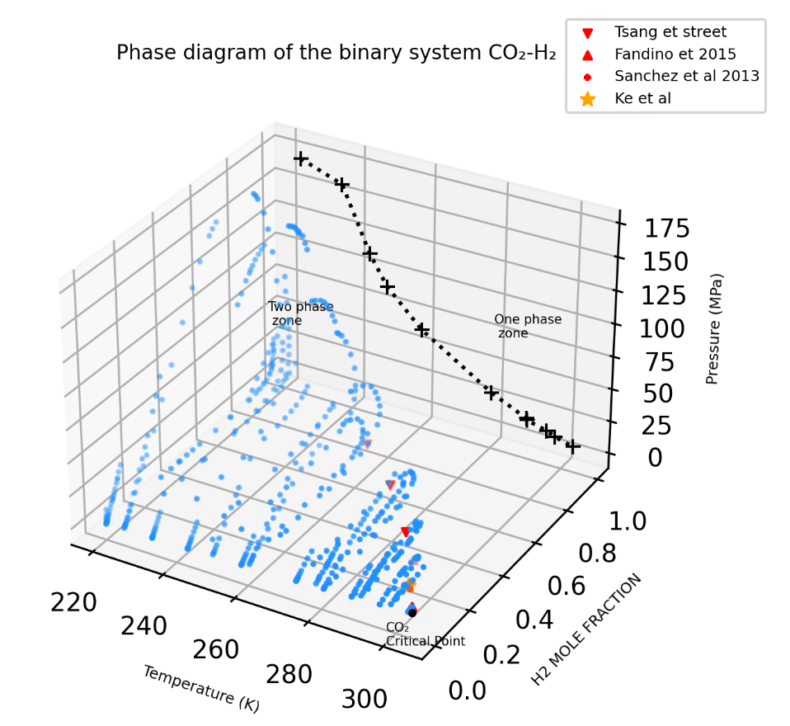
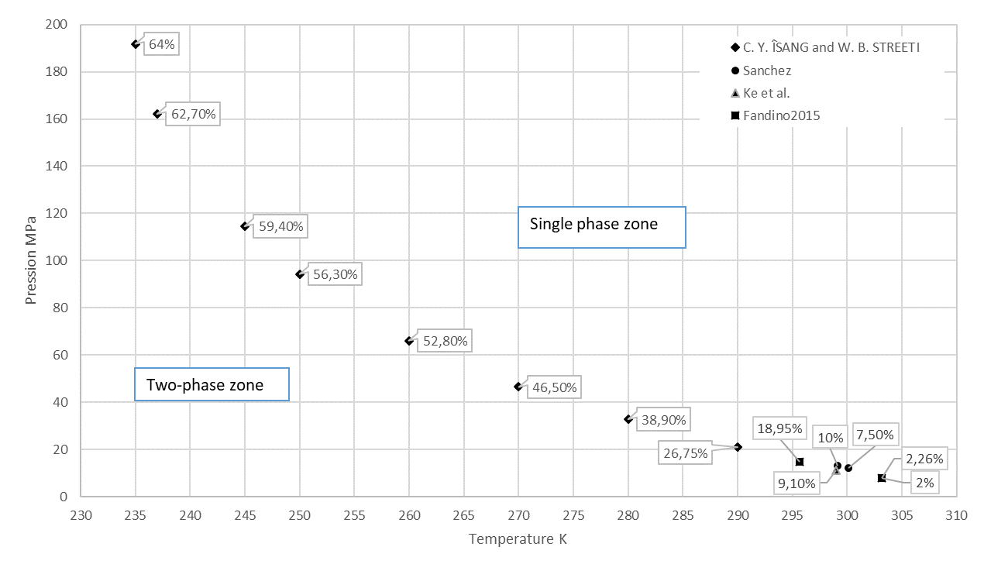
CO₂ – H₂ system
Phase diagram
thermodynamic behaviour of the system H₂ - CO₂

Slide 9
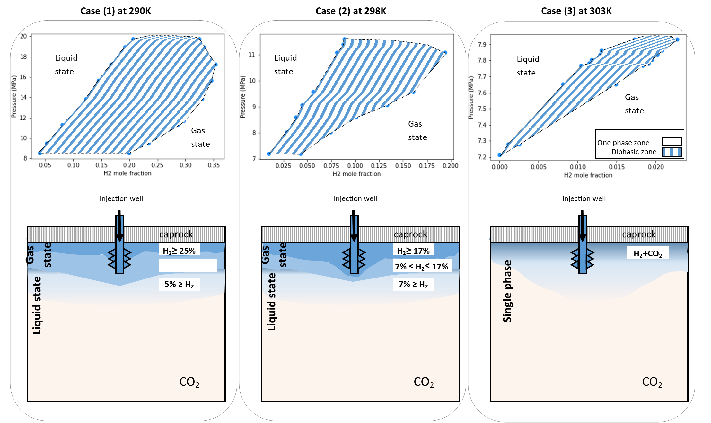
CO₂ – H₂ system
Phase diagram
Conceptual model
16,8°C
25°C
30°C
5% ≤H₂ ≤ 25%

Slide 10
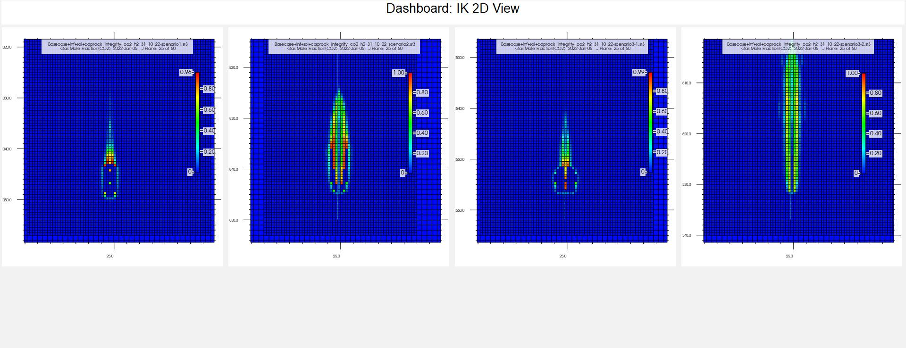
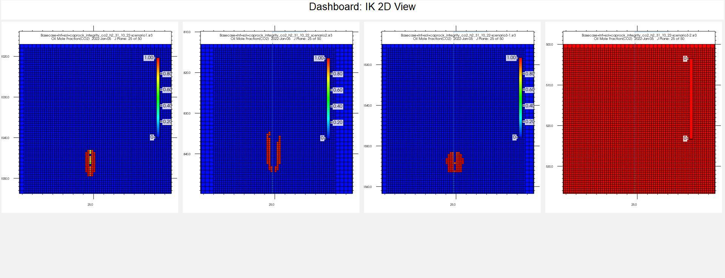
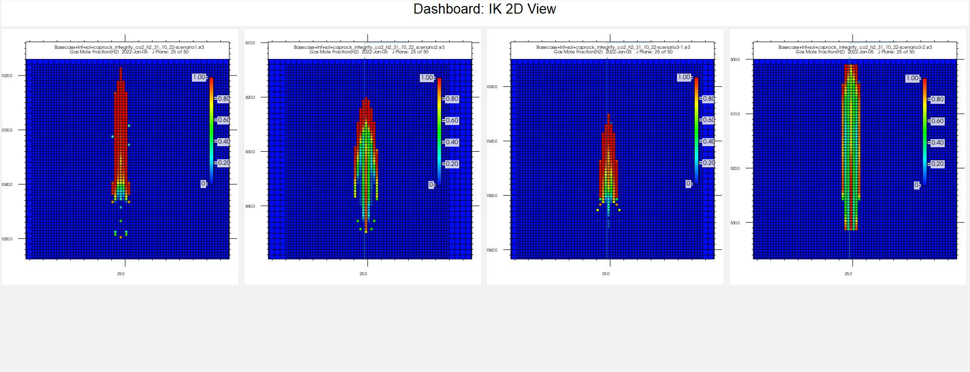
16,8°C
25°C
30°C
CO₂ – H₂ system
Concept simulation*
Scenario 2
Scenario 3.2
Scenario 1
CO₂ gas mole fraction
CO₂ liquid mole fraction
H₂ Gas mole fraction
* CMG-GEM courtesy

Slide 11
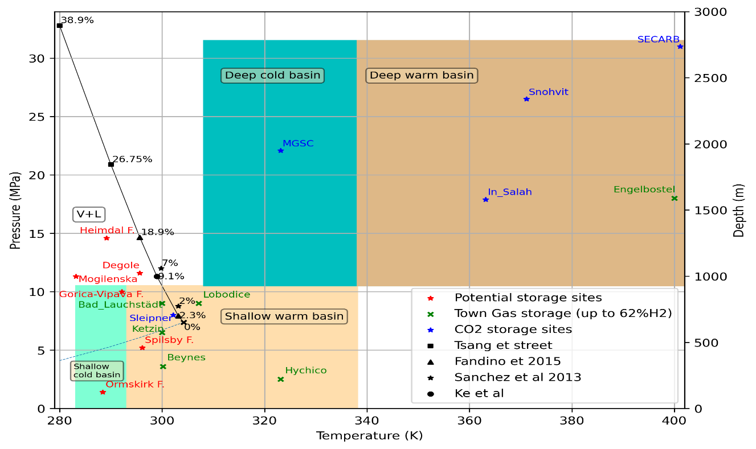
Conclusions
Storage conditions CO₂ – H₂ system
The investigation the P-T-x diagram of the system of interest concluded the possibility of 2 phases to exist.
The examination of the different EoS is a valuable guidance towards a robust equation, in order to better describe the complex liquid –gas behavior.
A multicomponent, multiphasic module
27°C

Slide 12
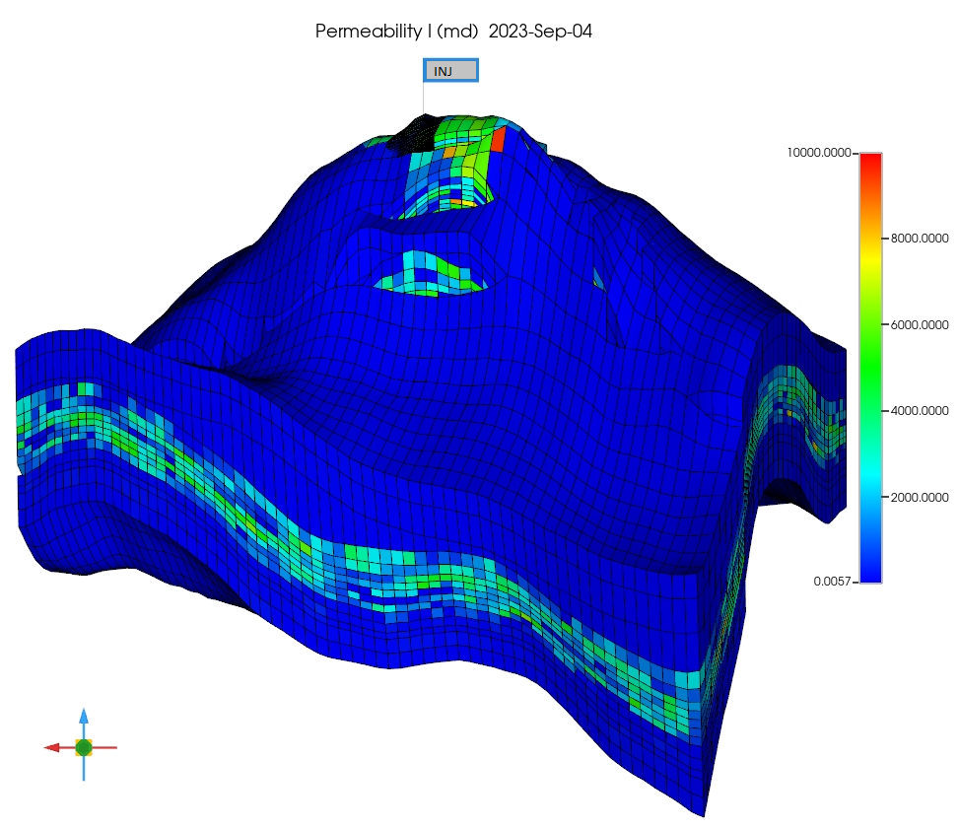
Conclusions
Feasibility of H₂ – CO₂ aquifer storage
Offshore reservoirs are promising targets to enable the concept,
Two-phase zone would serve as buffer zone limiting mixing
Challenge to simulate realistic cases
  Numerical complexity
  EoS uncertainties
Ongoing Testing
Realistic case

Slide 13


Thank you for listening
Contact:
s.benrhouma@brgm.fr
BEN RHOUMA Sabrine

