Slide 2
UNDERGROUND STORAGE OF AMMONIA (NH3)
Review of possibilities
M. TORQUET – 23/05/2023

Slide 3
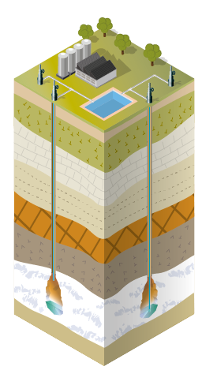
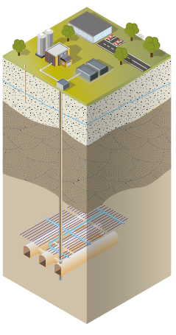
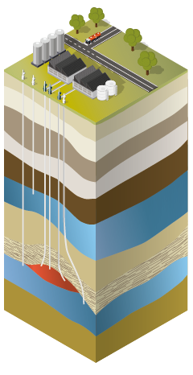
Underground storage techniques
Salt caverns
Mined rock caverns (unlined)
Natural Gas
Liquid Hydrocarbons
Liquefied Hydrocarbons
Compressed Air
Hydrogen
Effluents
Liquid Hydrocarbons
Liquefied Hydrocarbons
Natural Gas
Depleted fields & aquifers
Mined rock caverns
(lined)
Natural Gas
Compressed Air
Hydrogen
CO₂
Effluents
LNG
(Liquefied Natural Gas)
CNG
(Compressed Natural Gas)

Slide 4
Why storing ammonia ?
- Energy density important;
- Easily shipable ;
- Easily storable at low pressure and ambiant temperature.
With all these points, NH3 is a good candidate for energy carrier. Therefore NH3 is getting a lot of attention as a « transportable » H2.
TODAY : NH3 production is done with natural gas reaction (Haber-Bosch process) to produce fertilizer.
TOMORROW : Green H2 will replace natural gas reforming for H2 production involved in ammonia process.

Slide 5
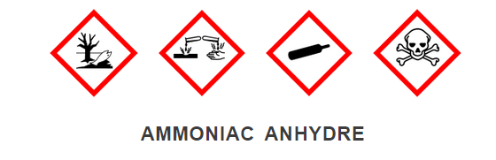
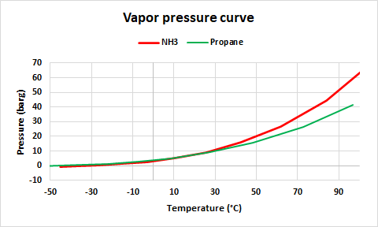
SPECIFICITY OF AMMONIA (NH₃)
Ammonia reacts with water ! And it’s exothermic !
2000 kJ/kg of NH₃ dissolve.
HSE : Vapor pressure curve is similar to propane vapor curve
Ammonia solubility in water

Slide 6
EXISTING STORAGES IN UNLINED MINED ROCK CAVERN
01

Slide 7
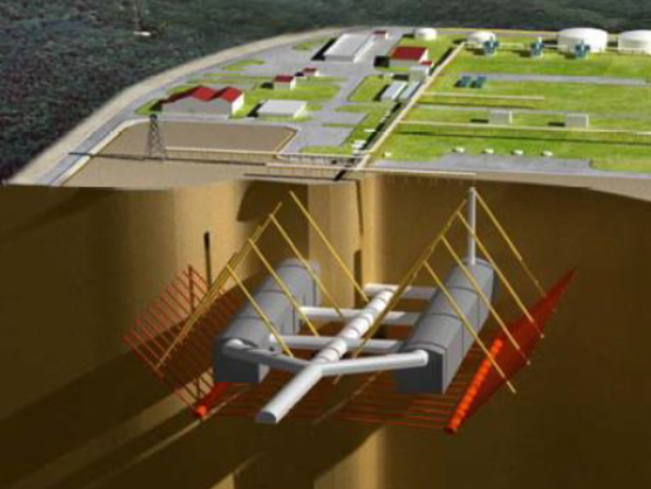
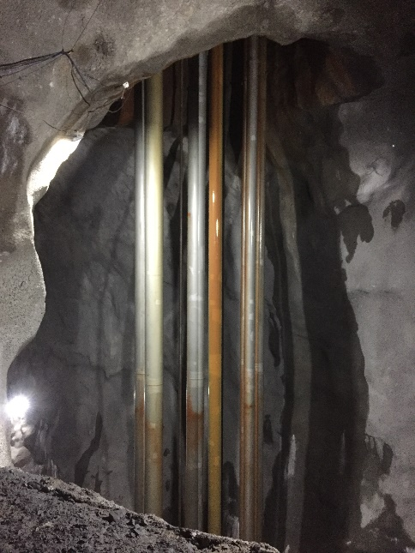
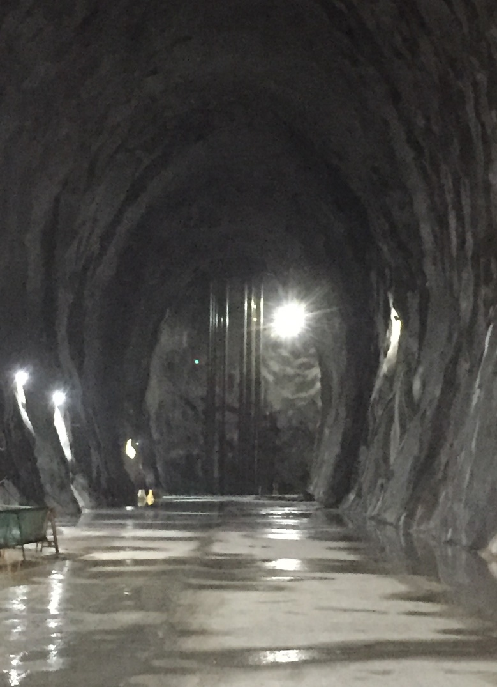
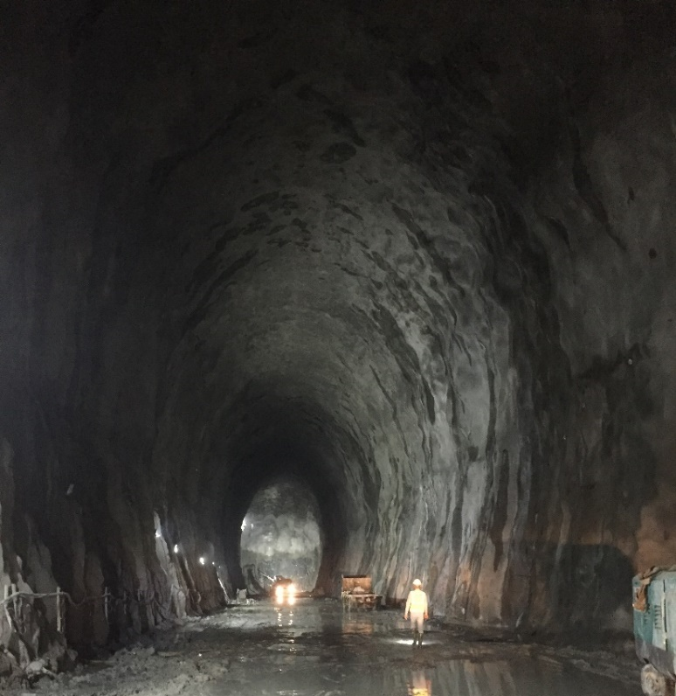
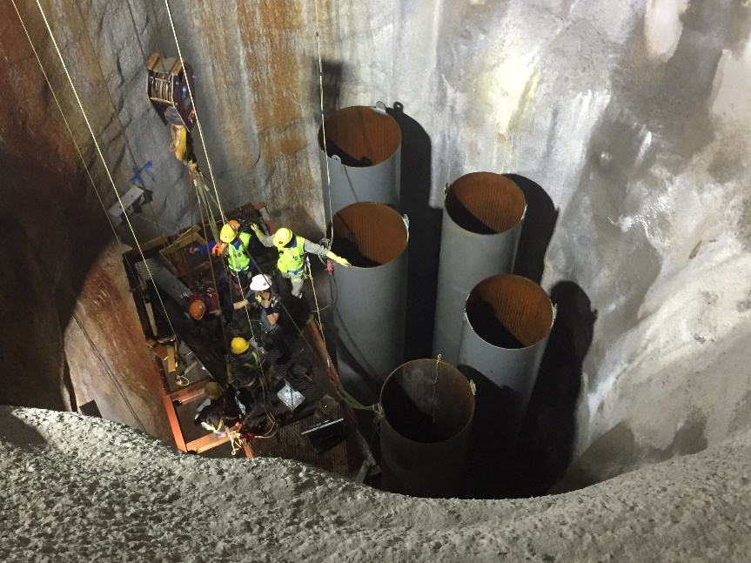
Pictures of Unlined Mined Rock Cavern

Slide 8
Underground storages of Ammonia - existing
All storages presented here are UNLINED mined rock cavern:
Norsk-Hydro storage in Porsgrunn (1967) near Oslo (Norway) : decommissionned.
Pressurised storage then transformed to refrigerated storage due to contamination of the product by seepage water.
Stockage Dupont de Nemours aux U.S.A. à Gibbtown (New Jersey) : Decommissioned. Possible reconvertion to LPG in 2016.
NH3 Refrigerated storage at -33° C and Patm.
Stockage Norsk Hydro à Glomfjord (Norway) – Still in operation
ALL THESE CAVERNS ARE UNLINED CAVERNS
Commissioning year | Volume (m3) | Length x heigth (m) | Temperature (°C) | Pressure (bara)
1968 | 50 000 | 10 x 12 | 6-8 | 8
Commissioning year | Volume (m3) | Length x heigth (m) | Temperature (°C) | Pressure (bara)
1967 | 29 000 | Rooms and pillars | -33 | 1
Commissioning year | Volume (m3) | Length x heigth (m) | Temperature (°C) | Pressure (bara)
1986 | 60 000 | 16 x 20 | -28 à -33 | 1 à 2 max

Slide 9
LINED MINED CAVERN STORAGE
02

Slide 10
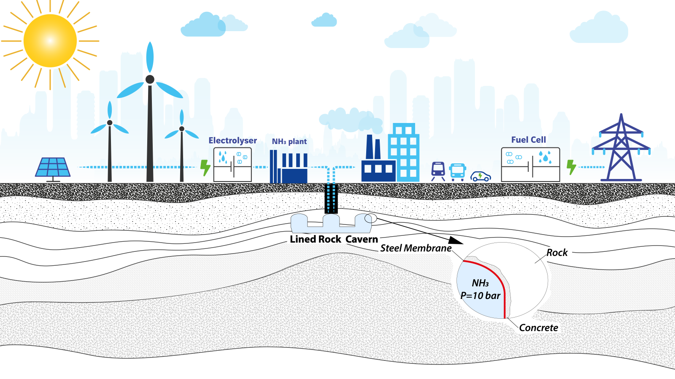
Lined rock cavern for liquid H2 carrier : NH3

Slide 11
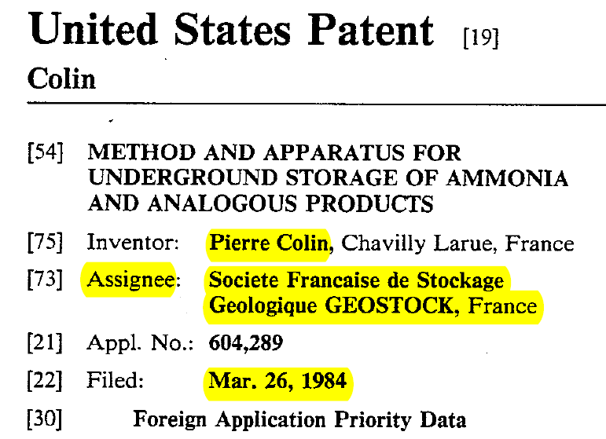
LINED MINED CAVERN
In the 1980-1990, lot of studies to store NH3 underground.
GEOSTOCK Patent 30 years ago. US4542626 :
No construction by GEOSTOCK.
https://patents.google.com/patent/US4542626

Slide 12
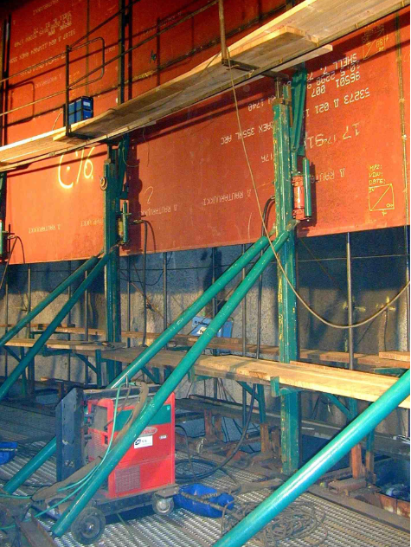
NH3 lined rock cavern – easier than H2 lined rock cavern
Ammonia = Very well known molecule by the Industry
Storage of ammonia at ambient temperature (Pressure = 8 à 10 barg). Similar to LPG.
Lining to be used should be more simple than the one for H₂.
- No permeation through the membrane of NH3
- Narrow range of operating pressure
- Narrow range of operating temperature
Lined cavern under construction for Natural Gas (Source: Thermie B - Project N° OG./270/97/SE/FR)

Slide 13
SALT CAVERN- and POROUS MEDIA
03

Slide 14
Salt cavern and porous media
Ammonia is a polar molecule similar to water.
Concern : Salt dissolution: 24,5 g/L for NH3. For water it is more than 300 gNaCl/L.
5 patents US in the 60’s about NH3 storage in salt cavern.
The patents are dealing with different kind of process to treat the salt dissolved in the ammonia.
On pilot unit in Texas: « The only actual underground storage of ammonia that I know of in salt was an experiment that Phillips Petroleum made out in West Texas some years ago. I assume from what I've heard that it was not successful and do know they haven't continued it or gone into it in other places. »
VERY DIFFICULT to store inside salt caverns – NOT POSSIBLE to store inside porous media due to reactivity with water.

Slide 15
Bring back to Office
Salt caverns and porous rock reservoirs are not suitable for Ammonia storage.
Unlined Rock Cavern for ammonia requires very low seepage rate or low temperature storage. The economics of such storages need to be studied case by case based on geology and commercial opportunities
Lined Rock Caverns (LRCs) for pressurised ammonia or pressurised hydrogen could be ready for commercialisation in the near future.

Slide 16
THANKS

