Slide 1
The COST Action “Geothermal DHC” in a Nutshell
2nd European Underground Energy Storage Workshop, Paris
Jessica Maria Chicco (MC Member of the CA18219), University of Torino (Italy)

Slide 2
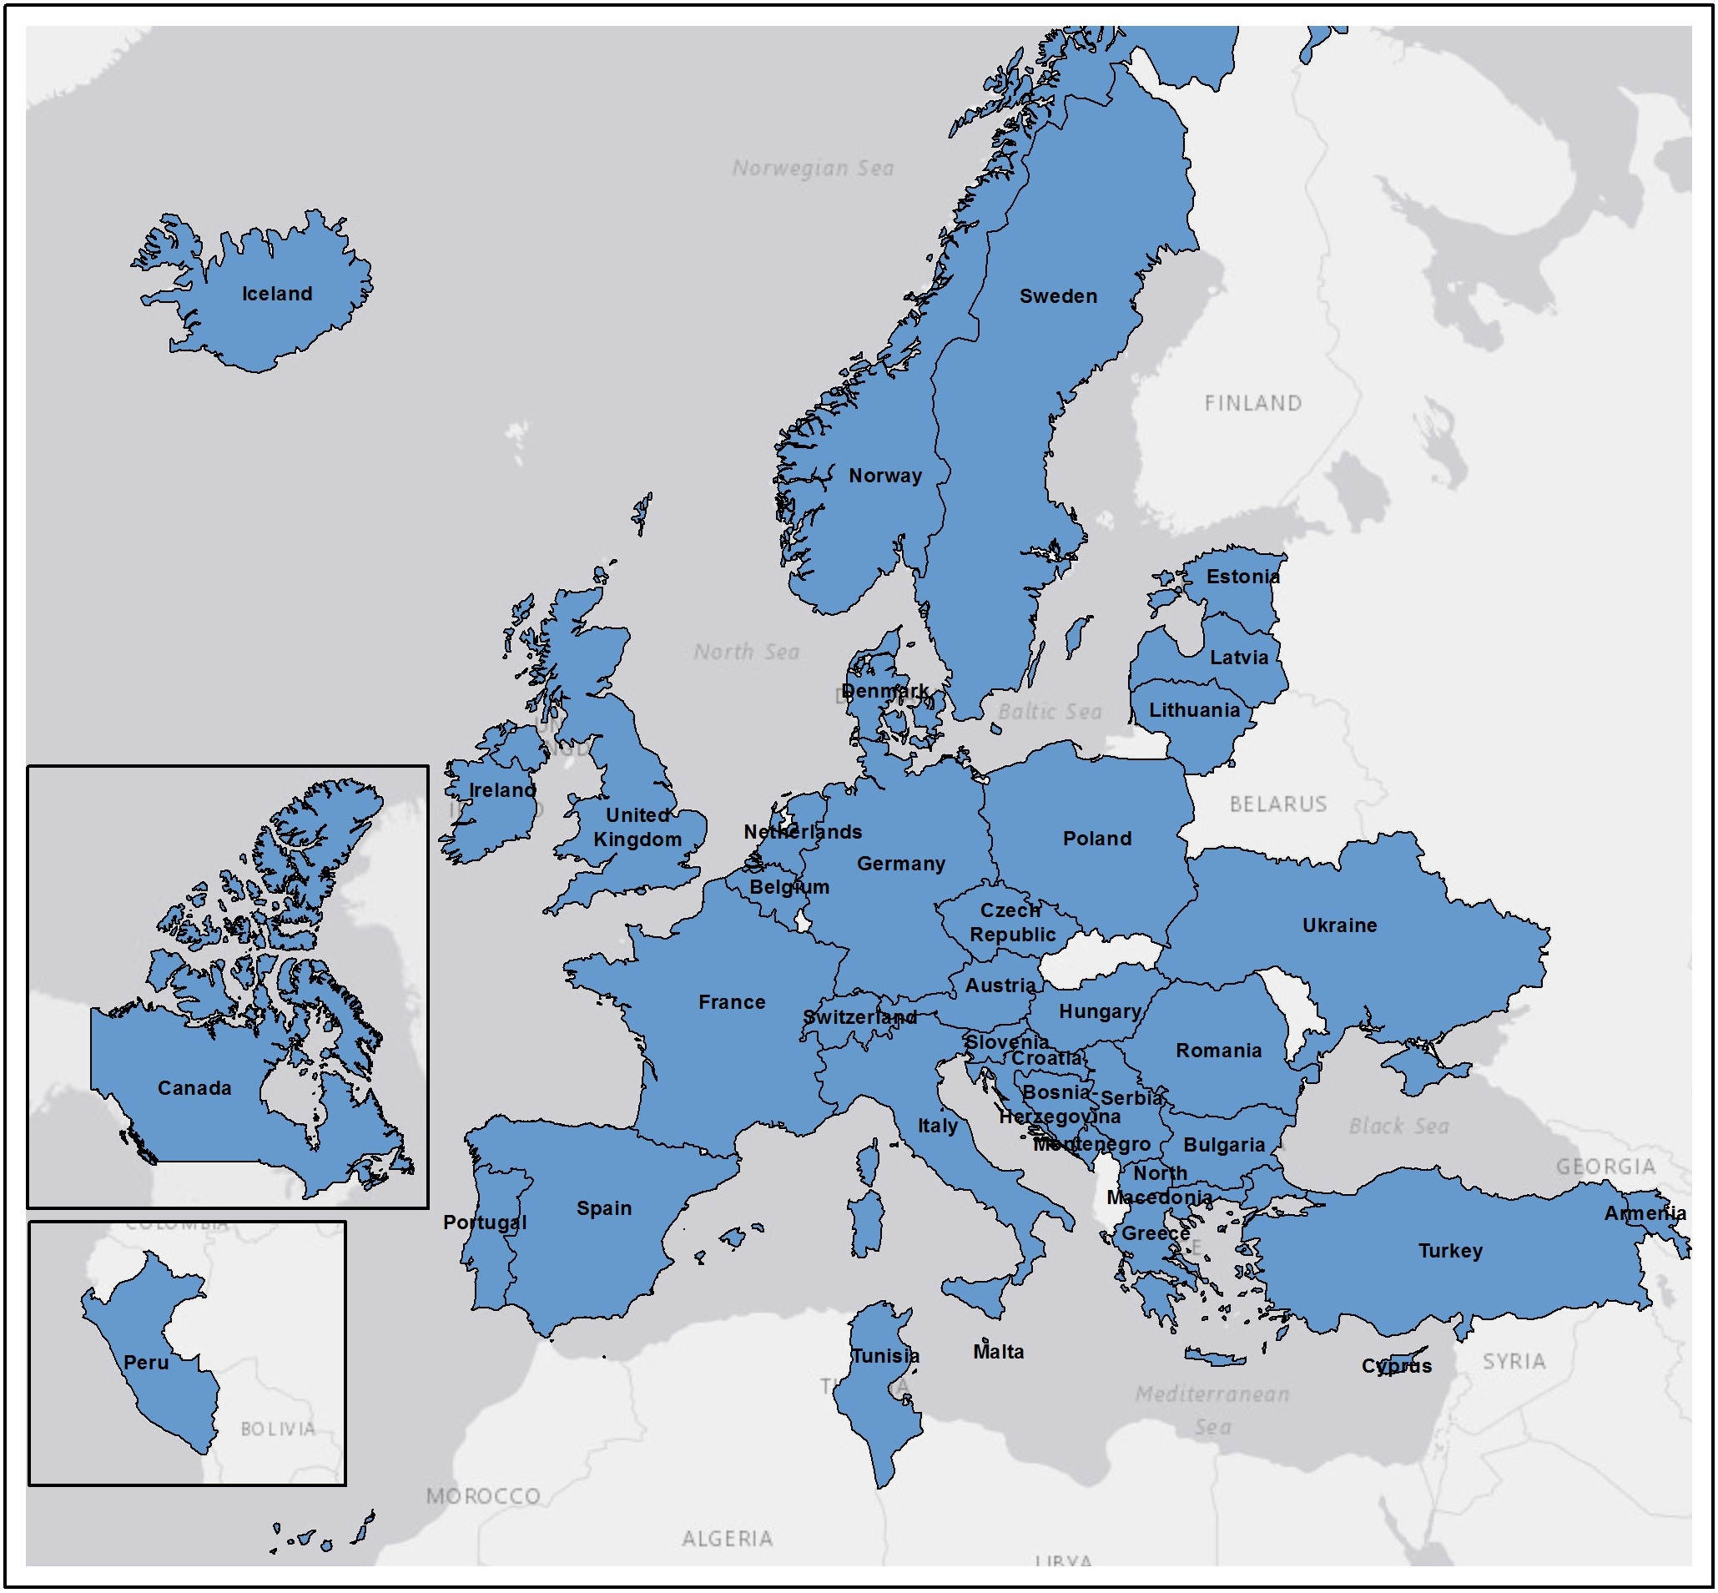
The COST Action ‘CA18219 Geothermal-DHC
„Research network on the integration of geothermal energy in decarbonized heating and cooling networks”
Operating period November 2019 – April 2024
Currently ~190 researchers from more than 40 countries
Open access network – financial support for traveling, dissemination and organizing events
Chairs: Gregor Goetzl (Austria), Dejan Milenic (Serbia)
ExCO members: Gregor Goetzl, Dejan Milenic, Giuseppe Mandrone, Jessica Maria Chicco, Vasiliki Gemeni, Edith Haslinger, Nina Rman, Rao Martand Singh, Ana Vranjes, Kai Zosseder
CA18219 participating countries
2nd European Underground Energy Storage Workshop. May 23, 2023. Paris

Slide 3
COST Actions are not projects!
COST funds research networks across Europe – everybody can join
No staff costs paid!
No work packages – democratic and flexible work structures (working groups) – bottom up principle
No fixed budget – each Grant Period receives funds according to network size and structure
What does Geothermal-DHC offer
Webinars, online trainings, in person training schools
Various grants: e.g. Short Term Scientific Missions, publication support, virtual mobility grants, conference grants etc.
Expanding your network
Repositories, fact sheets, web portal
Interlink between science – industry – communities in a European network
Joint initiatives and uptakes
PWG1 - Technology
PWG2 – Outreach & communication
PWG3 – Promoting young careers
PWG4 – Uptakes and capitalization
2nd European Underground Energy Storage Workshop. May 23, 2023. Paris

Slide 4
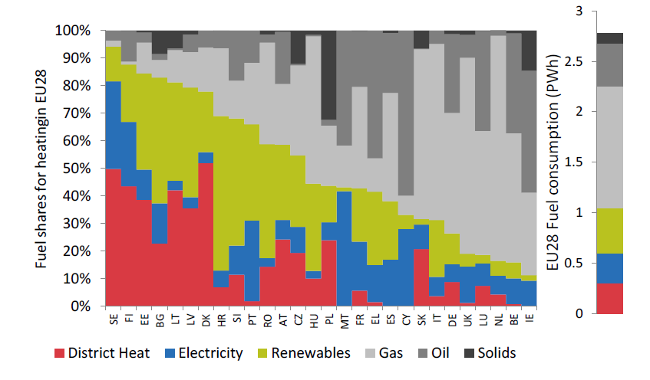
Main challenged addressed by CA18219
Integrate geothermal technologies at different scales and temperature levels into decarbonized district heating and cooling grids.
Geothermal DHC applies an inter-sectoral and technological bottom-up approach based on different case studies across Europe, instead of just tackling individual technical concepts, technologies or fields of applications
Greenfield solutions
Solutions for retrofitted HC networks
Fuel consumption for space heating in the EU in 2015
Source: Kavvadias et al. 2019
2nd European Underground Energy Storage Workshop. May 23, 2023. Paris

Slide 5
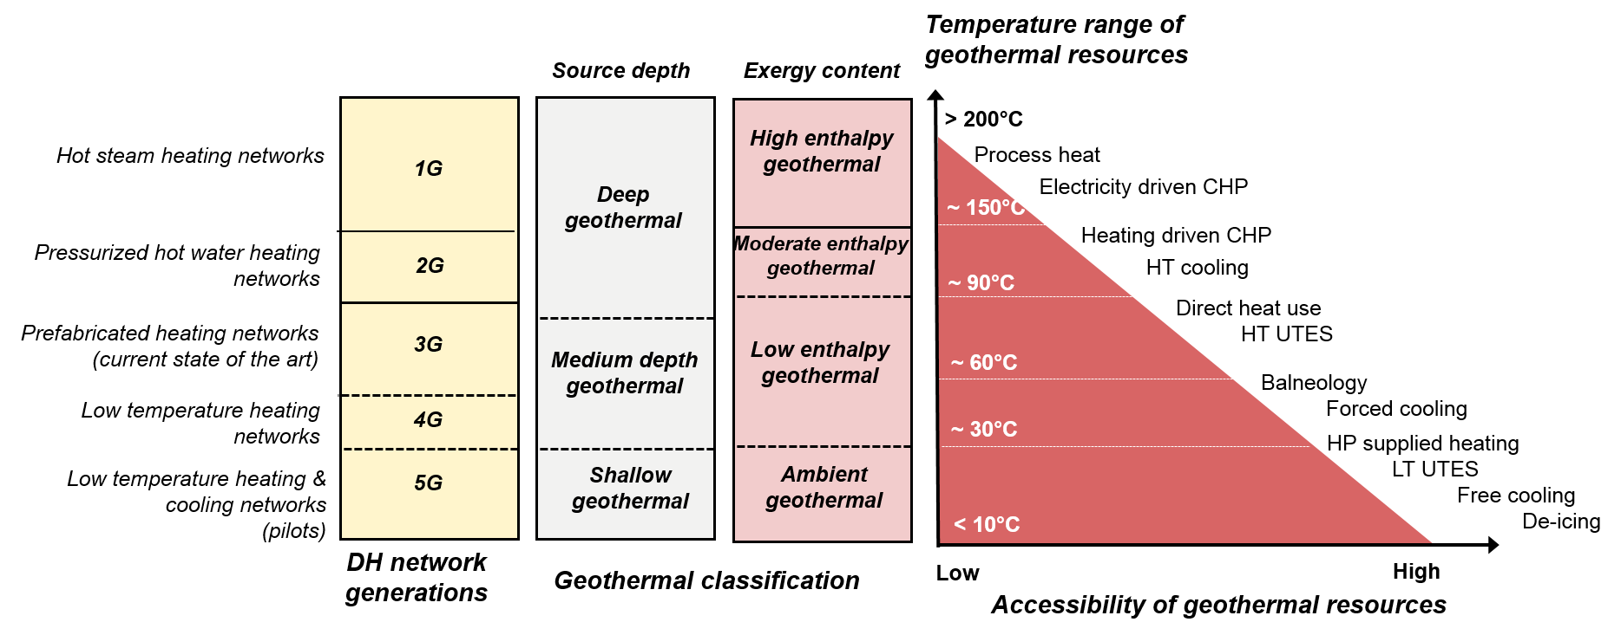
There are many ways to integrate geothermal in HC networks
Retrofitted
Cascadic
Greenfield
2nd European Underground Energy Storage Workshop. May 23, 2023. Paris

Slide 6
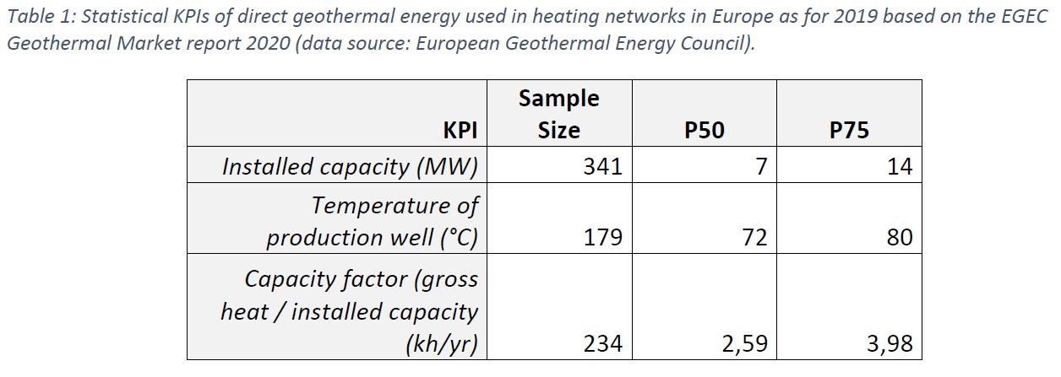
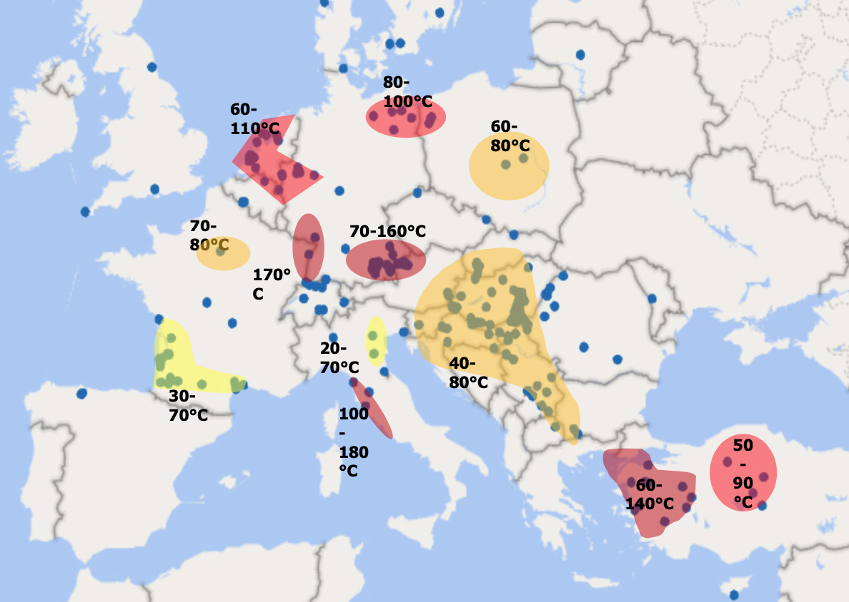
Positioning the current status
The role of geothermal heating and cooling networks in Europe
Source: Goetzl et al., 2022b
364 direct use geothermal DH networks in Europe ~ 5.6 GW capacity
Approx. >100 5G networks in Europe linked to geothermal technologies
Source: EGEC Geothermal Market Report 2021
2nd European Underground Energy Storage Workshop. May 23, 2023. Paris

Slide 7
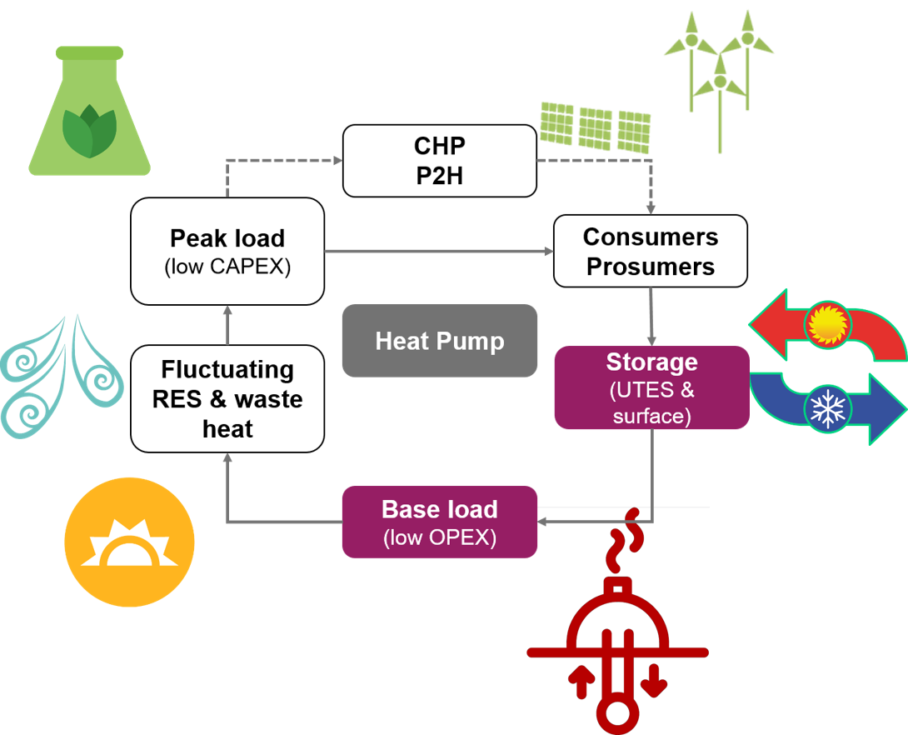
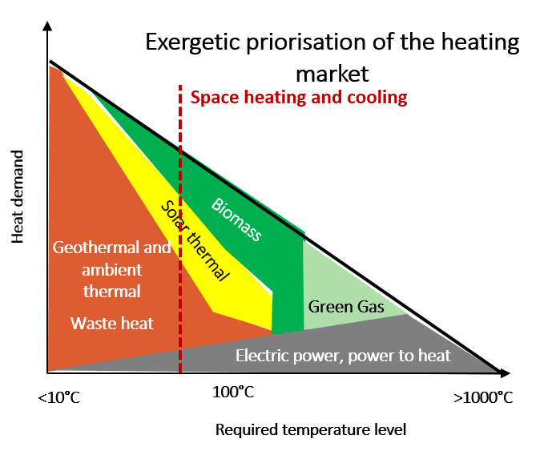
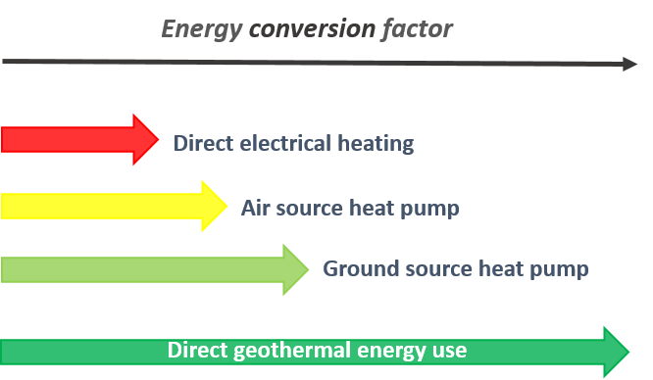
Key challenges and opportunities to be met
Low share of RES and strong dependency of energy imports inside HC market
Reduction of energy imports unleashes free capital for investments
Geothermal energy as local source of heat and storage
Low level of exploitation even for “low hanging fruits” inside geothermal
Source: Goetzl et al., 2022
Risk of binding high exergy sources for low exergy applications
30% of the energy consumption in the EU is linked to space heating and hot water
Geothermal solutions offer increased energy conversion factors
Source: Goetzl et al., 2022a
2nd European Underground Energy Storage Workshop. May 23, 2023. Paris

Slide 8
What Geothermal-DHC wants to deliver
Dedicated web portal
Knowledge and networking hub, increased visibility of technological options
Compiled knowledge
Fact sheets on technological and non-technological aspects linked to knowledge repositories
Strategies and policy input
Roadmaps to foster the deployment of geothermal HC networks in Europe
Educating young researchers
Training and educational concepts for the next generation of experts and decision makers
Promoting geothermal in HC networks
Providing easy digestible material to bring geothermal closer to the people
We might not solve everything but we want to set corner stones to be picked up!
2nd European Underground Energy Storage Workshop. May 23, 2023. Paris

Slide 9
SAPHEA – a follow up of the COST Action
HORIZON-CL5-2021-D3-02-03
October 2022 – June 2025
Develop a pan-European market hub to reduce market barriers for deploying geothermal heating and cooling networks
2nd European Underground Energy Storage Workshop. May 23, 2023. Paris

Slide 10
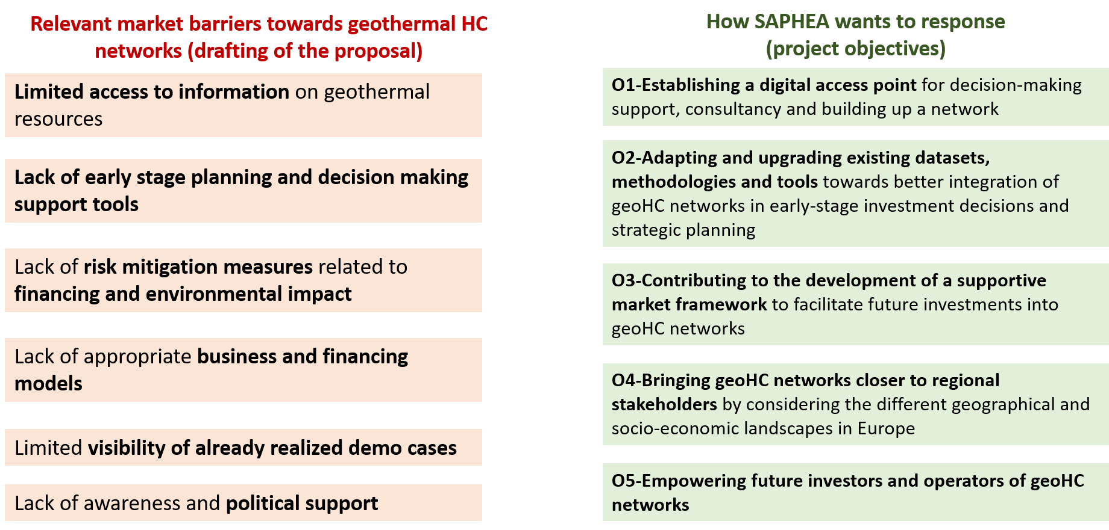
New EU project SAPHEA
Developing a single access point for the market uptake of geothermal energy use in multivalent heating and cooling networks across Europe
Funded by HORIZON-CL5-2021-D3-02-03
October 2022 until June 2025
2nd European Underground Energy Storage Workshop. May 23, 2023. Paris

Slide 11
The Geothermal-DHC portal
The future hub for geothermal energy in heating and cooling networks
Interlinking: Yellow Pages, forums
Repositories & materials: publications, fact sheets, case studies (“100 good reasons initiative”) – from October 2022 on
Tools: GIS application on case studies – from October 2022 on
Visit us at www.geothermal-dhc.eu and find out more
2nd European Underground Energy Storage Workshop. May 23, 2023. Paris

Slide 12
The 100 good reasons initiative
Scan me to find out more
2nd European Underground Energy Storage Workshop. May 23, 2023. Paris

Slide 13
Upcoming events
Ljubljana (Slovenia) → 3 to 8 July, 2023
2nd European Underground Energy Storage Workshop. May 23, 2023. Paris

Slide 14
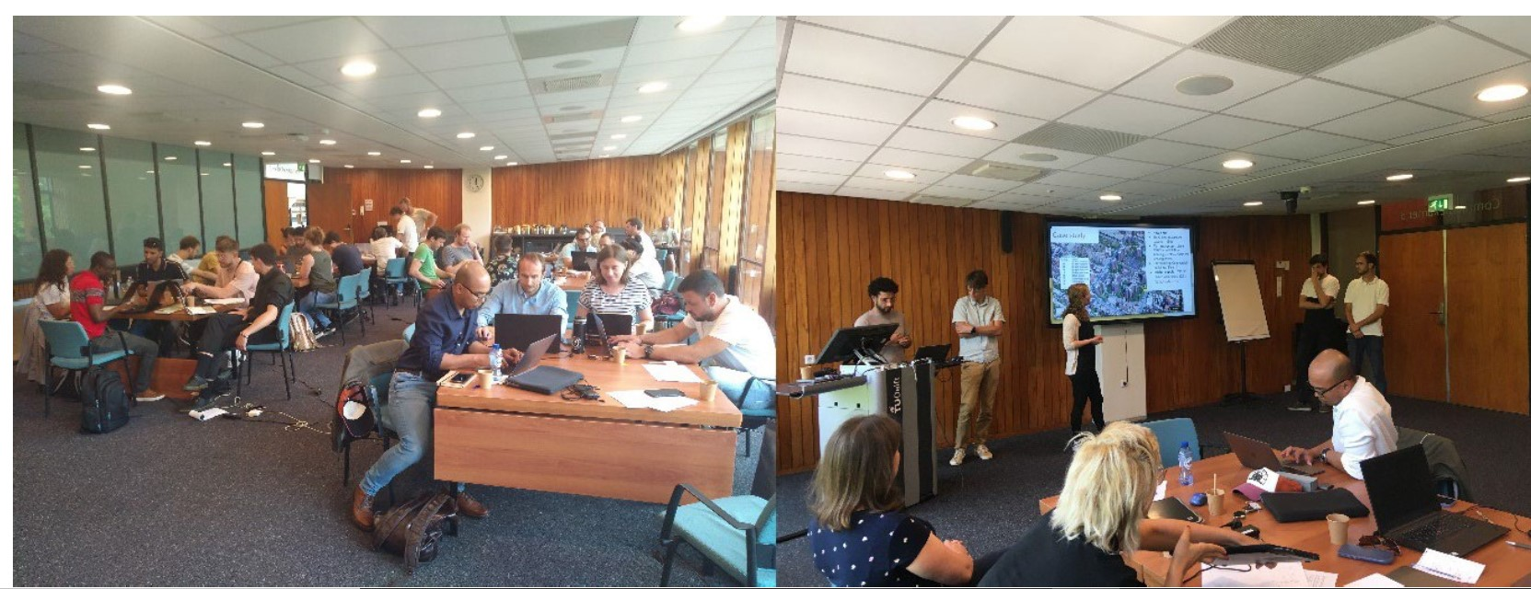
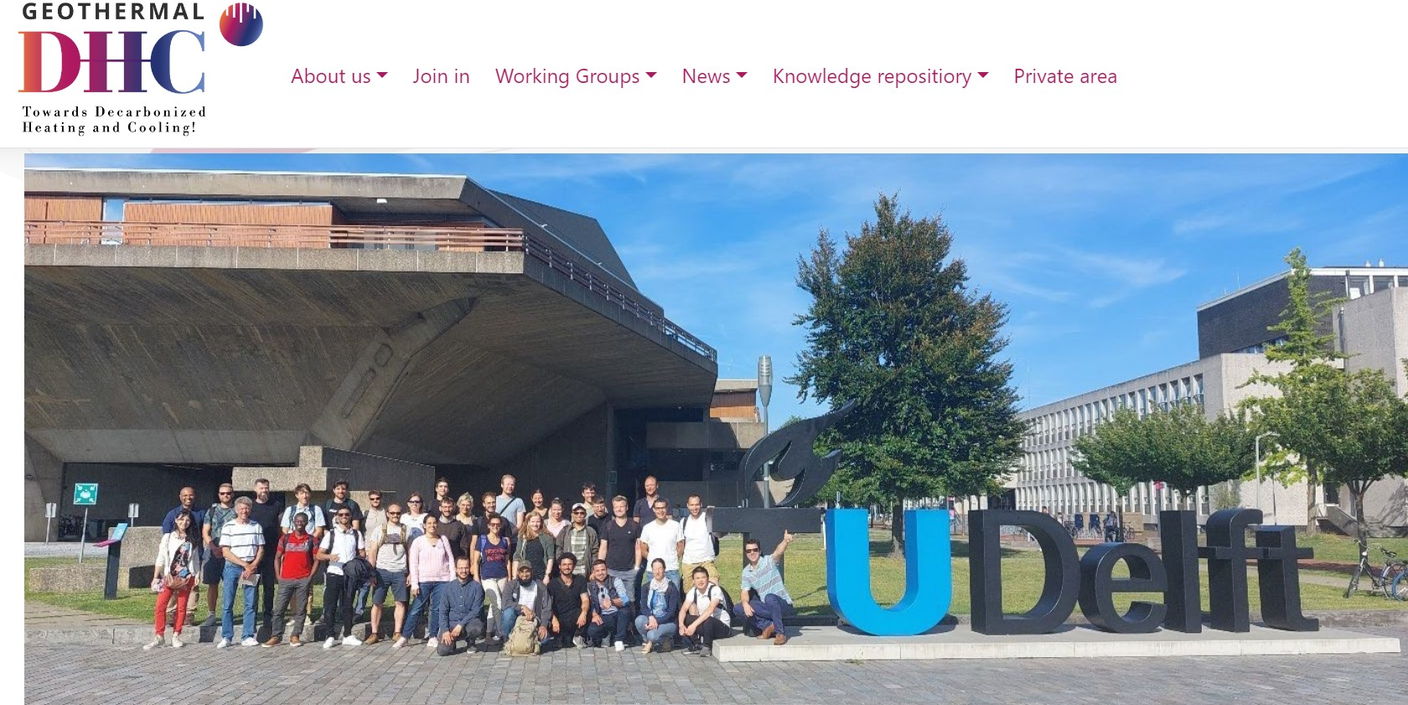

Slide 15
Upcoming events
Aarhus, Denmark → 19 to 21 September, 2023
Second District Heating and Cooling Day
2nd European Underground Energy Storage Workshop. May 23, 2023. Paris

Slide 16
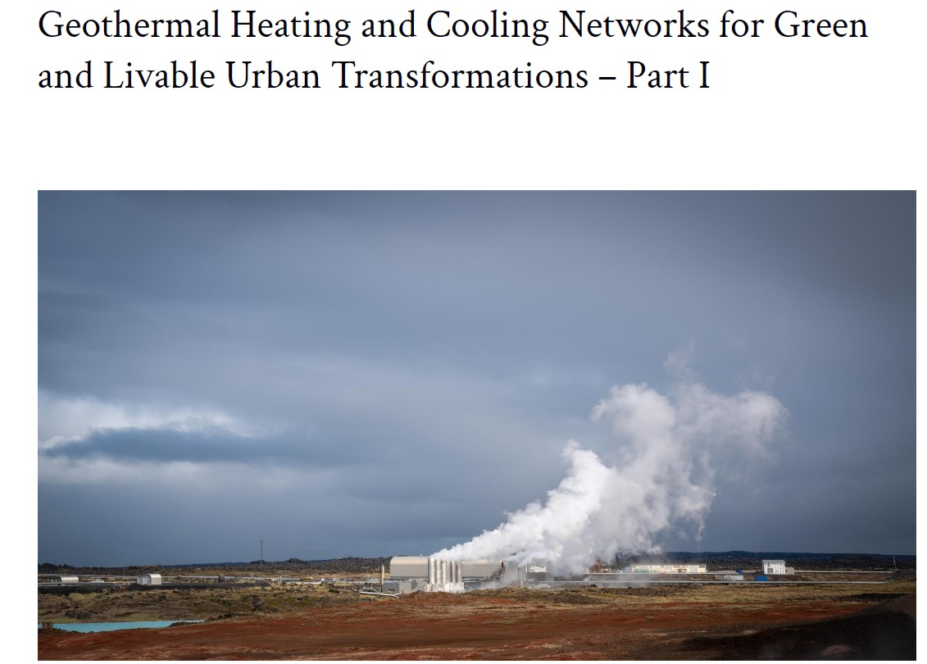
Publication inside Cost Action
For more information:
https://www.europenowjournal.org/2021/05/10/geothermal-heating-and-cooling-networks-for-green-and-livable-urban-transformations-part-ii/
2nd European Underground Energy Storage Workshop. May 23, 2023. Paris

Slide 17
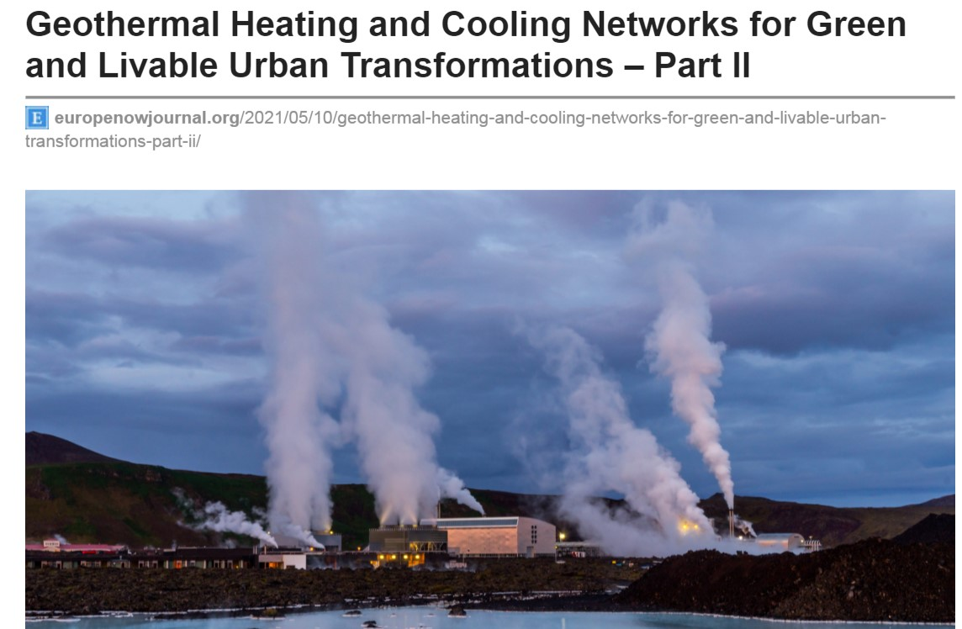
Publication inside Cost Action
For more information:
https://www.europenowjournal.org/2021/05/10/geothermal-heating-and-cooling-networks-for-green-and-livable-urban-transformations-part-ii/
Scan me to find out more
2nd European Underground Energy Storage Workshop. May 23, 2023. Paris

Slide 18
Publication inside Cost Action
For more information:
https://eurogeologists.eu/goetzl-pathways-to-better-integrate-geothermal-energy-at-its-full-technological-scale-in-european-heating-and-cooling-networks/
2nd European Underground Energy Storage Workshop. May 23, 2023. Paris

Slide 19
Thank you
Subscribe to our news
www.geothermal-dhc.eu
@Geothermal_DHC
Scan me to join the network
COST Geothermal DHC
Acknowledgements
This article/publication is based upon work from COST Action Geothermal-DHC, supported by COST (European Cooperation in Science and Technology).

