Slide 1
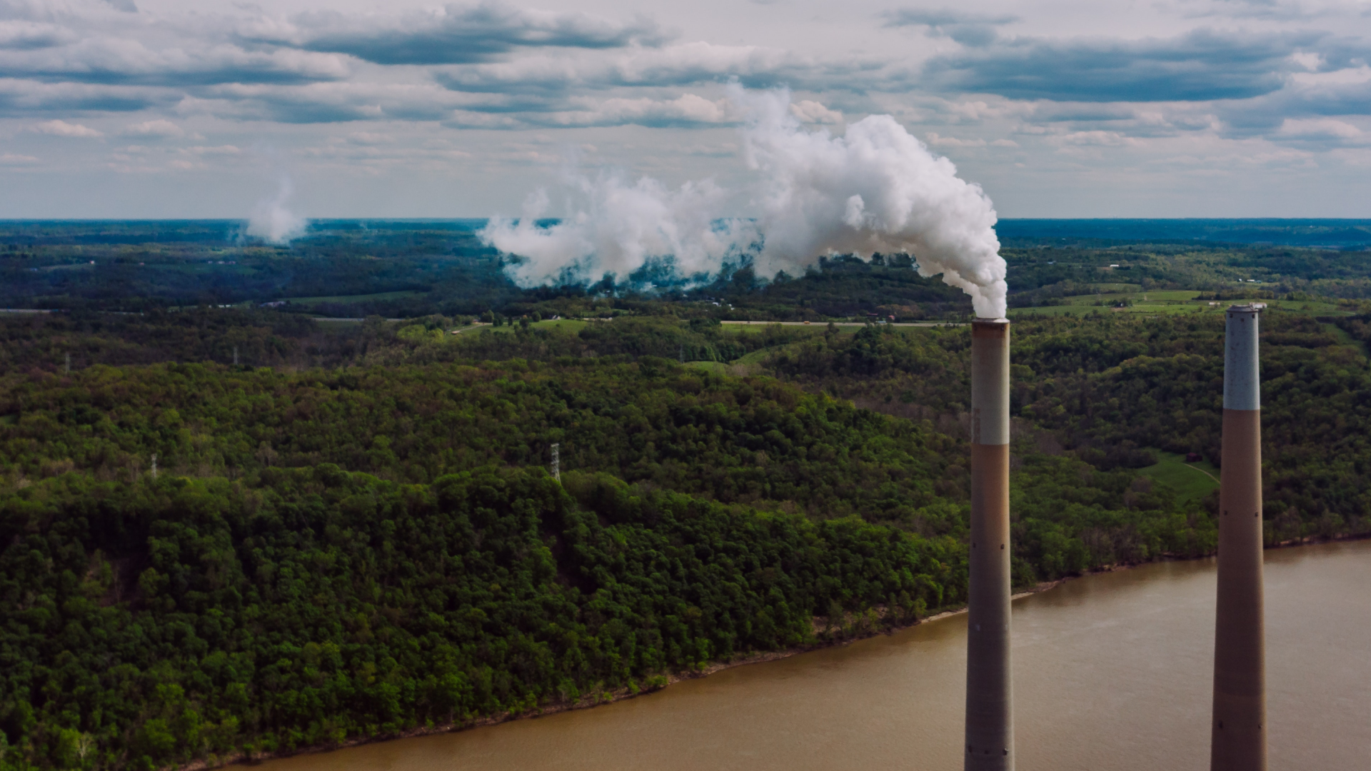
Helping decarbonize industry and mobility with Carbon Capture & Storage and Hydrogen
Avalon International Corporation
Net Zero by 2050

Slide 2
Problem
Humans and wild animals face new challenges for survival because of climate change. More frequent and intense drought, storms, heat waves, rising sea levels, melting glaciers and warming oceans can directly harm animals, destroy the places they live, and wreak havoc on people's livelihoods and communities.
Extreme weather, food supply disruptions, and increased wildfires are other effects of climate change caused by greenhouse gases.

Slide 3
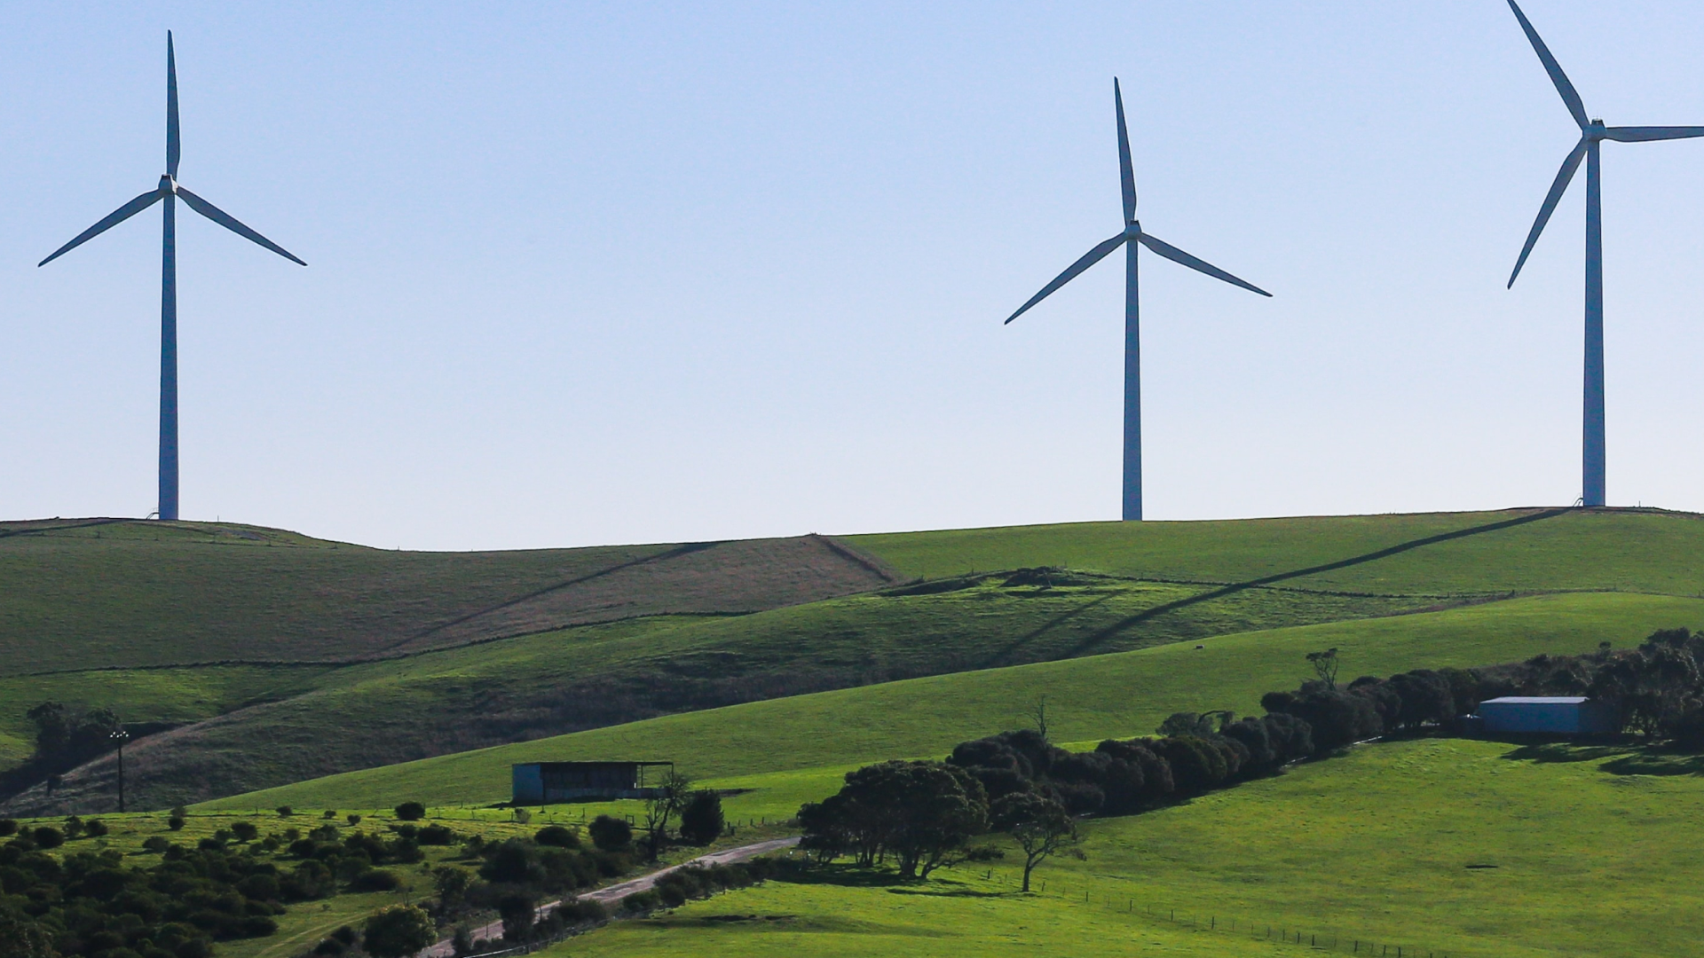
50.0
gigatonnes
Every year, the world adds approximately 50.0 Gigatonnes of greenhouse gases GHG to the atmosphere, trapping heat and running up global temperatures, which can significantly cause severe impacts and consequences for humans and the environment.

Slide 4
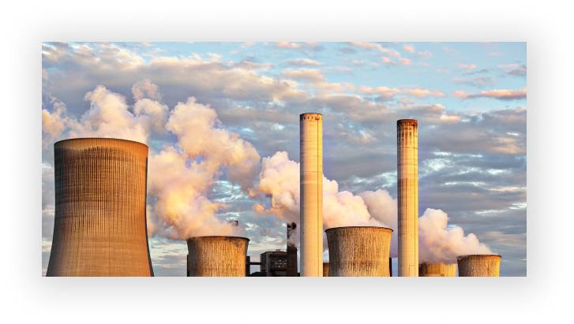
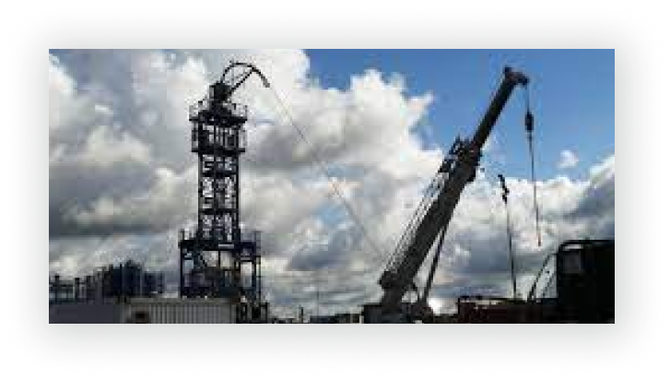
According to a study conducted by the EPA in 2019, carbon dioxide CO2 made up 81% of all greenhouse gases. Most industrial process emits CO2,
the top emitters are:
coal-fired power plants
cement plants
steel plants
oil & biorefineries
natural gas processing facilities
ethanol plants
fertilizer plants
agricultural processes
mobility

Slide 5
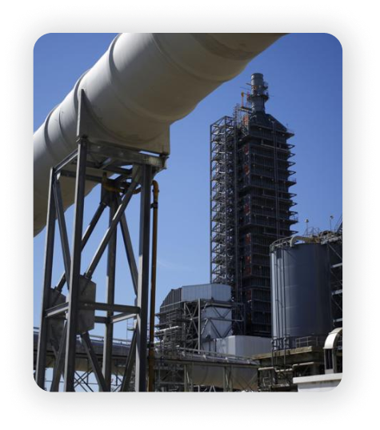
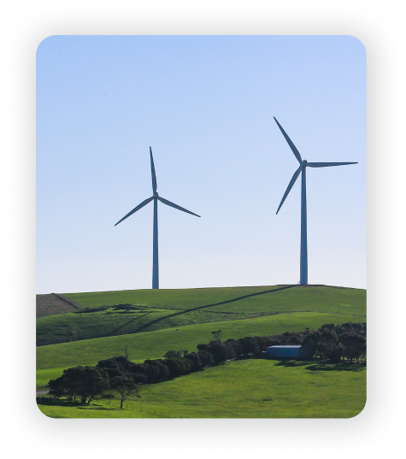
Solution
The only way to avoid the worst impacts of climate change is to stop adding greenhouse gases by 2050.
According to international energy and climate change agencies
Carbon Capture Utilization & Storage
Hydrogen & Net-Zero Ecosystem
Renewable Energy & Energy Storage
is a crucial technologies for meeting the Paris Agreement’s goal of limiting the rise in the global temperature to well below 1.5°C

Slide 6
Carbon Capture Utilization & Storage
Hydrogen & Net-Zero Ecosystem
Energy Storage &
Renewable Energy
Gets CO₂ out of the industrial GHG emitters
& Direct Air Capture
Gets CO2 out of the mobility:
car, train, plane, ship
Can be burned with natural gas
Manages variable renewable power production
Prolongs investments in current coal-fired power plants
Power grid benefits
Net-zero energy
Industrial uses

Slide 7
Market Size by 2050
40 Trillion +
8.0 Trillion
400B
REDUCING GHG EMISSION (worldwide)
Total Available Market
Based only on source IEA
CARBON SEQUESTRATION
Serviceable Available Market Based only on source IEA
CCS AVALON
Share of Market 5% of Available Market

Slide 8
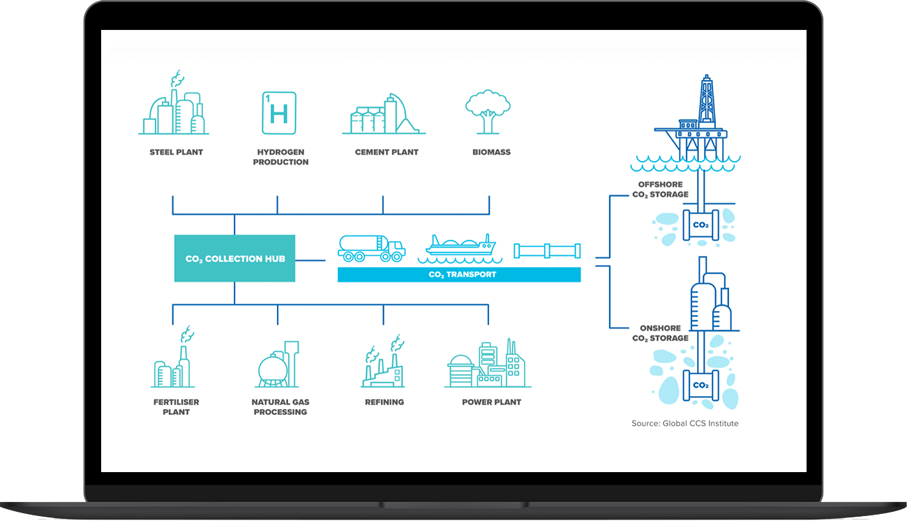
Infrastructure HUB with CCS
Carbon Capture Storage as Service - CCSasS and Clean Energy production
With the synergy of cross-industrial partnerships, infrastructure HUBs provide an affordable cost-effective Carbon Capture Storage service to HUB’s customers and provide low-carbon and clean hydrogen fuels, high technology and new products from CO2 to emerging and existing markets.
This is a unique opportunity for HUb’s resident and partners to save tens of millions of dollars, and have a significant impact on the local community increasing capitalization, and stock value, leading to the creation of new high-paying jobs, triggering accelerated social economic development communities.

Slide 9
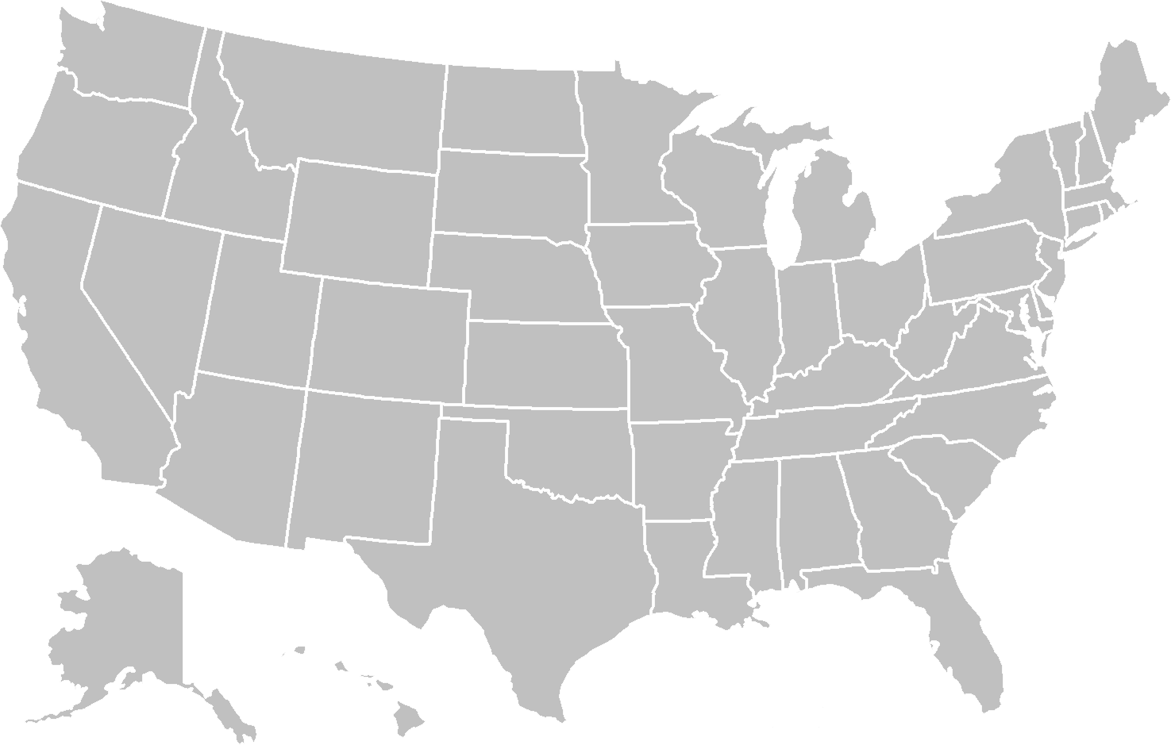
The United States
HUB with CO2 storage
Under development
Upcoming

Slide 10
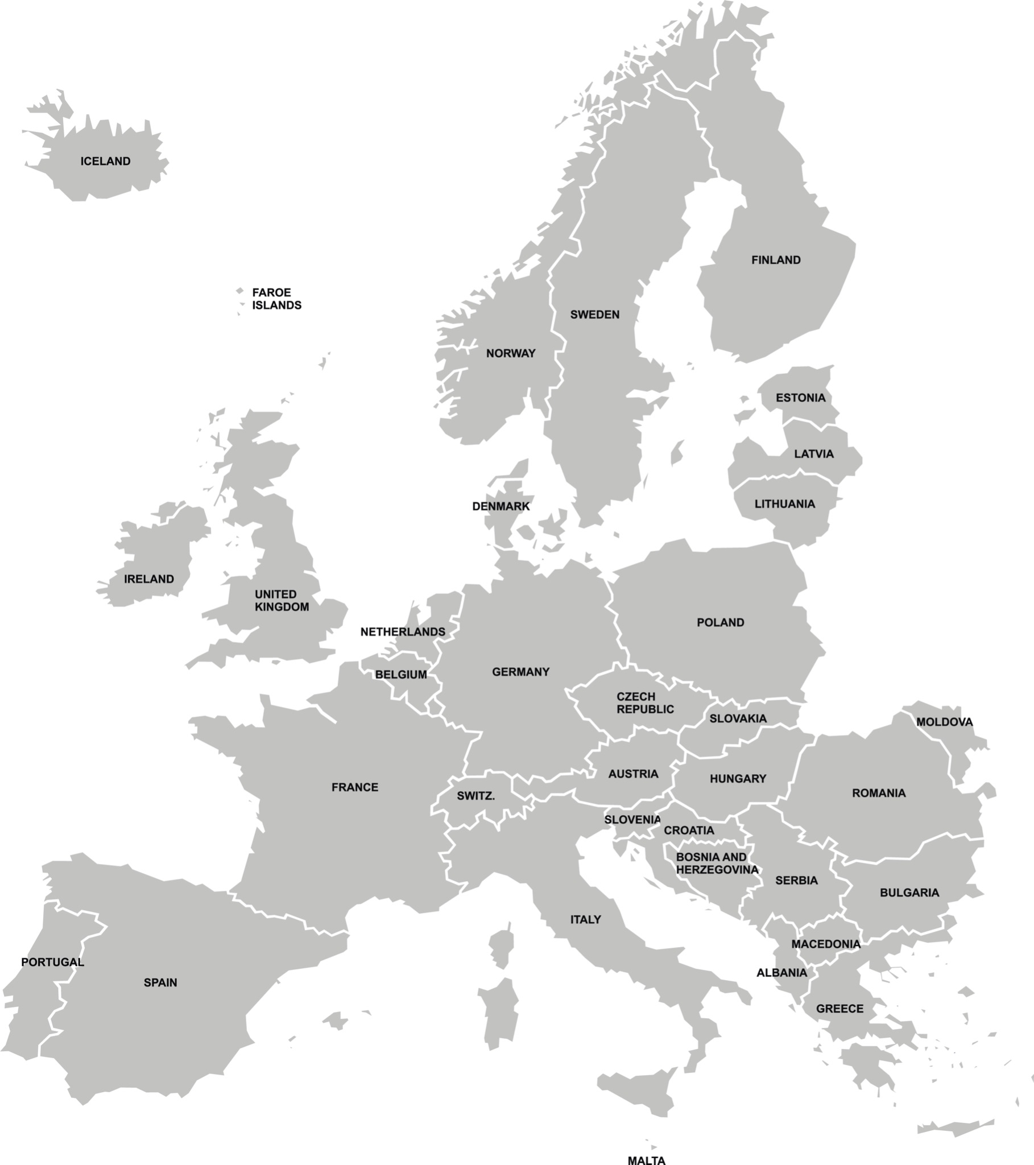
Europe
HUB with CO2 storage
Under development
Upcoming

Slide 11
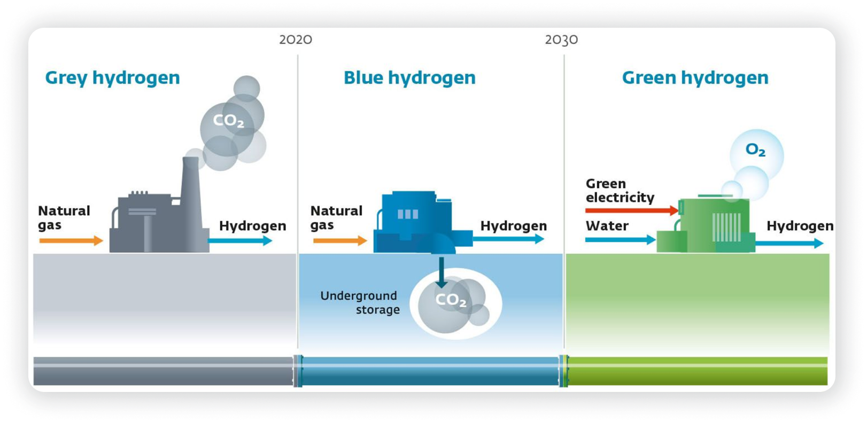
CCS - Clear path from grey to green Hydrogen

Slide 12
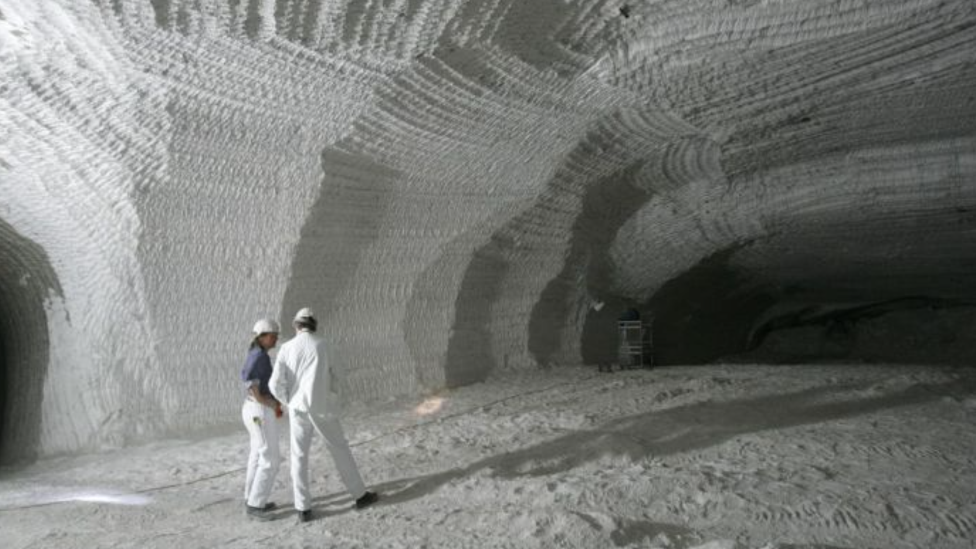
Clean Hydrogen
The global hydrogen energy boom is coming?
According to Forbes, CNBC, Popular Mechanics, but
also US DOE, IEA, EU Commission, and others Infrastructure boom is inevitable – scalability is critical Commercial technology exists but not widespread and depends heavily on geology and resources Ammonia, methanol, natural gas, …

Slide 13
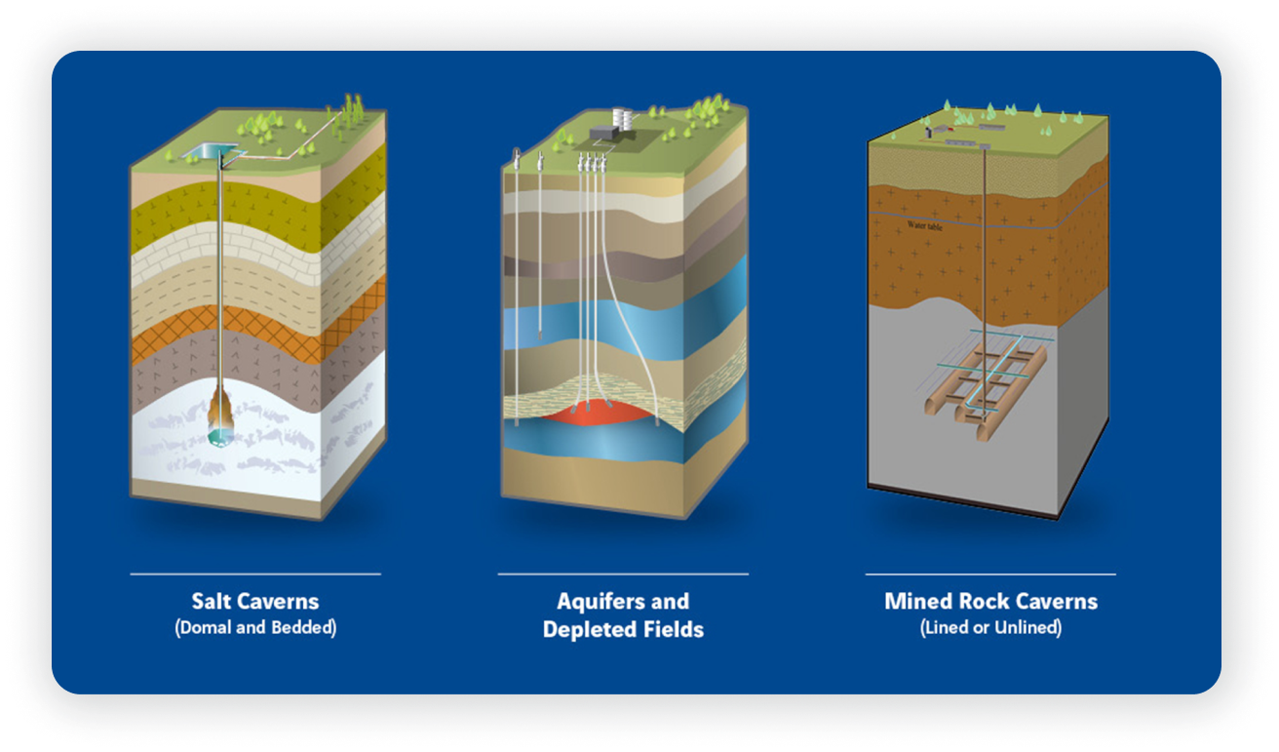
Energy Storage Type

Slide 14
Hydrogen as energy storage vehicle

Slide 15
Hydrogen as energy storage vehicle

Slide 16
Adoption Strategy
PARTNERSHIPS
direct/indirect CO2 emitters
Industry - CO₂ emitters: ethanol plants, fertilizer plants, steel plants, oil&bio refineries, cement plants, coal-fired power plants, oil&gas and agriculture processing facilities
Landowners and agriculture companies: Syngenta, Bayer, Cargill, DuPont, Yara International, BASF
Technology companies and data centers: Google, Facebook, Microsoft, Stripe, Oracle, cryptocurrency miners
Mobility: vehicles, tracks, airline and shipping companies
Insurance company, Public Companies, Pension Funds, Banks, Hedge Funds, Private Equity
Government: Departments of Energy, Departments of Defends, Department of Agriculture

Slide 17
Competitive advantages
1st to Market for point CO2 emitters
CAPEXLess infrastructure for point CO2 sources
Identified, explored and characterized locations for storage > 5.0 Gigatonnes of CO2
Established reliable relationships with landowners and landlords and CO2 emitters:
access to two major (>500MM tonnes) and a few smaller (250MM+ tonnes) suitable CO2 storage with the feasibility, design and permit study for quick project implementation
access to eleven huge industrial CO2 emitters (refineries, fertilizers and coal-fired power plants >10MM tonnes of CO2/yr each) and a several small (biorefineries, ethanol, blue hydrogen plants 150K+ tonnes of CO2/yr each)
Managed CCUS R&D and field deployment projects funded by DOE since 2008
Direct experience with UIC program, permitting, regulations, nuanced knowledge of the matter, including Class VI, LCFS, and 45Q
Extensive experience in oil & gas, infrastructure & real estate development, renewable energy, environmental engineering
Involved in state and federal CCUS legal infrastructure framework formulation
Active participants of national and international CCUS related initiatives
Connected to key political, governmental, regulatory, and industrial groups, NGOs relevant to CCUS, Hydrogen, Critical Minerals, and other energy transition technologies

Slide 18
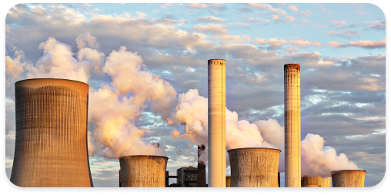
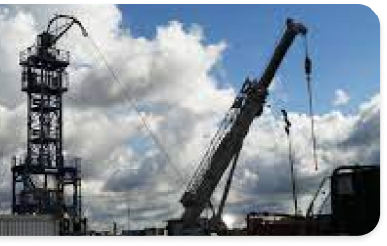
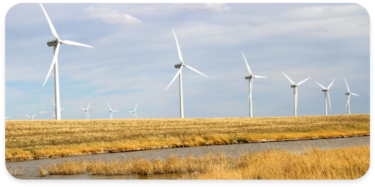
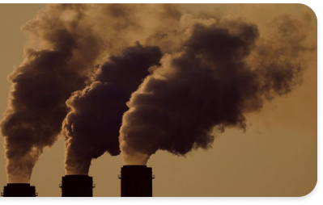
Benefits for partners and investors
Save tens of million of dollars of capital
Tax credits: 45Q & LCFS
Growth revenue, capitalization, value of shares and assets
Creation sustainable reputation and new well-paid jobs
Significant impact on the local community surrounding HUBs
Triggering an accelerating social economic development
Helping the world stop global warming and climate disaster

Slide 19
Technology Portfolio
Cementless concrete
CO2 capture and storage
Low-cost hydrogen and fuel cell
Water desalination (technical and drinking)
GHG/methane field leak detection and permanent O&G wells abandonment and storage of gases (CO2, CH4) in geoformations backed Artificial Intelligence (AI)
GHGless Bitcoin crypto mining backed AI
Energy microgrids backed AI
Gas-tight in situ pH resistant mineral seal enabling permanent subsurface isolation of methane, CO2, and H2S
Nano-engineered chemicals for liquefaction of solidified oil-based sludges into liquid crude and bitumen
Retrofitting oil sludge and used tires into diesel and carbon black
Microbial consumption of crude oil, grease, sewage, and animal waste

Slide 20
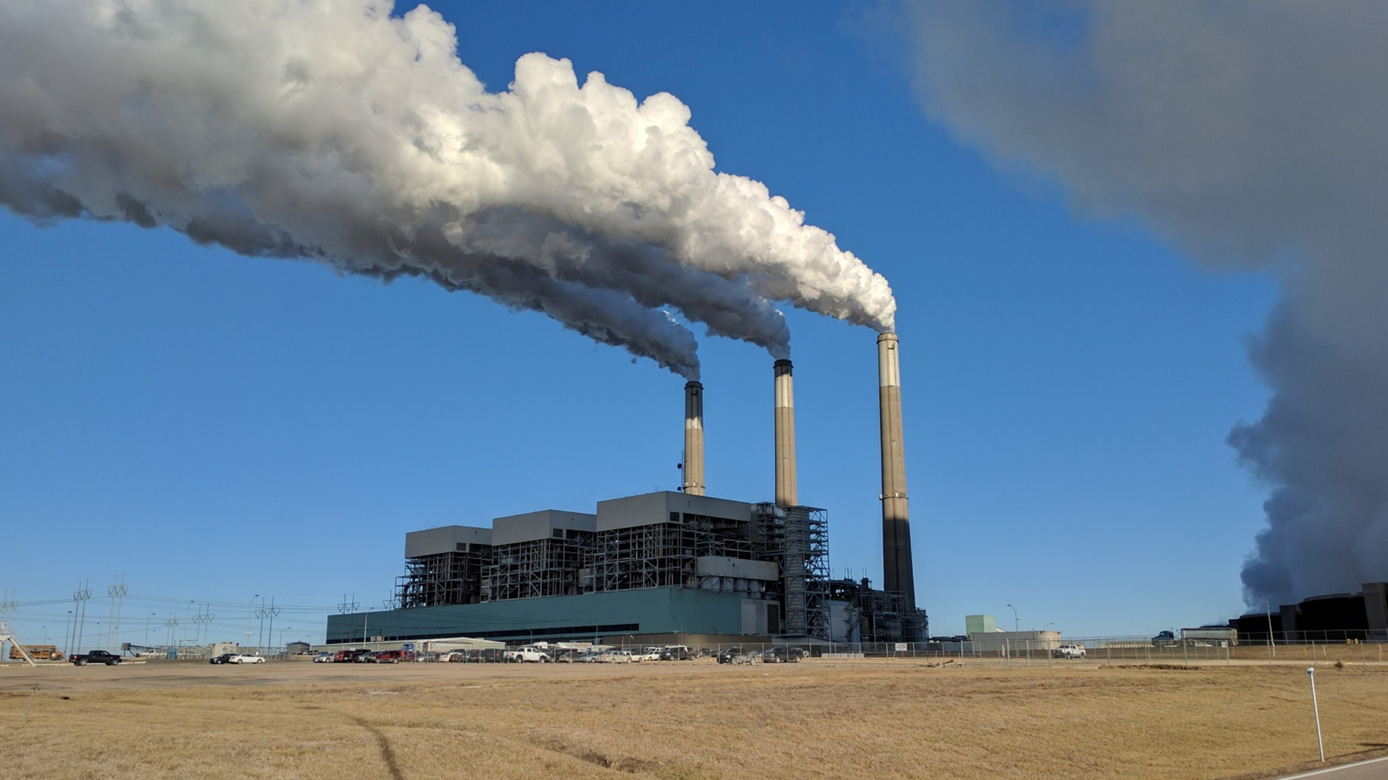
$50
$50
$85
$85
$85
Questions?
Miguel.Silva@Avalon-int.com?
Jeffrey Energy Center, KS, 2.16 gigawatts, ~12Mt CO₂/yr

