Slide 1




Comparison of carbon-neutral technologies and need for energy storage
www.shogenergy.eu
Social MEDIA
WWW.EU

Slide 2
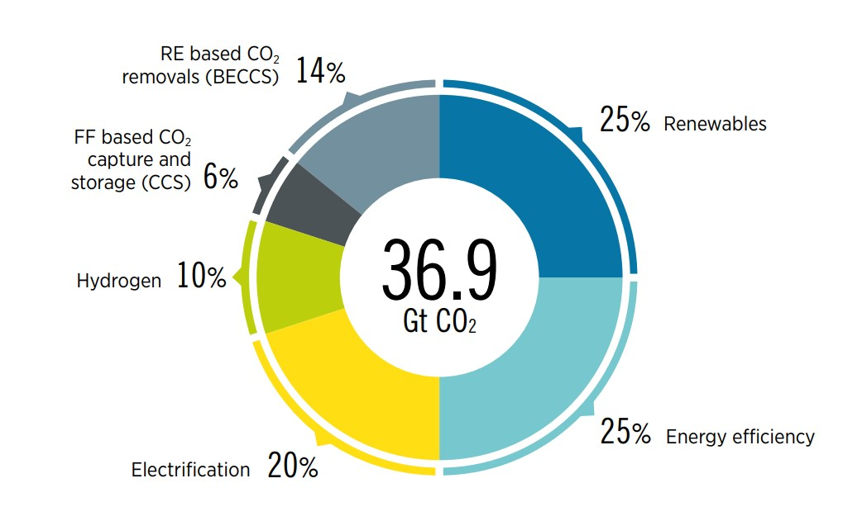
Introduction
Despite good progress in some areas, there are large gaps between the current deployment of energy transition technologies and the levels needed to achieve the 1.5°C Paris climate goal.
A 1.5°C compatible pathway requires a massive transformation in consuming and producing energy.
By 2050, the world would need to have net zero emissions, requiring a cut of nearly 37 gigatonnes (Gt) of annual CO₂ emissions.
Global energy consumption would need to decrease by 11% from 2019 levels through ambitious energy efficiency improvements, with a simultaneous increase in the share of renewables in the global energy mix – to 79% by 2050, from 19% in 2019.
Renewables would have to increase across all end-use sectors, while a high rate of electrification in sectors such as transport or buildings would require a ten-fold increase in renewable electricity capacity by 2050.
Reducing emissions by 2050 through six technological avenues
IRENA (2022), World Energy Transitions Outlook 2022: 1.5°C Pathway, International Renewable Energy Agency, Abu Dhabi

Slide 3

Options for climate change mitigation
Arguments for energy policy
Price of energy
Diversification (more fuel sources)
Energy security (independence of other countries)
Trade balance
Employment and industry policy (e.g. mines)
Military
Next generations
Environment/climate change
Options that can meet demands
Energy storage, energy efficiency
Renewable sources
  Wind
  Solar
  Biomass
  Tidal/wave (current)
  Geothermal
Fossil fuels with CCUS
Biomass with CCS (Bio-CCS, or BECCS)
DACCS
Nuclear
©Getty Images | Andriy Onufriyenko
Updated after van Egmond et al, 2004

Slide 4
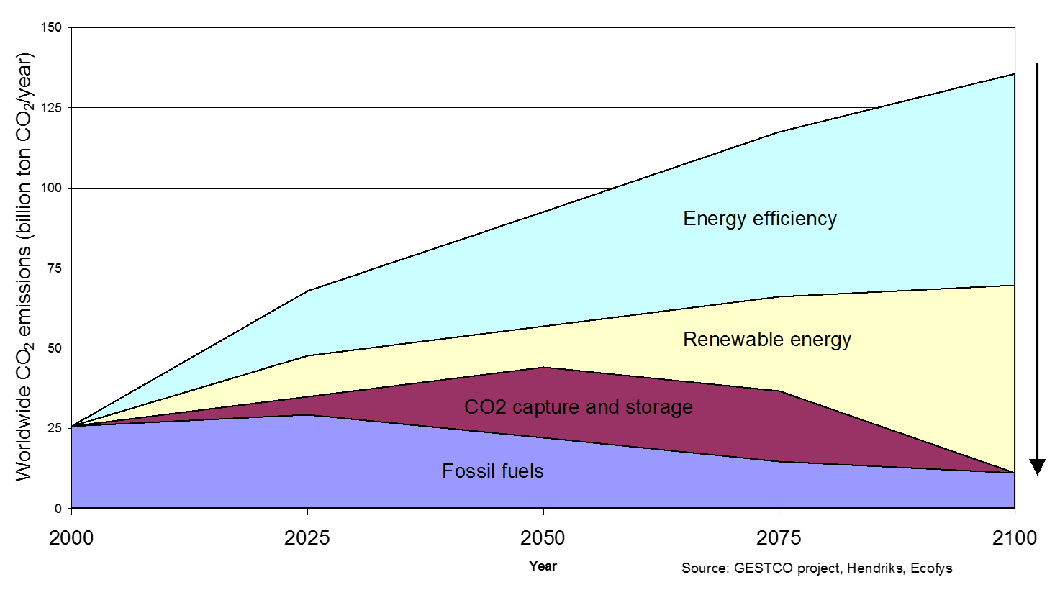
Options for climate change mitigation

Slide 5
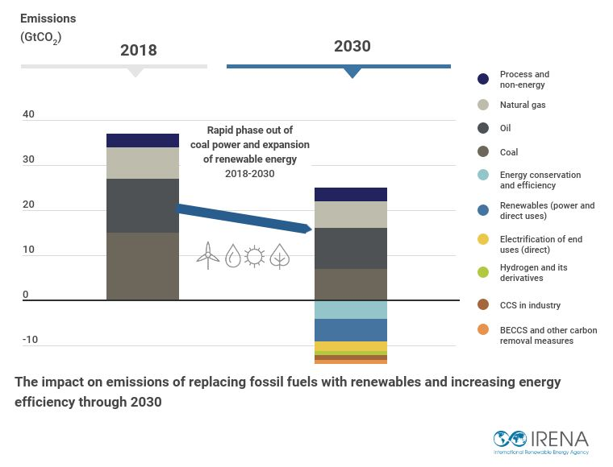
World energy transition targets by 2030
Renewable energy share in electricity generation must increase to 65% by 2030
The share of direct electricity in total final energy consumption (TFEC) must rise from 21% to 30%;
Deployment of energy effi­ciency measures must increase 2.5 times
Direct renewables in end use sectors must grow from 12% in 2019 to 19% by 2030.
IRENA (2022), World Energy Transitions Outlook 2022: 1.5°C Pathway, International Renewable Energy Agency, Abu Dhabi

Slide 6
Reducing emissions by 2050 through six technological avenues
IRENA’s 1.5°C pathway positions electrification and efficiency as key drivers of the energy transition, enabled by renewables, hydrogen, and sustainable biomass.
This pathway would result in a cut of nearly 37 Gt of annual CO₂ emissions by 2050.
These reductions can be achieved through
significant increases in generation and direct uses of renewables-based electricity;
substantial improvements in energy efficiency;
the electrification of end-use sectors (e.g. electric vehicles and heat pumps);
clean hydrogen and its derivatives;
bioenergy coupled with carbon capture and storage;
last-mile use of carbon capture and storage
CCS = carbon capture and storage; BECCS = bioenergy with carbon capture and storage; GtCO₂ = gigatonnes of carbon dioxide; RE = renewable energy; FF = fossil fuel.
Source: World Energy Transitions
Outlook 2022, IRENA

Slide 7
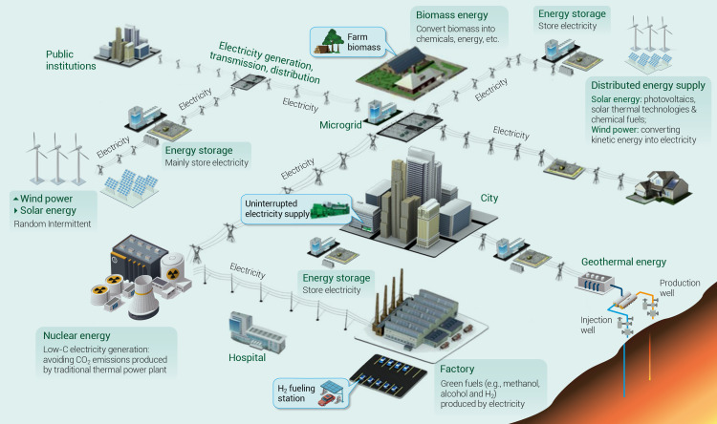
Options for climate change mitigation
Renewable energy is energy derived from natural sources, that are replenished at a higher rate than they are consumed.
Sunlight and wind, for example, are such sources that are constantly being replenished.
Renewable energy sources are plentiful and all around us.
Fossil fuels - coal, oil and gas - on the other hand, are non-renewable resources that take hundreds of millions of years to form.
Fossil fuels, when burned to produce energy, cause harmful greenhouse gas emissions, such as carbon dioxide.
Core technologies for renewable energy production (Wang et al, 2021)
Source: What is renewable energy? | United Nations

Slide 8

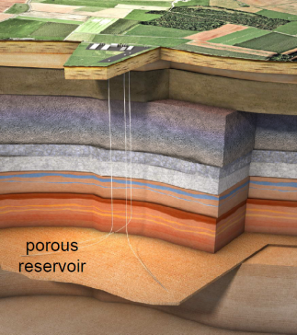
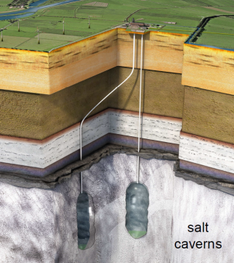
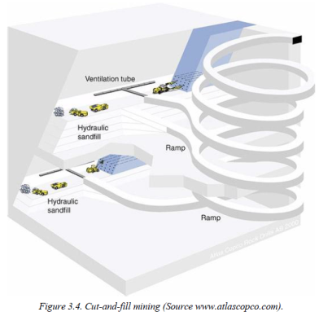
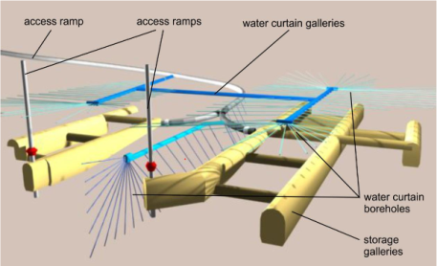
Underground Energy Storage
Underground energy storage is another option for combating climate change, permitting to use of produced energy more effectively
Energy storage is required for balancing intermittent renewable energy like wind and solar energy
Energy could be stored in structural traps in reservoir rocks, man-made cavities in salt and hard rocks and porous basalts located at a suitable depth
Abandoned mines
Lined rock caverns

Slide 9
Electrical Storage Technologies
P. Audigane, ENeRG NL29, 2014

Slide 10
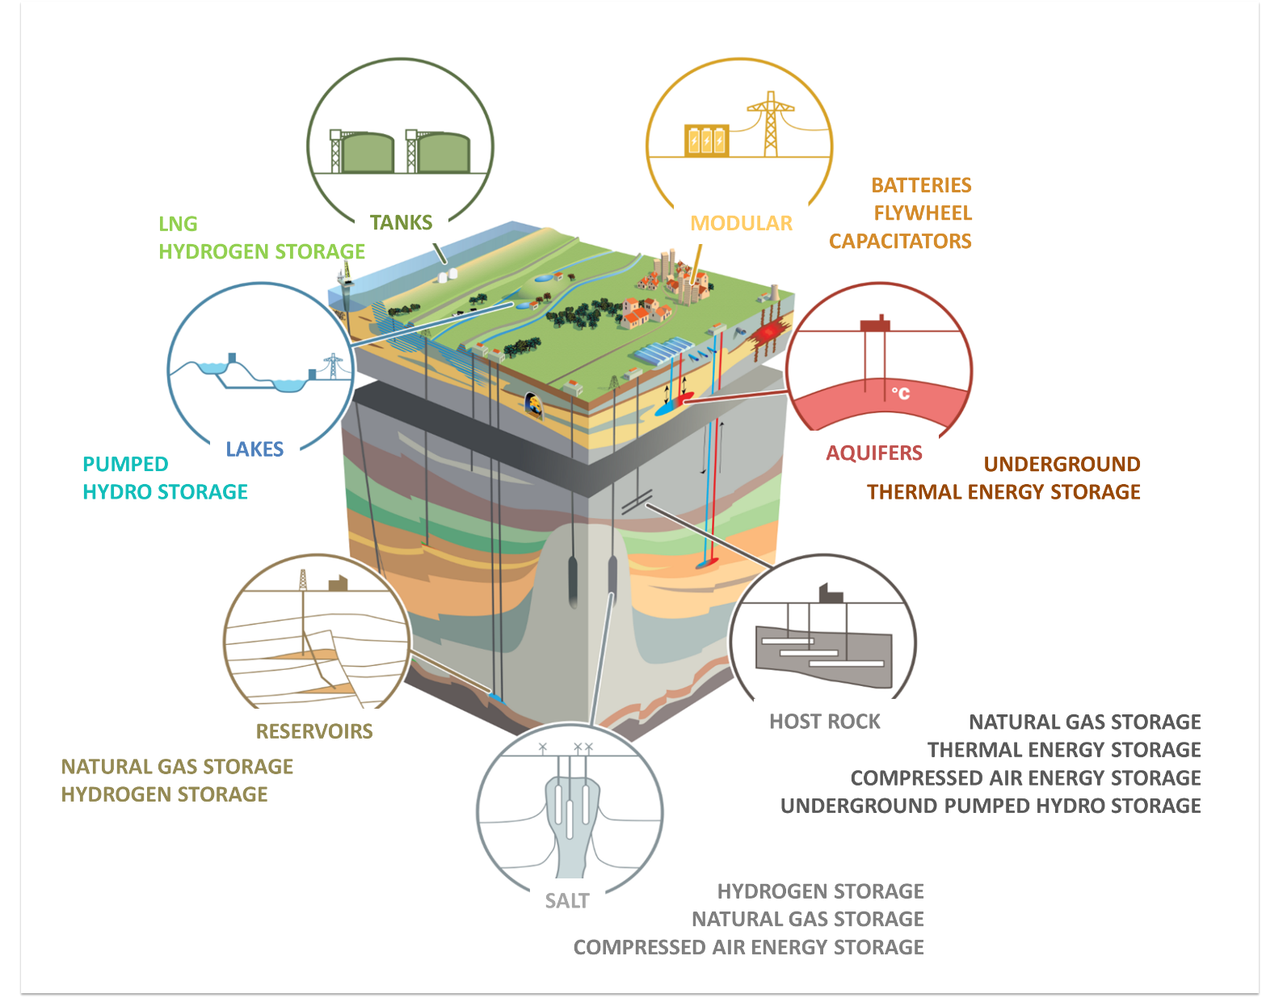
Subsurface and above-ground energy storage technologies
ESTMAP project, S. van Gessel & V. Hladik, GEO ENeRGY NL34

Slide 11
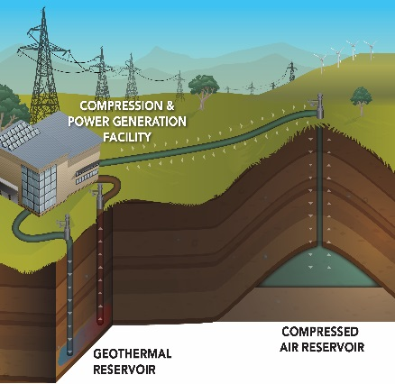
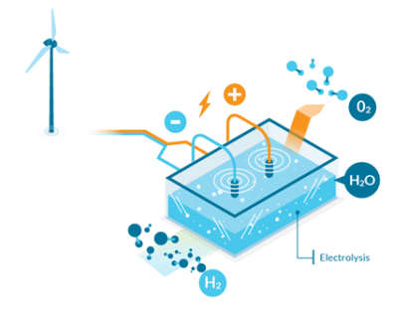
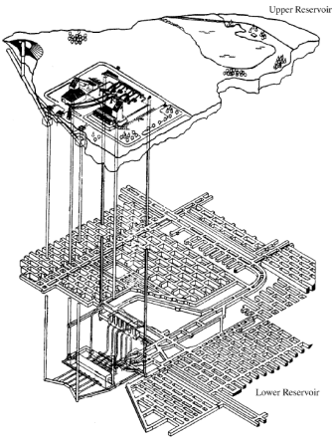
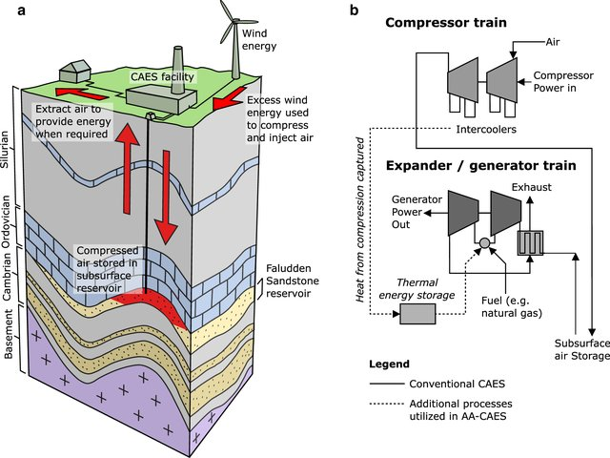
Underground Energy Storage
Compressed Air Energy Storage (CAES)
Hydrogen and Synthetic Methane Storage
and CO₂ energy storage are in research, pilot and demonstration phase only
Pumped-Hydro Storage is good known technology,
but not yet implemented in abandoned mines
(in developing phase only,
including one project
in Estonia)
Front page – Energiasalv
Compressed Air Energy Storage at Yakima Mineral site (BP McGrail, USDOE)
Power to Gas
Pumped-Hydro Storage in abandoned mines

Slide 12
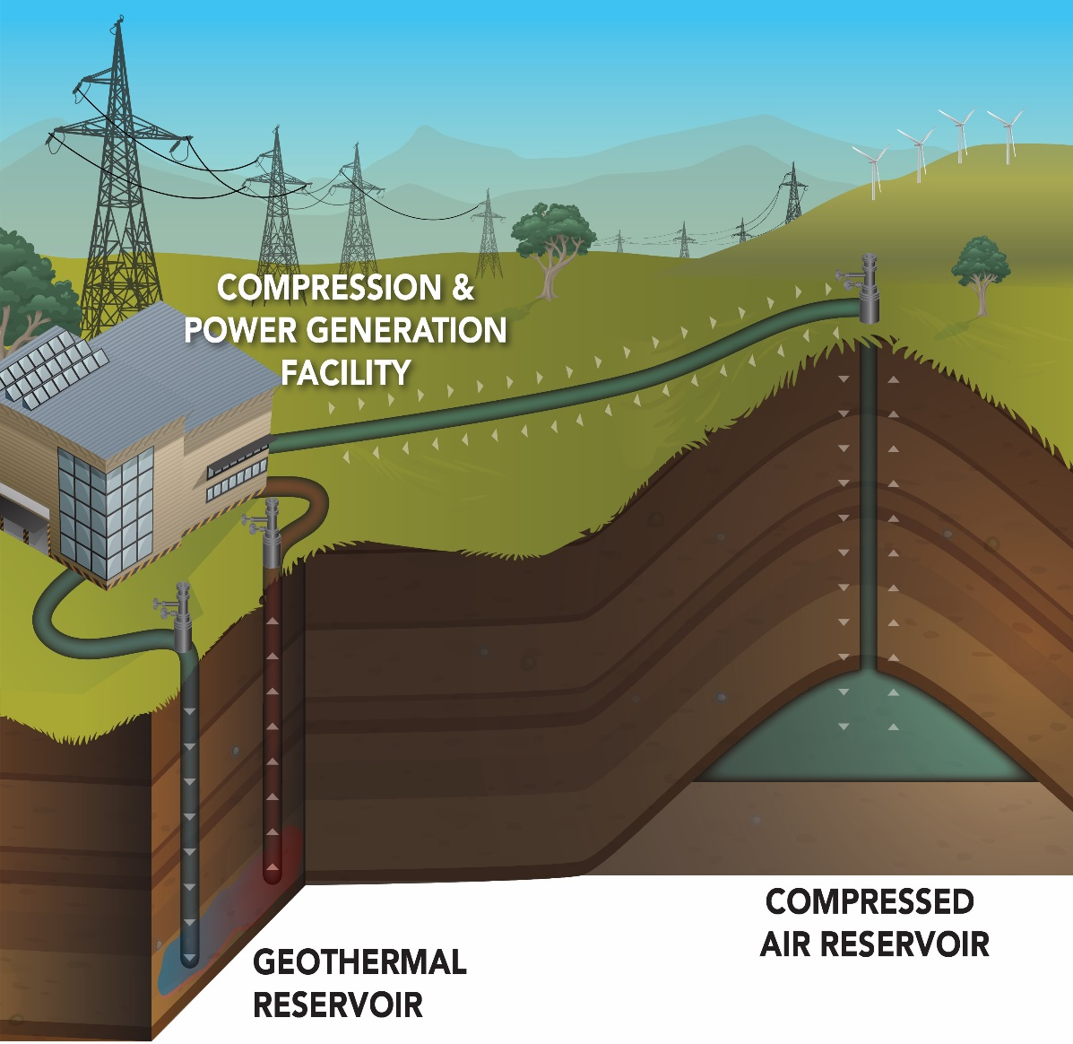
Compressed Air Energy Storage
a) A schematic cross-section demonstrating the concept of CAES within the porous Faludden sandstone reservoir beneath Gotland. b) A schematic of a CAES plant. The solid lines outline the main processes utilized in conventional CAES. The dotted lines indicate additional processes utilized in AA-CAES, where heat from the compression stage is stored and used later in the expansion stage, mitigating the need to utilize fuel for heating (Sopher et al, 2019 - modified by from Succar and Williams 2008)
Compressed air energy storage at Yakima Minerals site. Geothermal energy recovery from water ≥150°C is predicted at a depth of more than 3600 m. The storage reservoir is represented by thick sub-basalt sandstones with excellent permeability at a depth of more than 3000 m. (BP McGrail, USDOE, A. Shogenova, ENeRG NL29, 2014)

Slide 13
Energy saving: only advantages
The cheapest option, often money can be earned
Large potential: factor 2–4 savings
Reducing dependence on (imported) fuels
Reducing pollution
Suited to small and large-scale applications
However, in practice implementation is not always easy.
van Egmond et al, 2004

Slide 14
Solar energy Wind energy
Solar energy is the most abundant of all energy resources and can even be harnessed in cloudy weather. The rate at which solar energy is intercepted by the Earth is about 10,000 times greater than the rate at which humankind consumes energy.
Solar technologies can deliver heat, cooling, natural lighting, electricity, and fuels for a host of applications. Solar technologies convert sunlight into electrical energy either through photovoltaic panels or through mirrors that concentrate solar radiation.
Although not all countries are equally endowed with solar energy, a significant contribution to the energy mix from direct solar energy is possible for every country.
The cost of manufacturing solar panels has plummeted dramatically in the last decade, making them not only affordable but often the cheapest form of electricity. Solar panels have a lifespan of roughly 30 years and come in a variety of shades depending on the type of material used in manufacturing.
Wind energy harnesses the kinetic energy of moving air by using large wind turbines located on land (onshore) or in the sea- or freshwater (offshore).
Wind energy has been used for millennia, but onshore and offshore wind energy technologies have evolved over the last few years to maximize the electricity produced - with taller turbines and larger rotor diameters.
Though average wind speeds vary considerably by location, the world’s technical potential for wind energy exceeds global electricity production, and ample potential exists in most regions of the world to enable significant wind energy deployment.
Many parts of the world have strong wind speeds, but the best locations for generating wind power are sometimes remote ones.
Offshore wind power offers tremendous potential.
©Getty Images | Andriy Onufriyenko

Slide 15
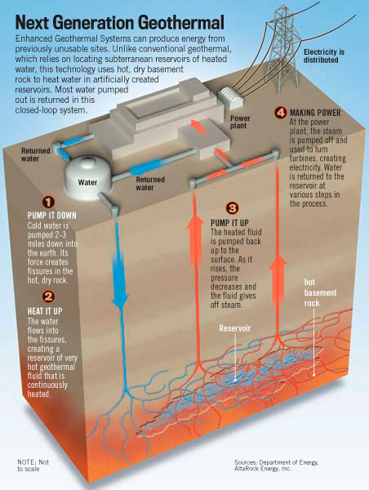
Geothermal energy
Geothermal energy is the only renewable and non-intermittent (in contrast to intermittent wind and solar energies) underground resource, which could be shallow, deep permeable aquifer reservoirs, hot springs, fumaroles, geysers, travertine deposits, chemically altered rocks and hot dry rocks.
Deep geothermal energy is not yet sustainable in many regions, being more expensive than produced from fossil fuel
Until recently, geothermal power systems have exploited only resources where naturally occurring heat, water, and rock permeability are sufficient to allow energy extraction.
Enhanced Geothermal System (EGS) is a relatively new type of geothermal power technology that does not require natural convective hydrothermal resources

Slide 16
Hydropower and Ocean energy
HYDROPOWER
Hydropower harnesses the energy of water moving from higher to lower elevations. It can be generated from reservoirs and rivers. Reservoir hydropower plants rely on stored water in a reservoir, while run-of-river hydropower plants harness energy from the available flow of the river.
Hydropower reservoirs often have multiple uses - providing drinking water, water for irrigation, flood and drought control, navigation services, as well as energy supply.
Hydropower currently is the largest source of renewable energy in the electricity sector. It relies on generally stable rainfall patterns and can be negatively impacted by climate-induced droughts or changes to ecosystems that impact rainfall patterns.
The infrastructure needed to create hydropower can also impact ecosystems in adverse ways.
For this reason, many consider small-scale hydro a more environmentally-friendly option, and especially suitable for communities in remote locations.
OCEAN ENERGY
Ocean energy derives from technologies that use the kinetic and thermal energy of seawater - waves or currents for instance - to produce electricity or heat.
Ocean energy systems are still at an early stage of development, with a number of prototype wave and tidal current devices being explored.
The theoretical potential for ocean energy easily exceeds present human energy requirements.

Slide 17
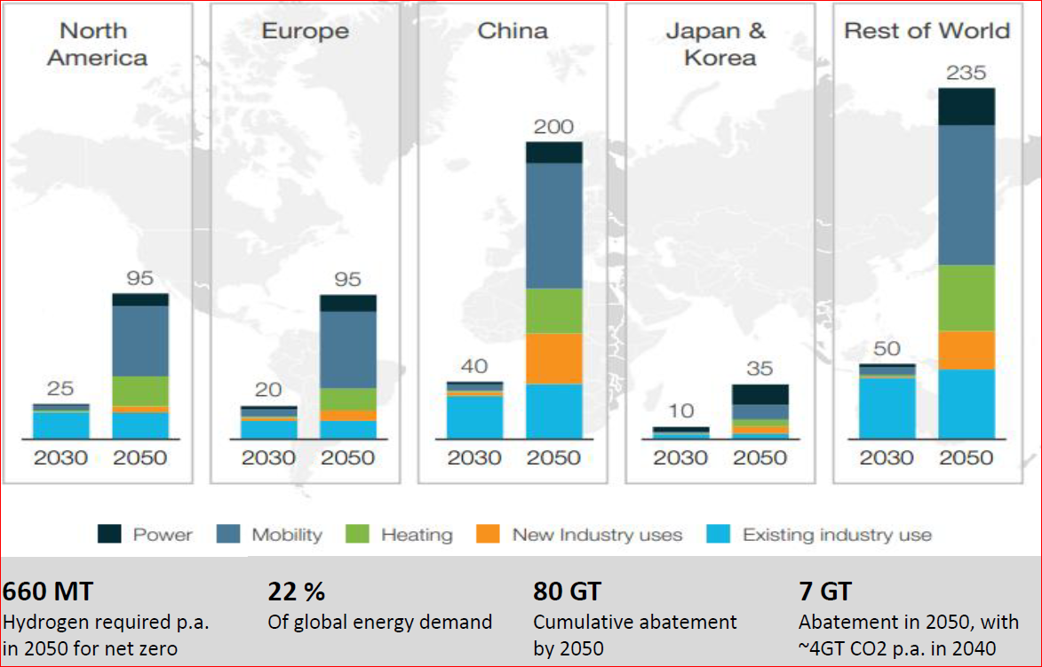
Introduction to H₂ energy production
(energy storage option)
Hydrogen has an important role in fighting global warming and reaching carbon neutrality by 2050.
In addition to others decarbonization technologies green and blue hydrogen (renewable and low carbon) offer the cost-effective option for deep decarbonization in sectors such as steel, maritime, aviation, and ammonia.
With annual potential of reducing 7 GT CO₂ in 2050, hydrogen can contribute 20% of the total abatement needed in 2050.
This requires the use of 660 million tons (Mt) of hydrogen in 2050, equivalent to 22% of global final energy demand
Source: Hydrogen Council, McKinsey & Company, 2021

Slide 18

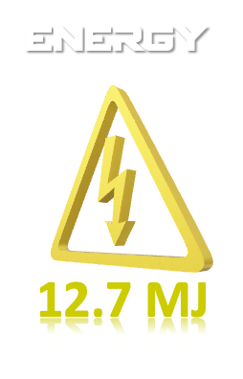
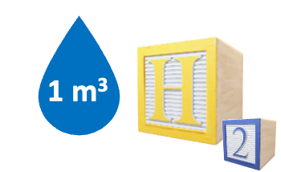


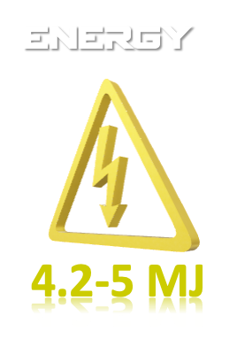
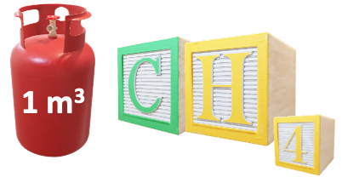
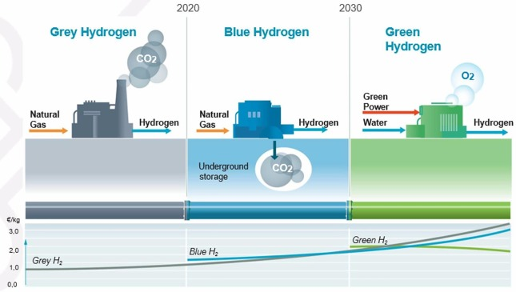

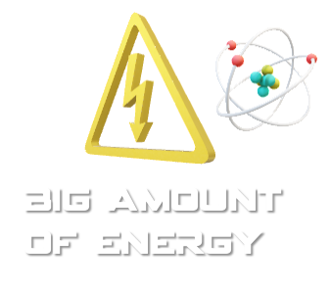


Introduction to H₂ energy production
(energy storage option)
H₂ produces about 3 times more energy than natural gas.
However, production of H₂ needs a lot of energy.
Considering that H₂ production requires more energy than it can provide, it is known as one of the energy storage options.
Large H₂ projects will need Underground Hydrogen Storage (UHS)
Source: Nasiru Salahu Muhammed, et al, 2022

Slide 19




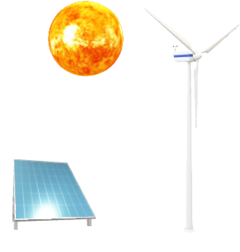


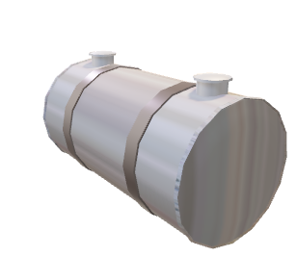




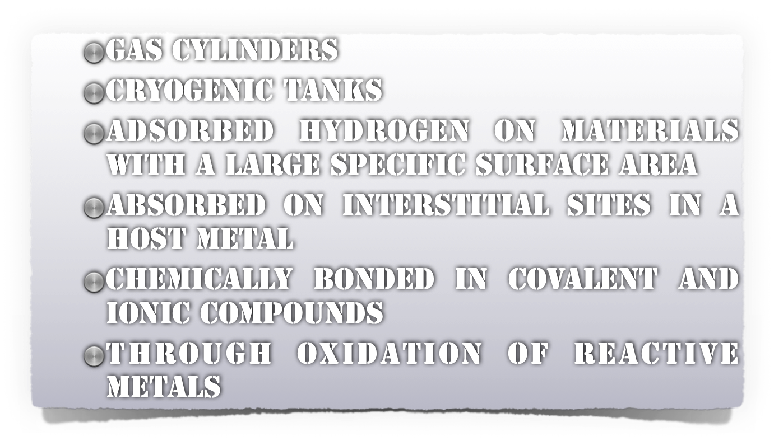
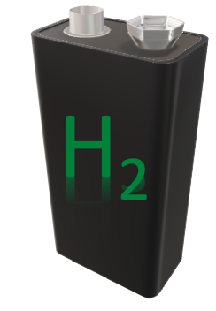
HYDROGEN STORAGE OPTIONS
Energy
storage
“Geological power-bank” (k.Shogenov)
H2 storage options
On the ground facilities
Underground storage (UHS)
Conventional:
Salt caverns
Saline aquifers
Depleted oil and gas fields
Unconventional:
excavated caverns in coal,
Igneous and metamorphic rocks

Slide 20
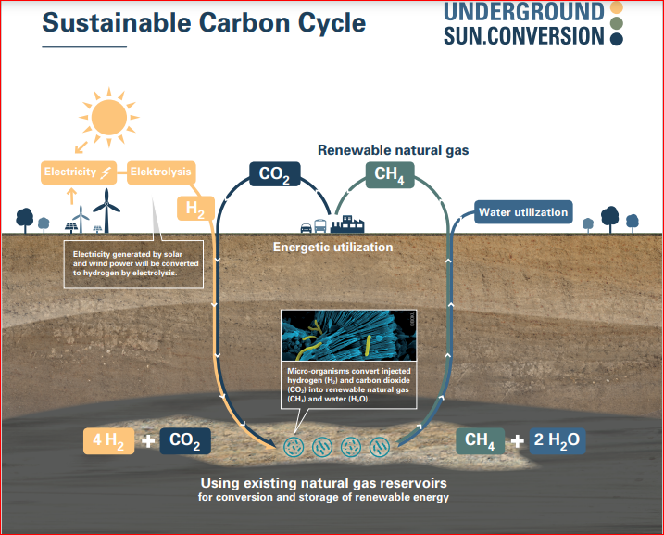
Underground Sun Storage (Austria)
First, hydrogen is produced from solar or wind power and water, in an above-ground facility, and then injected with carbon dioxide into an existing (porous) natural gas reservoir.
At a depth of over 1 km, in a relatively short time naturally occurring microorganisms convert these substances into renewable gas which can be stored in the same reservoir, withdrawn as needed at any time, and transported to consumers via the existing pipeline network.
The aim of the research project is to use existing gas (pore) reservoirs as natural bio-reactors.
The methanation process and storage take place naturally in underground pore reservoirs. This represents a huge source by potentially providing the urgently needed flexibility which renewable energy sources currently lack.
Initial laboratory tests conducted as part of the forerunner project, Underground Sun Storage – which is also supported by the Austrian Climate and Energy Fund – show that hydrogen and carbon dioxide injected into the reservoir are converted into methane by microbiological processes.
This enables the creation of a sustainable carbon cycle.
Advantages:
Carbon neutral
Renewable natural gas is carbon neutral if CO₂ that is already present – for example, from burning biomass – is utilised and absorbed by the production process. This creates a sustainable carbon cycle.
Renewable energy becomes storable
Solar and wind power output fluctuates due to changing weather conditions, meaning that production cannot be adjusted to demand. The problem of storing renewable energy is solved by converting it into renewable natural gas.
Use of existing infrastructure
Infrastructure already in place can be used for the natural production process, as well as for underground storage in natural gas reservoirs, and environmentally friendly transportation to consumers.

Slide 21
Comparison of the conventional H₂ storage options
Storage option | Storage capacity | Discharge rate | Initial cost | Cyclic cost | Seismic risk | Chemical conversion rate | Cushion gas requirement | Leakage risk | Usability
Caverns | Dependson cavern size | High | High | Low | Low | Low | Low (22-33%) | Low | Frequent
Aquifer | High | Low | Average | Average | High | High | High (up to 80%) | High | Seasonal
Depleted reservoirs | High | Average | Average | Average | Average | Average | Average (50-60%) | High | Seasonal
Modified after Visser, 2020 and Mohammed et al, 2022

Slide 22
Future prospects for underground H₂ storage
Hydrogen underground storage technology and cross-cutting issues are yet in their early development stages.
There are no unified and agreed requirements for storage site selection, storage capacity estimation and ISO standards for H₂ production and storage
Regulations for UHS are mostly not available
Social perception is not known (as very limited projects in the world)
Storage in Depleted Hydrocarbon Fields are not yet demonstrated
Storage in saline aquifers is known only for H₂ mixtures
A lot of experience could be gained from natural gas and CO₂ storage
For example, storage should be made only in saline aquifers (not in fresh aquifers). As CO₂ storage in Europe is not permitted in potable water columns and aquifers, similar regulations could be expected for H₂ storage.
Monitoring requirements should be also established and described in ISO standards.
ISO/TC 197 Hydrogen technologies are under development now.
Still, a lot of research is needed about possible risks for storage in sandstone and carbonate reservoirs: possible reaction of H₂ with sulphide minerals, and biological reaction, both can lead to loss of H₂.
The cost of energy and availability of excess green energy are critical issues for H₂ production and use.
The efficiency of H₂ production is still a great issue for researchers.
After the energy transition period in 2050-2070 many working UGS will be available for storage of CO₂, and/or H₂. The large available expertise is a promising issue for switching from CH₄ storage to H₂ storage, and to CO₂ storage, which still will be needed for industry.
Bio-CCS and DACCS are needed to implement negative emission scenarios.

Slide 23
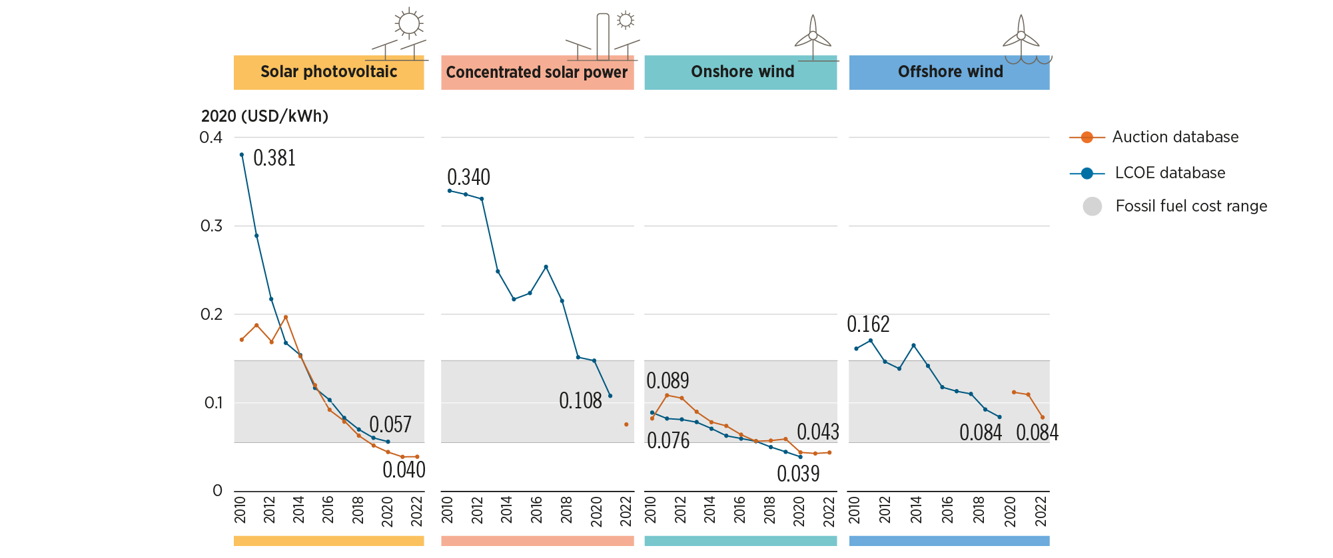
Advantages renewables
Diversifying energy carriers
Reducing dependence on imported fuels
Reducing pollution from conventional energy systems
Suited to small and large-scale applications
Disadvantages renewables
Technologies often capital intense
Costs are often not (yet) competitive
Diffuse energy source: spatial requirements
Environmental and social concerns (hydro, wind, biomass)
Intermittent character (wind, solar)
Latest Developments:
Significant decrease in RE technologies cost during 2010-2020:
The global weighted average levelised cost of electricity from utility-scale solar photovoltaic (PV) projects fell by 85%
concentrating solar power (CSP) by 68%
on-shore wind by 56%,
and off-shore wind by 48%
(IRENA 2022)
However, the 2021-2022 energy crisis negatively influenced all energy costs!

Slide 24
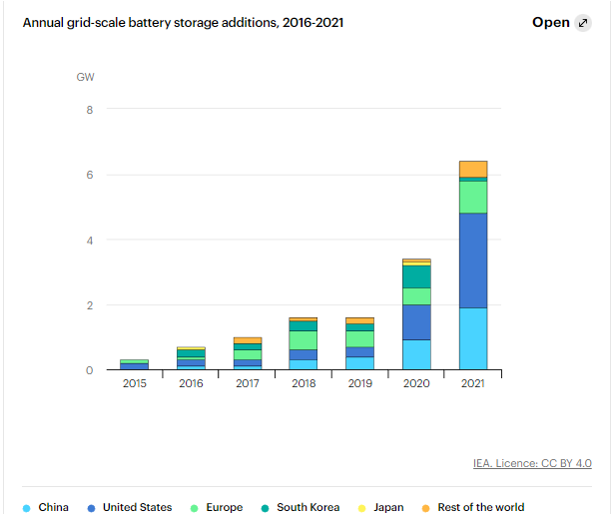
Key findings by IEA, 2022
Pumped-storage hydropower is still the most widely deployed storage technology today, but grid-scale batteries are catching up
Grid-scale storage plays an important role in the Net Zero Emissions by 2050 Scenario, providing important system services that range from short-term balancing and operating reserves to long-term energy storage and restoring grid operations following a blackout.
Pumped-storage hydropower is the most widely used storage technology and it has significant additional potential in several regions.
Batteries are the most scalable type of grid-scale storage and the market has seen strong growth in recent years.
Other storage technologies include compressed air and gravity storage, but they play a comparatively small role in current power systems.
IEA, Annual grid-scale battery storage additions, 2016-2021, IEA, Paris https://www.iea.org/data-and-statistics/charts/annual-grid-scale-battery-storage-additions-2016-2021, IEA. Licence: CC BY 4.0

Slide 25
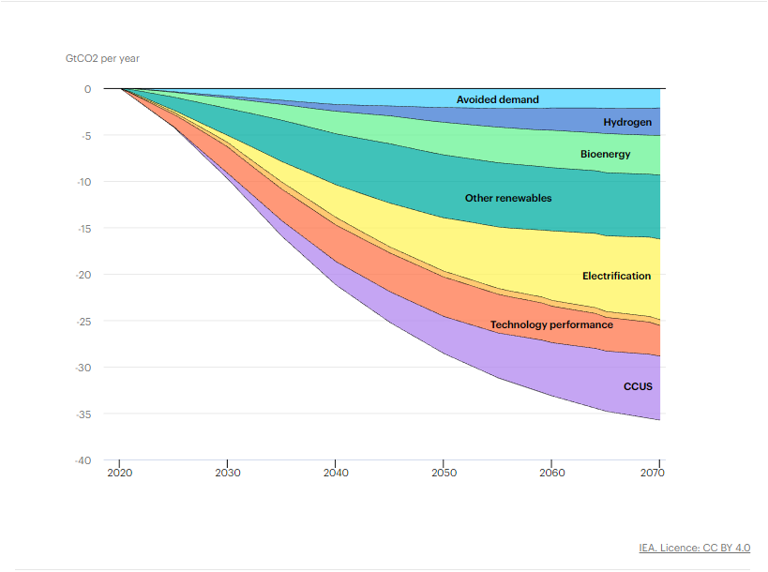
Energy transformations for net-zero emissions (IEA, 2020)
An energy sector transition to net-zero CO₂ emissions by 2070 of the kind depicted in the Sustainable Development Scenario requires a radical technological transformation of the energy sector.
Energy efficiency and renewables are central pillars, but additional technologies are needed to achieve net-zero emissions.
Four technology value chains contribute about half of the cumulative CO₂ savings: technologies to widely electrify end-use sectors (such as advanced batteries); carbon capture, utilisation and storage (CCUS); hydrogen and hydrogen-related fuels; and bioenergy.
IEA (2020), Energy Technology Perspectives 2020, IEA, Paris https://www.iea.org/reports/energy-technology-perspectives-2020, License: CC BY 4.0

Slide 26
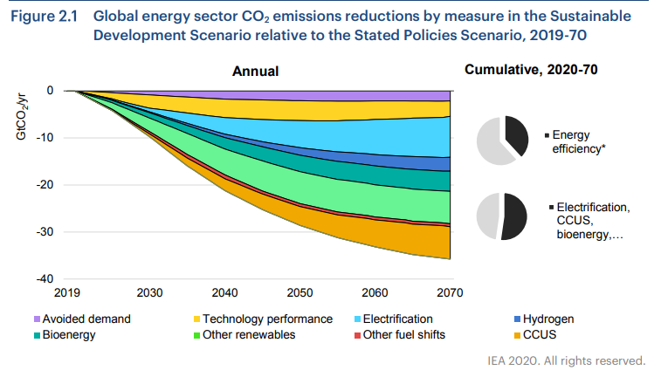
CCUS in the Sustainable Development Scenario
In total, CCUS contributes nearly 15% of the cumulative reduction in CO₂ emissions worldwide compared with the Stated Policies Scenario, which takes into account current national energy- and climate-related policy commitments.
The contribution of CCUS to the transition to net-zero emissions grows over time, accounting for nearly one-sixth of cumulative emissions reductions to 2070.
Energy Technology Perspectives 2020, Special Report on Carbon Capture, Utilisation and Storage, IEA 2020, https://www.iea.org/reports/ccus-in-clean-energy-transitions

Slide 27
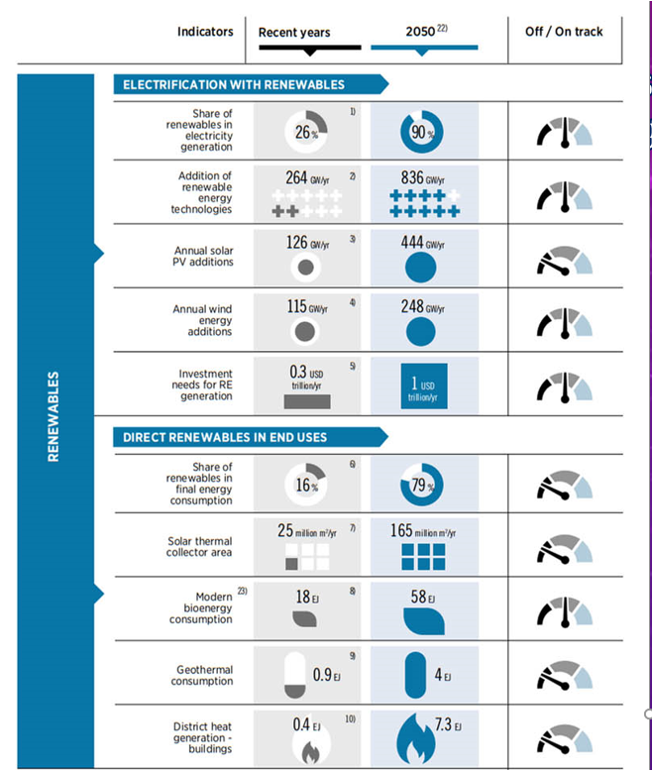
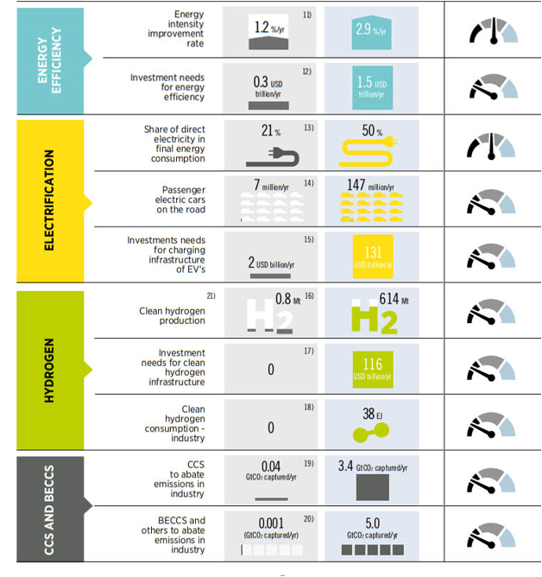
A roadmap to 2050 – tracking progress of key energy system components to achieve the 1.5°C target (IRENA, 2022)

Slide 28
Conclusions
Energy efficiency and renewables are key technologies needed to reach climate targets, but additional technologies are needed to achieve net-zero emissions.
Energy Storage as one of the energy efficiency technology needs to increase investments 5 times and improve 2.5 times intensity rate by 2050 compared to recent years
Clean hydrogen production should increase from 0.8 Mt to 614 Mt by 2050
CCS should increase from 0.04 Gt captured/year to 3.4 Gt/year by 2050.

Slide 29
Thank You!
www.shogenergy.eu
Social MEDIA
WWW.EU

