Slide 1
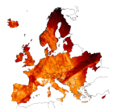
This workshop is dedicated in the memory of our colleague from the Czech Geological Survey
Vit Hladik

Slide 2
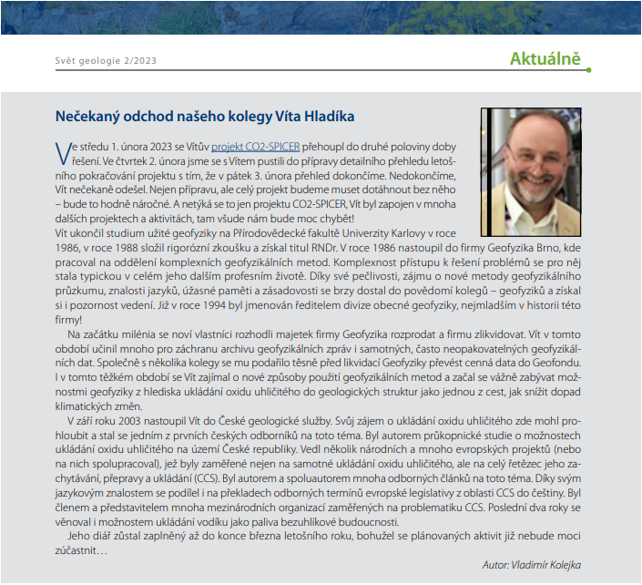
Great loss in the ENeRG family
On 3rd February 2023 we lost Vit Hladik, our
great colleague and friend
We cooperated during 20 years:
in the ENeRG network
in international projects
in CO2 GeoNet, COST Actions, etc, etc…
We were co-authors of unique publications and reports
We spent together nice evenings after the condensed working days at conferences, workshops and meetings, at concerts, in small restaurants or just investigating new historical sites and castles during excursions between or after these events

Slide 3
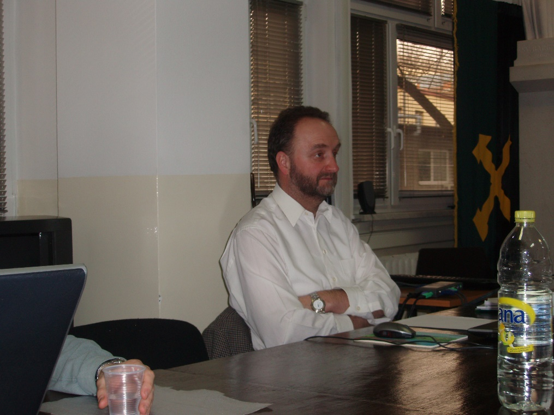
Vit Hladik background
Vit had MSc degree in applied geophysics from Charles University in Prague
Master in Business Administration from Nottingham Trent University / Brno Business School
In 1994-2003 he was working as a Division Manager in Geofyzika, Brno and
Since 2003 in Czech Geological Survey (Brno Division) as a Senior project manager.

Slide 4
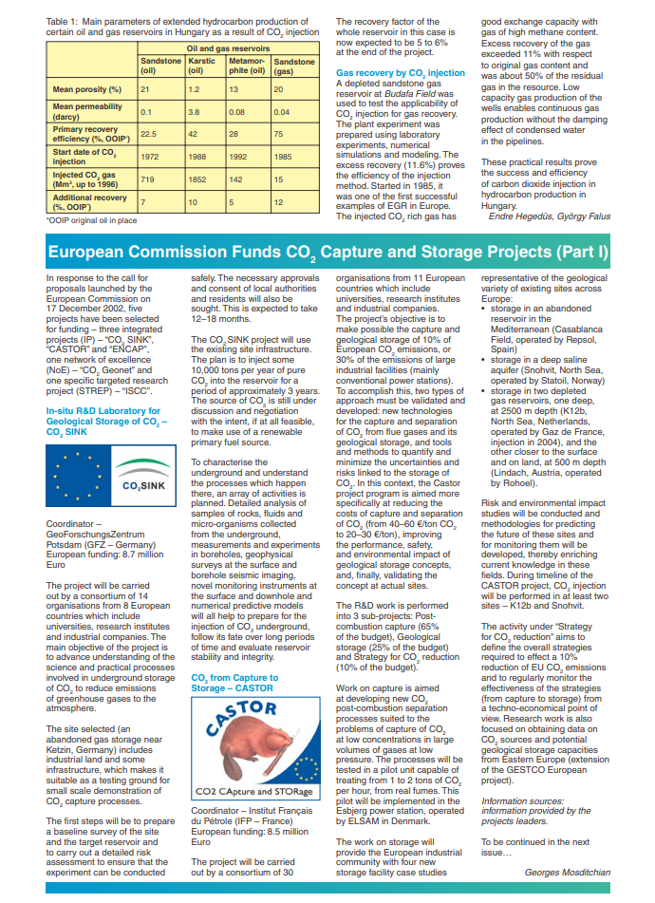
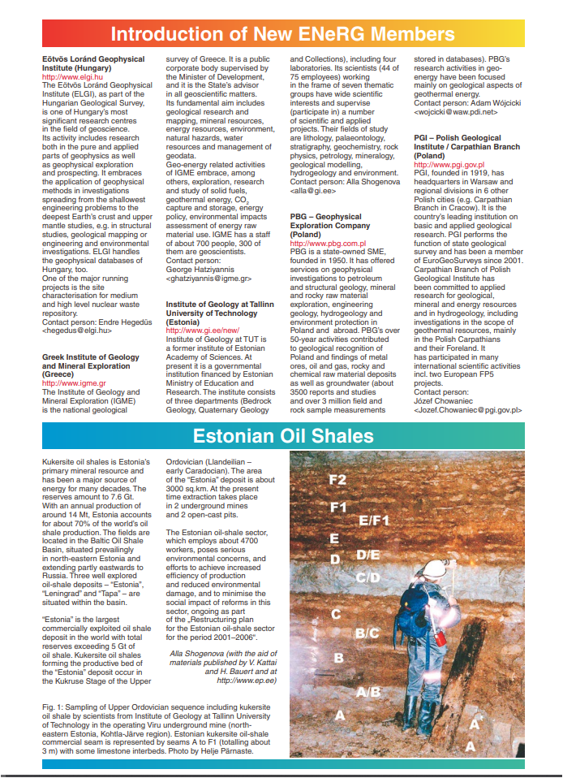
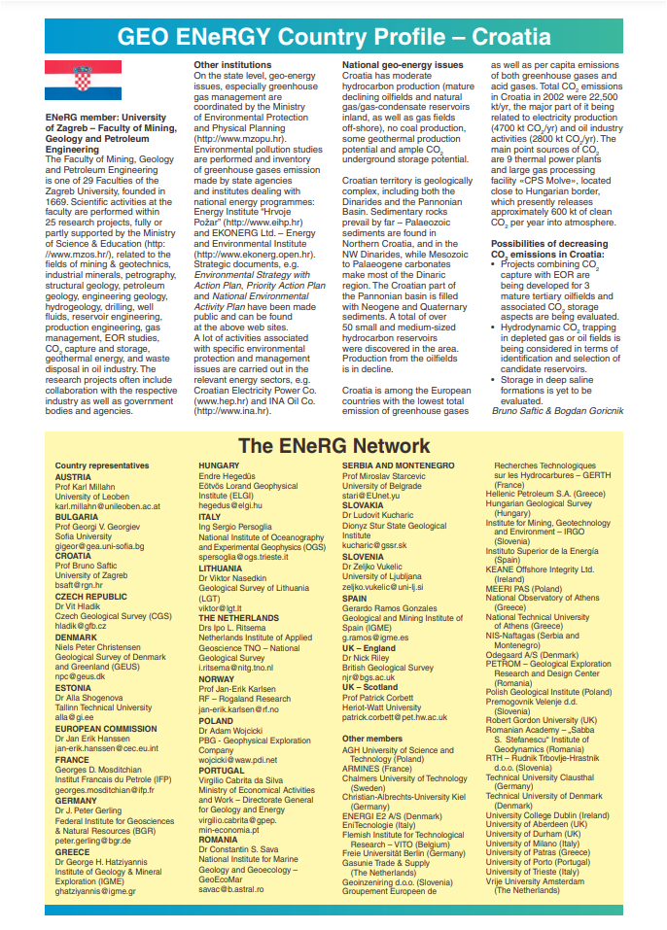
Vit Hladik in
Vit represented the Czech Republic as a Steering Committee member in ENeRG since 2002
He was in charge of the GEO ENeRGY newsletter of ENeRG from 2004-2011
Vit worked as an editor of the ENeRG website from 2012-2017
First Newsletter produced by Vit
in 2004

Slide 5
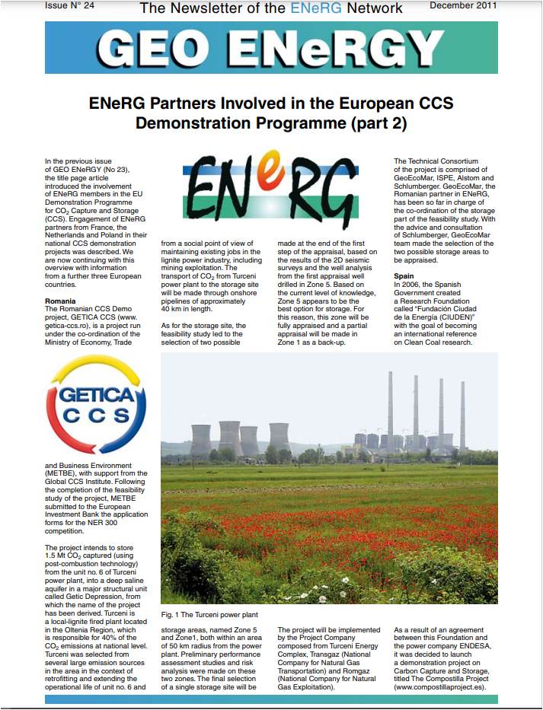
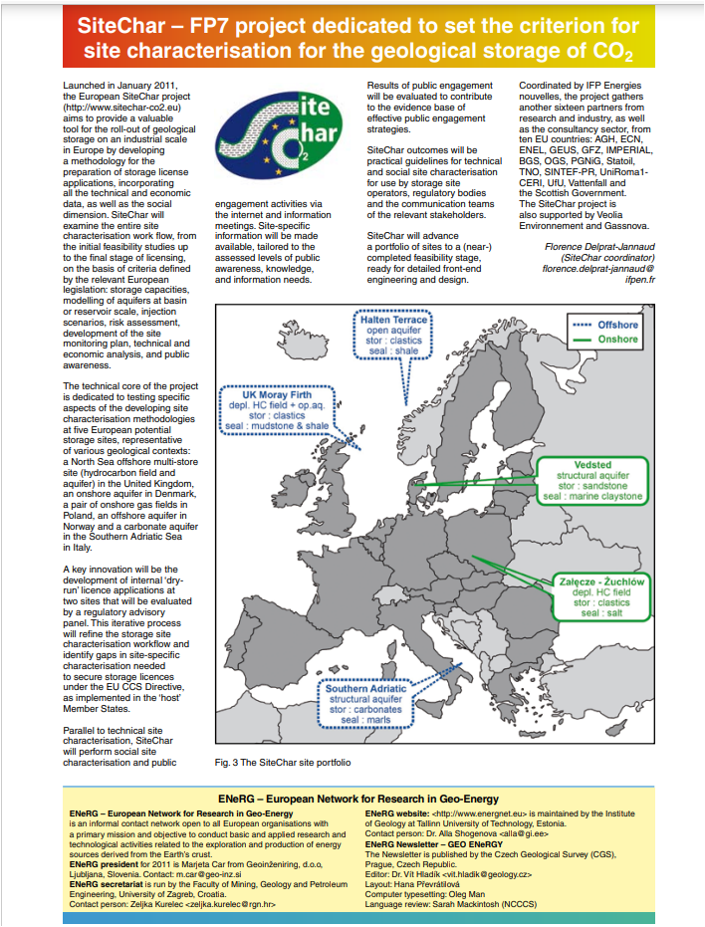
Vit Hladik in
Vit represented the Czech Republic as a Steering Committee member in ENeRG since 2002
He was in charge of the GEO ENeRGY newsletter of ENeRG from 2004-2011, and worked as an editor of the ENeRG website from 2012-2017
Last Newsletter produced by Vit
in 2011

Slide 6
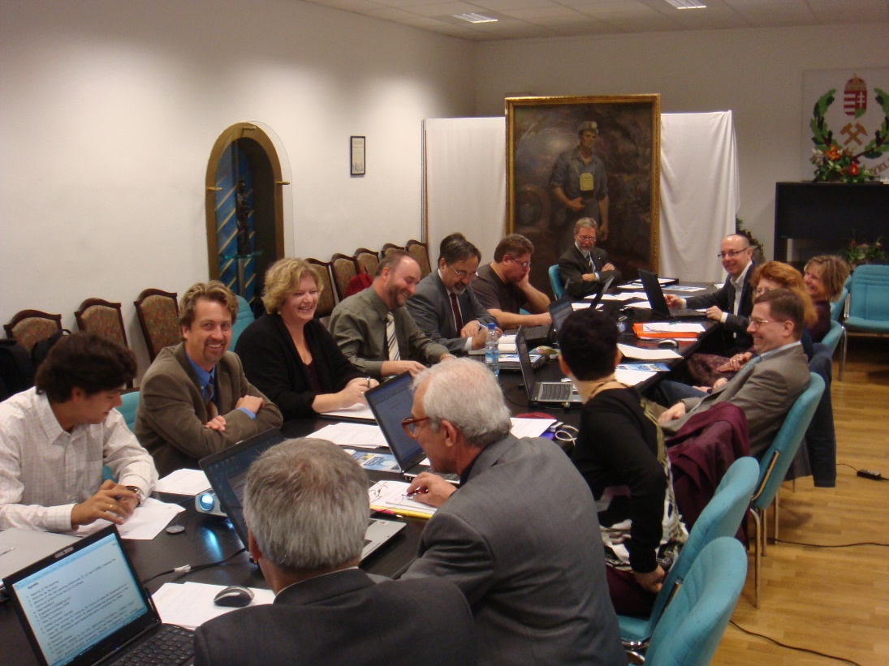
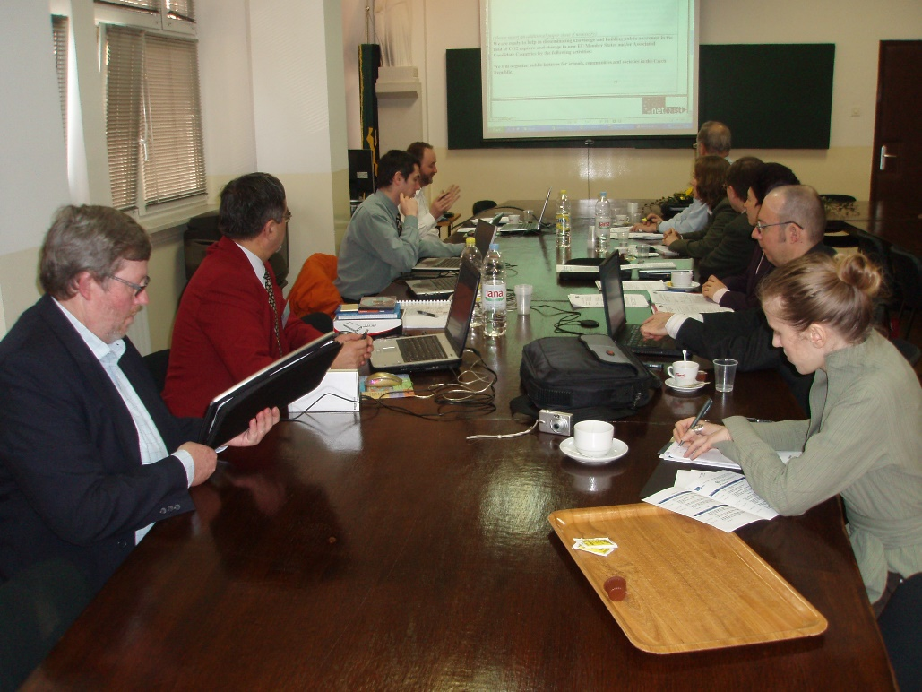
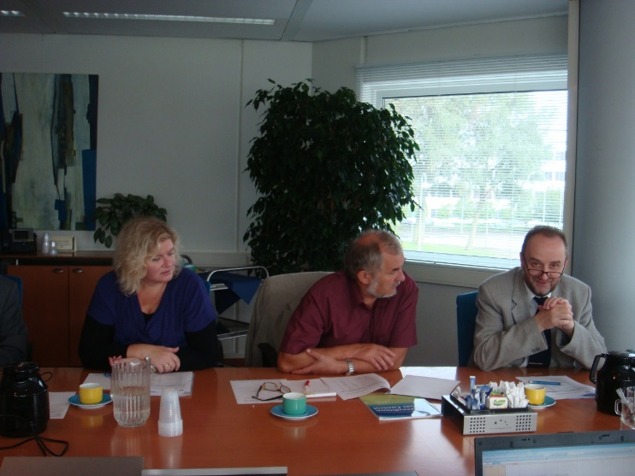
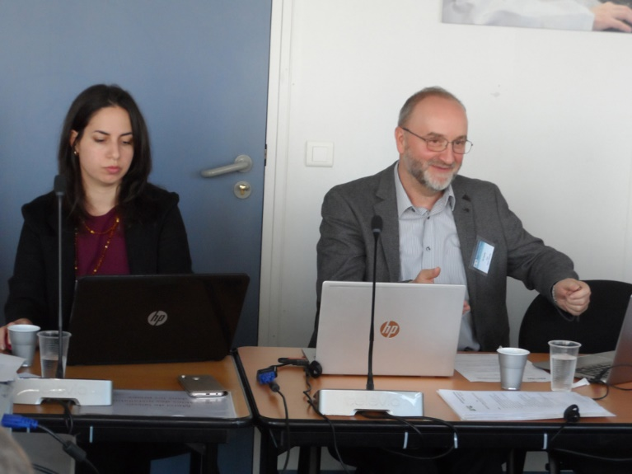
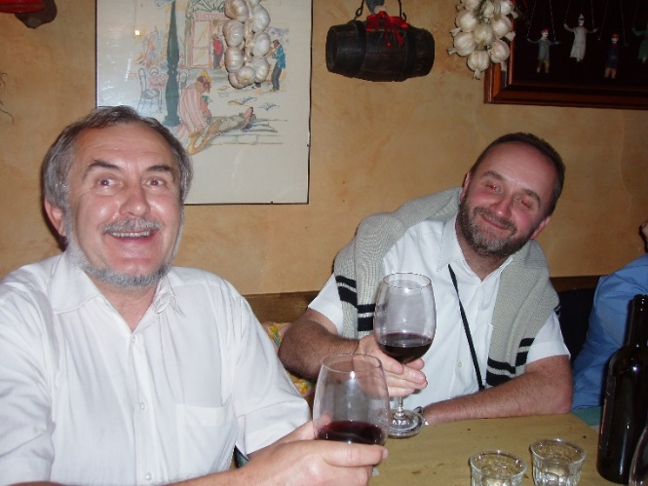
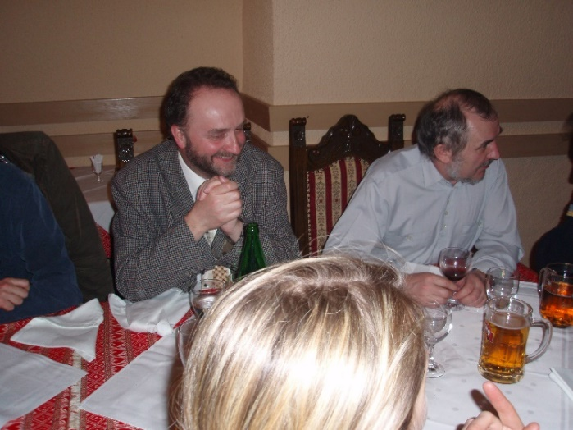
Vit Hladik in
Vit represented the Czech Republic as a Steering Committee member in ENeRG since 2002.
He was the ENeRG president for 2018-2019, when he organized, together with BRGM, the First European Underground Energy Storage (UES) Workshop in Paris.

Slide 7
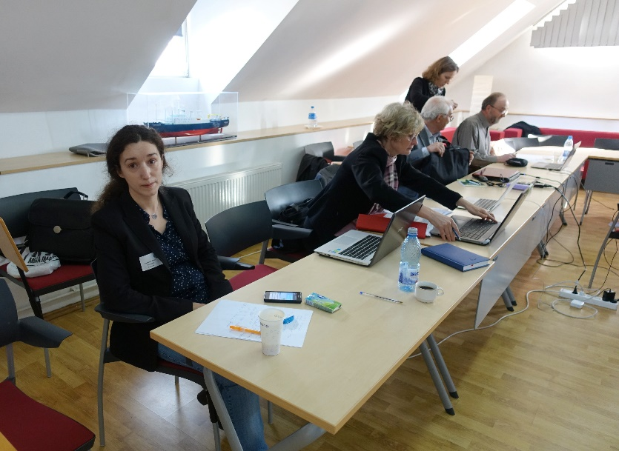
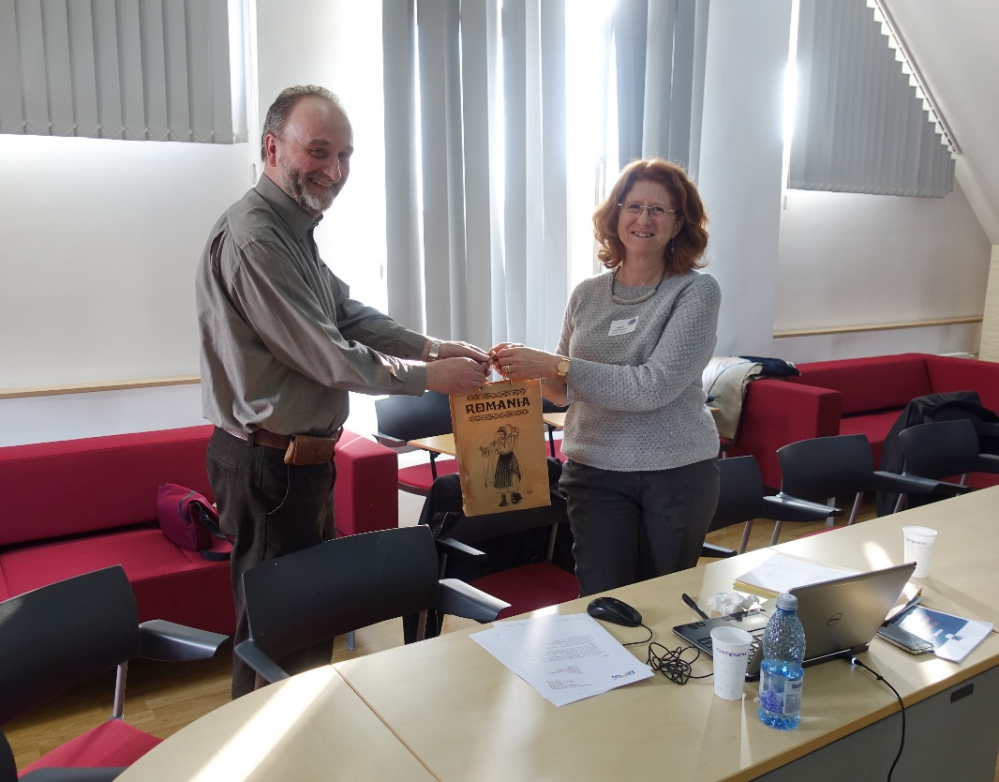
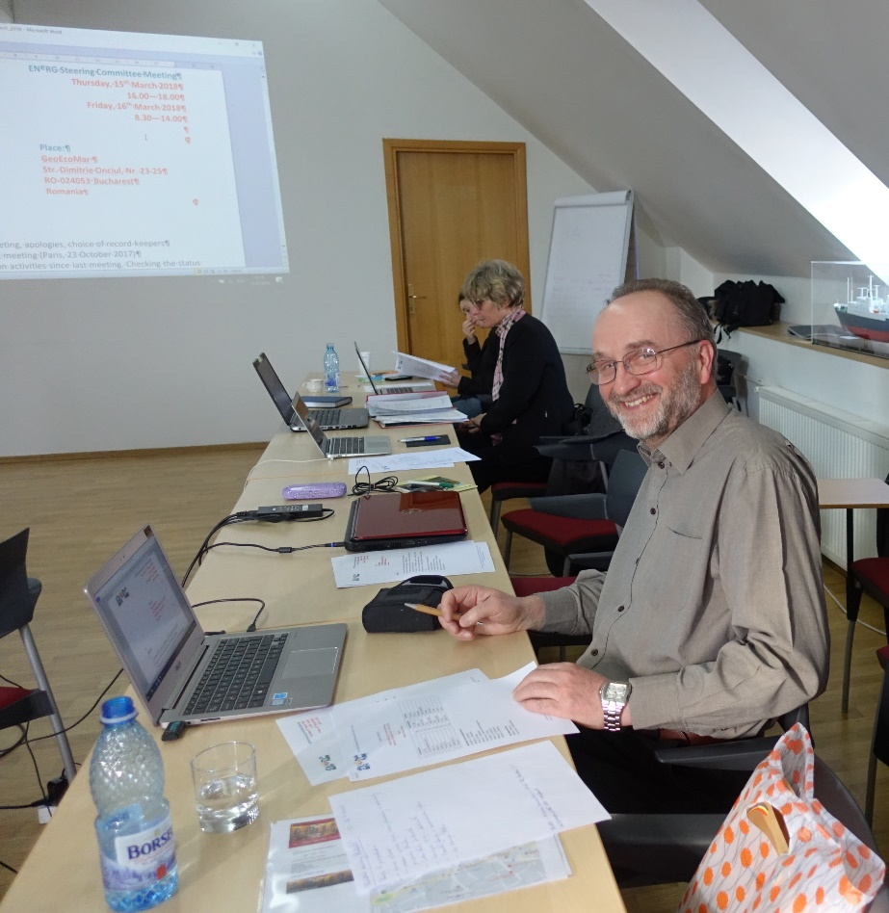
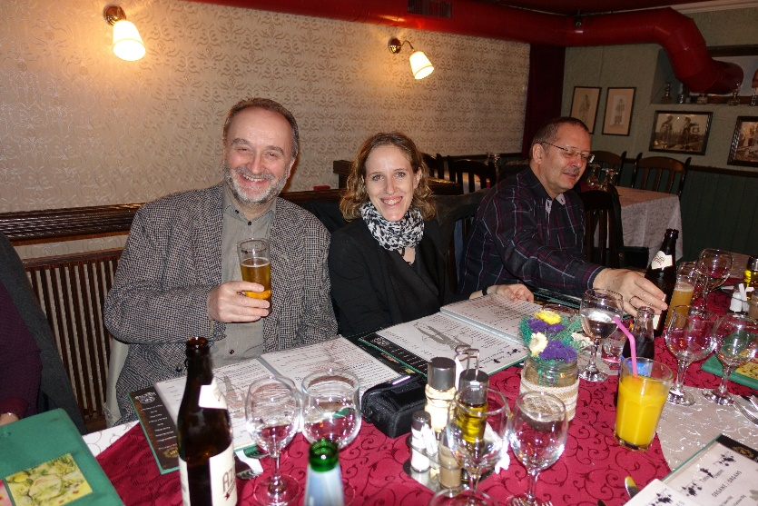
ENeRG Presidency
ENERG meeting in Bucharest 2018

Slide 8
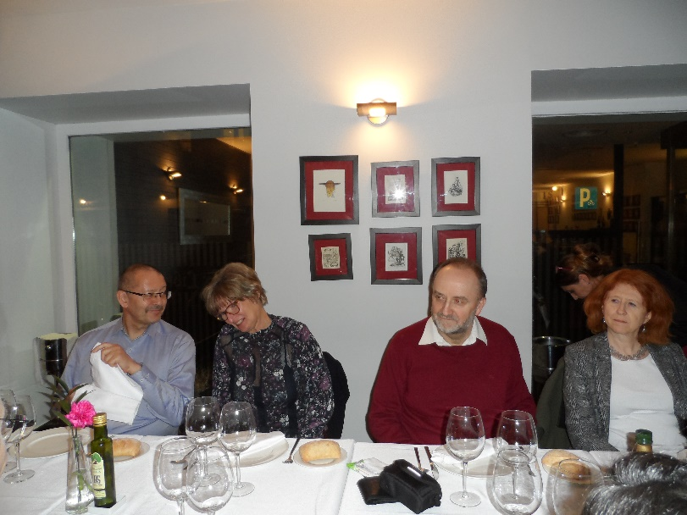
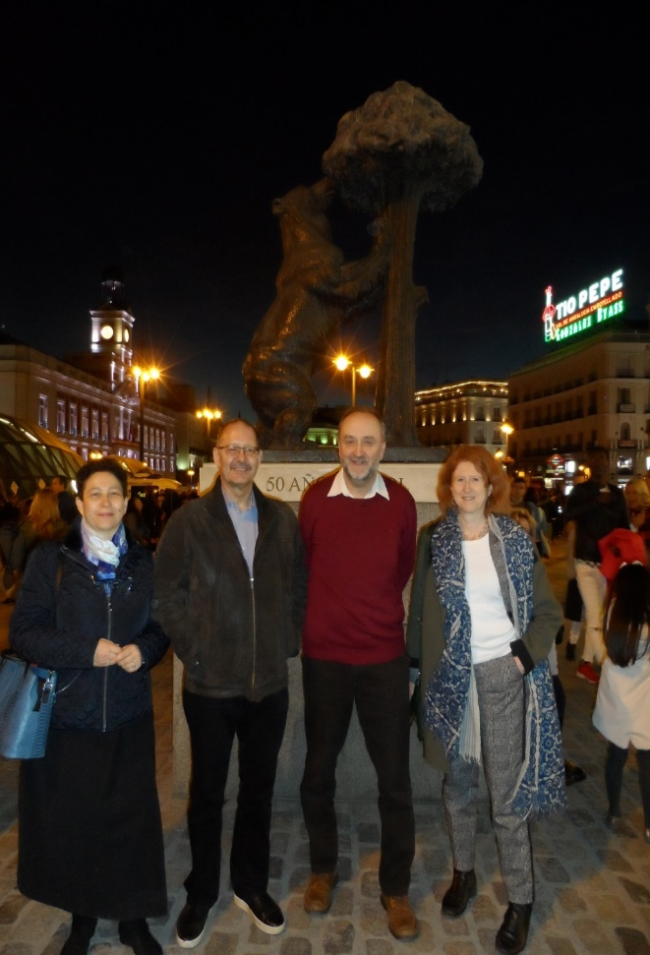
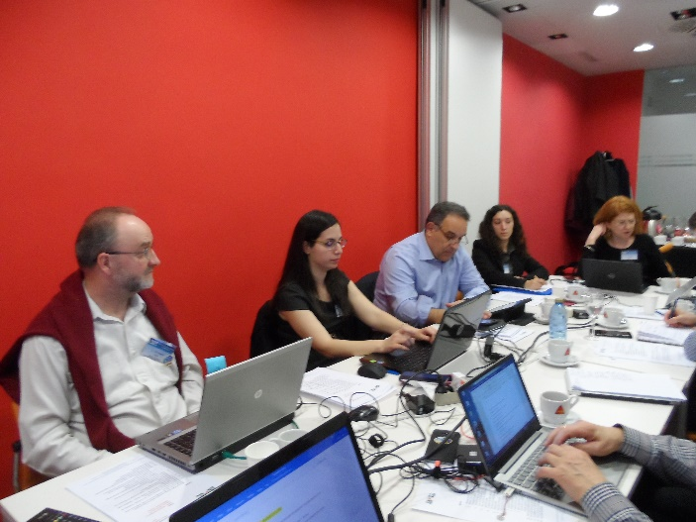
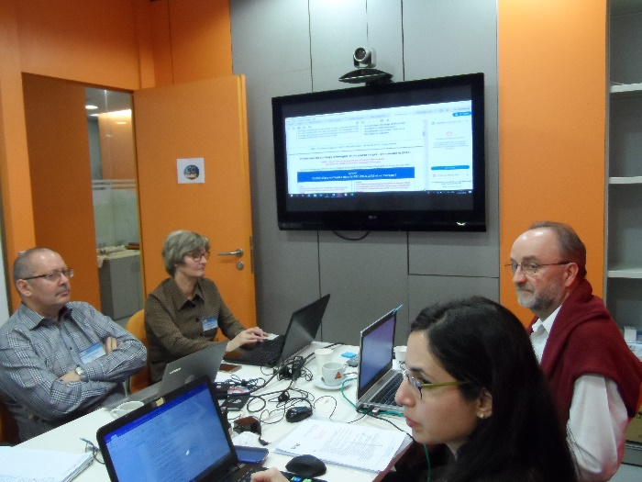
ENeRG Presidency 2019
Vit was the ENeRG president for 2018-2019, when he organized, together with BRGM, the First European Underground Energy Storage (UES) Workshop in Paris.
ENeRG Meeting in Madrid, March, 2019

Slide 9
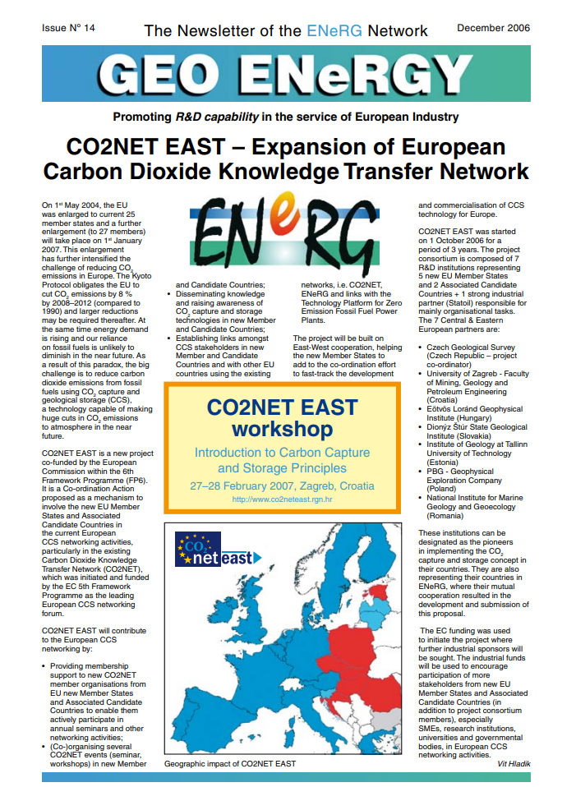
Project Coordinator EU Project: CO2NetEast 2006-2009
CO2 capture and storage networking extension to new member states (Coordinator Vit Hladik, CGS)
European Union, FP6 No. FP6-038946
CO2NET EAST is a coordination action co-funded by the EC within the 6th Framework Programme for research, technological development and demonstration activities.
The main goal of the project is to extend the existing European CO2 capture and storage (CCS) networking activities to new EU Member States and Associated Candidate Countries.

Slide 10
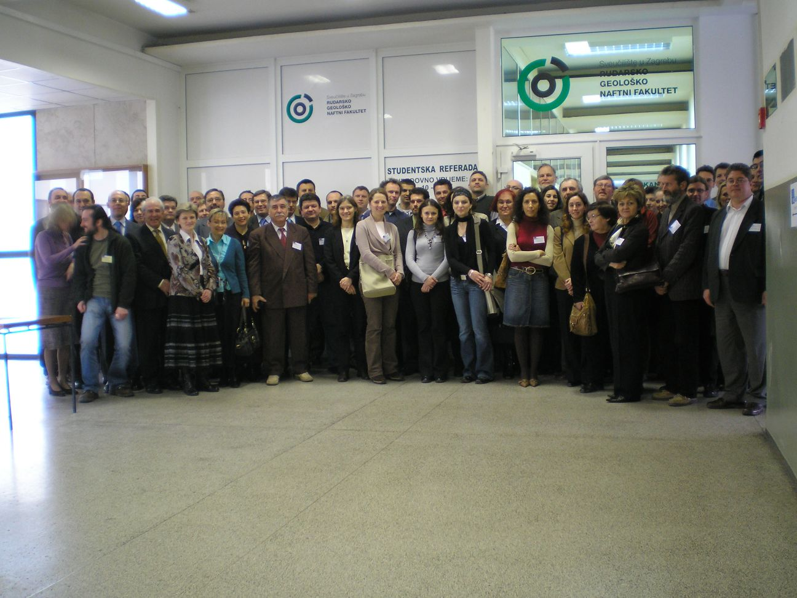
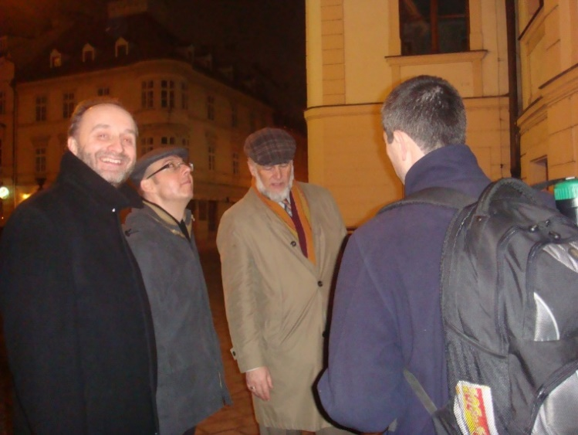
Project Coordinator EU Project: CO₂NetEast
Zagreb - 2007
Warsaw - 2008

Slide 11
Project Coordinator EU Project: CO₂NetEast
Lisbon, 2007, CO2netesat at CO2Net Conference

Slide 12
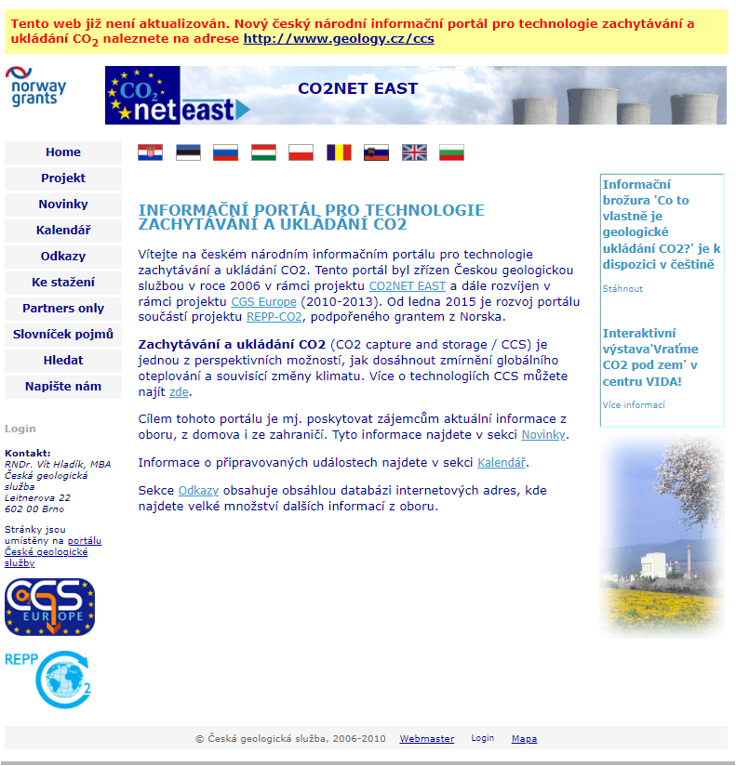
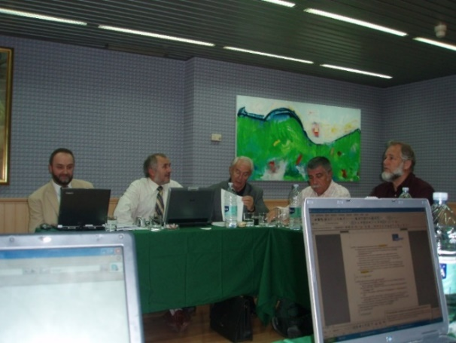
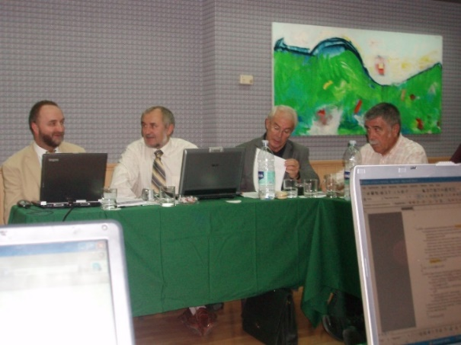
Project Coordinator EU Project: CO₂NetEast

Slide 13
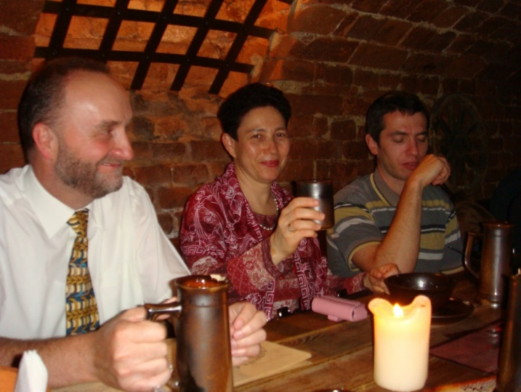
CO₂NetEast in Brno, CGS

Slide 14
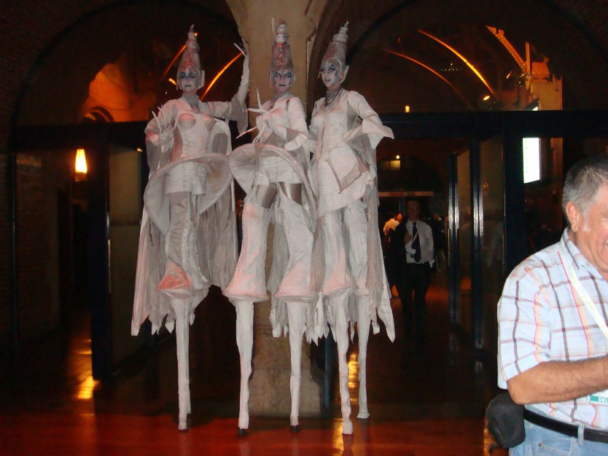
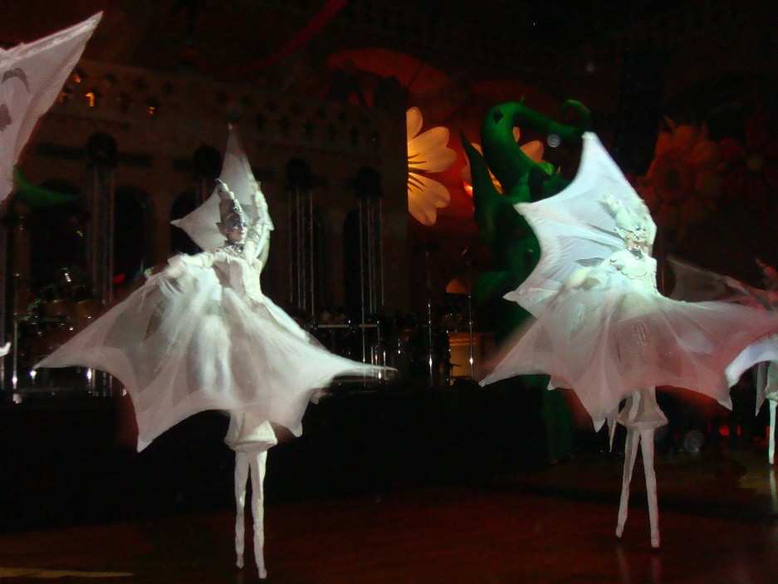
Amsterdam 2010 – Last year of CO2NetEast
GHGT10 Conference in Amsterdam, 19-23 September 2010
Alla, Vit and my colleagues from TalTech

Slide 15
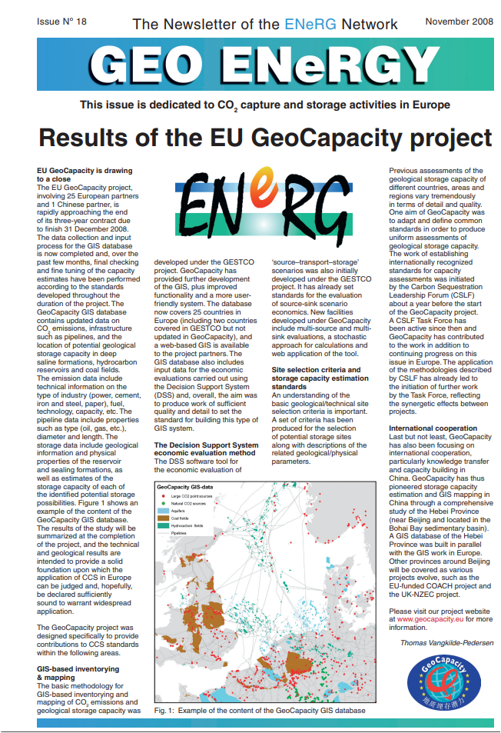
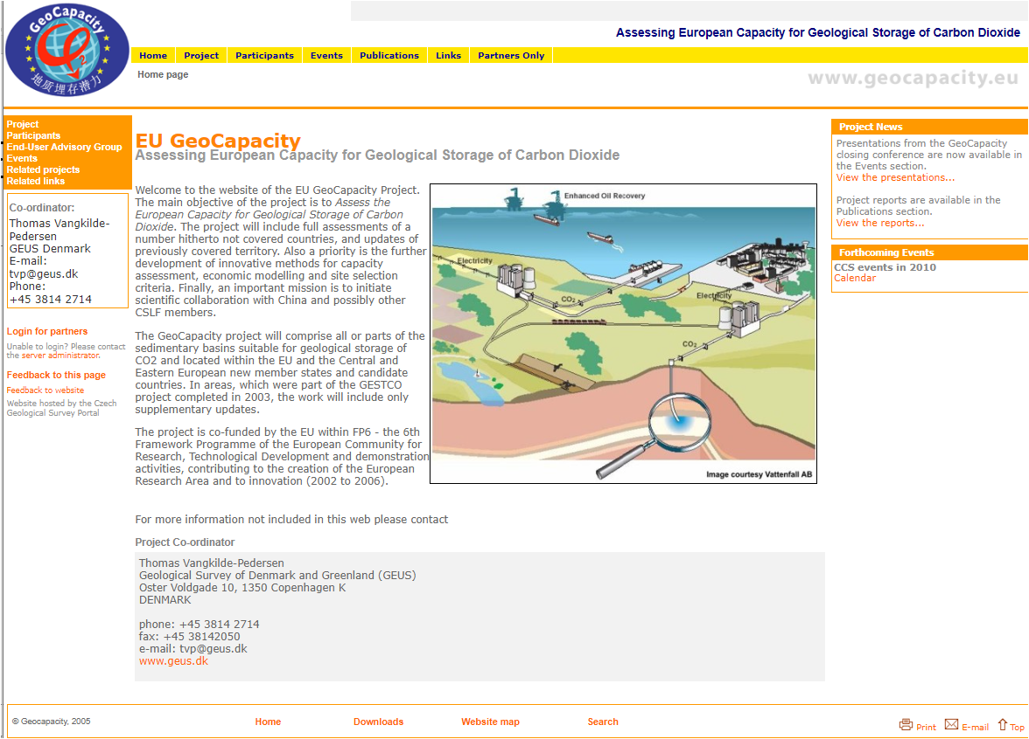
FP6 Project - EU GeoCapacity

Slide 16
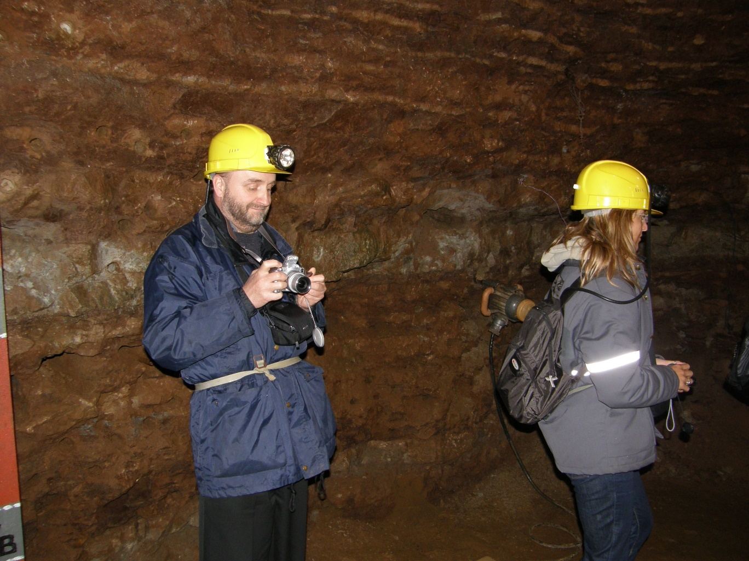
EU GeoCapacity
Estonia, 2008, Excursion to the oil shale mining museum
Spoletto, 2007

Slide 17
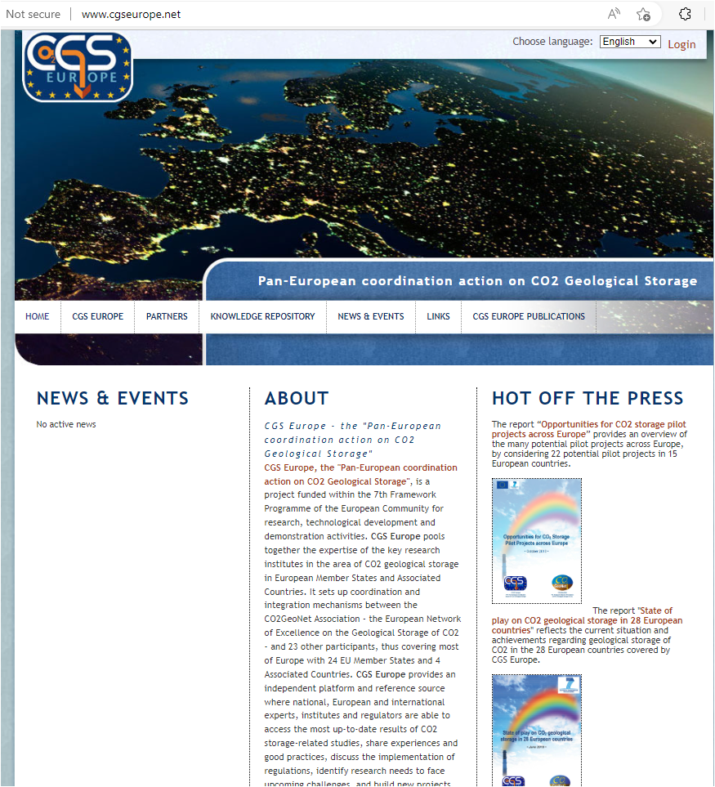

Slide 18
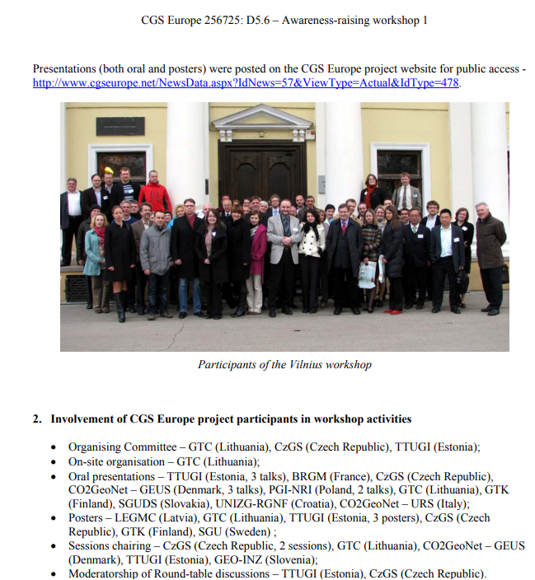
CGS Europe Awareness-raising workshop in Vilnius CO2 Capture and Storage - Response to Climate Change" Vilnius, Lithuania, 13-14 April 2011
The structure of 70 represented stakeholders was:
industry (19 participants),
research institutions (43 participants),
ministries (6 participants),
international agencies (2 participants)
ZEP platform (1 participant).
In addition to the oral presentation, a general poster session was organised as well. Altogether, 29 oral presentations and 16 posters were presented during 2 days

Slide 19
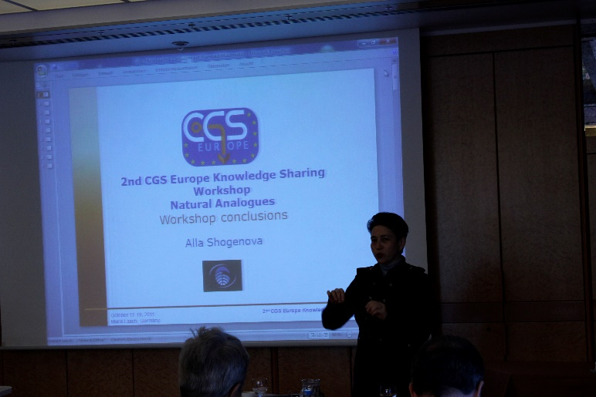
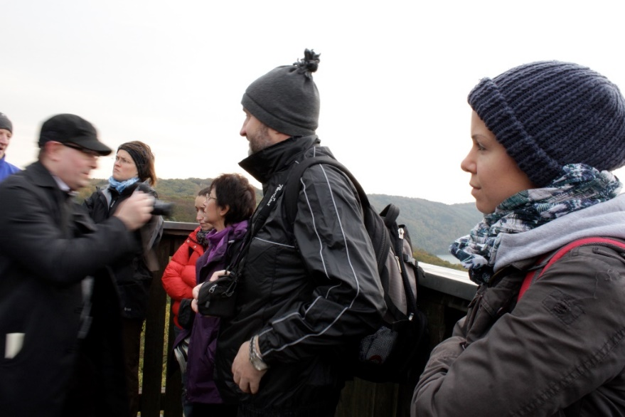
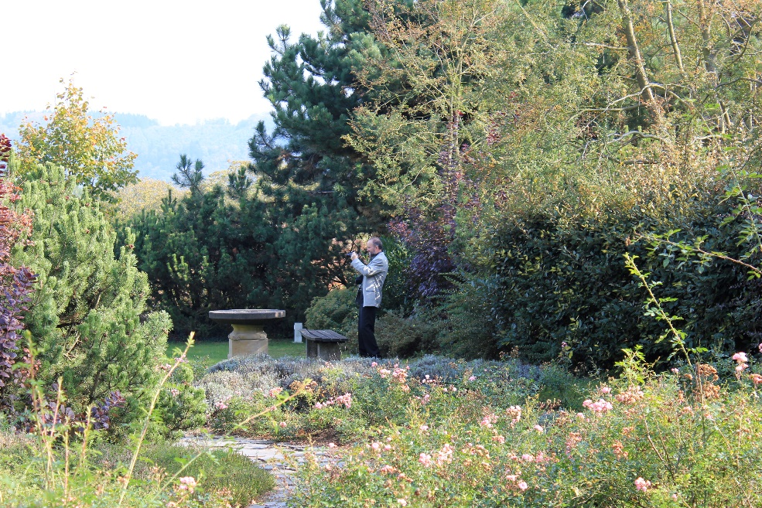
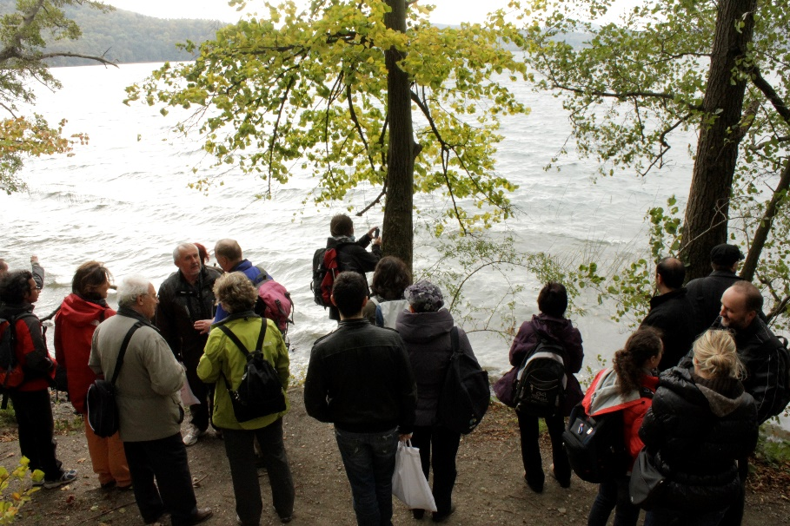
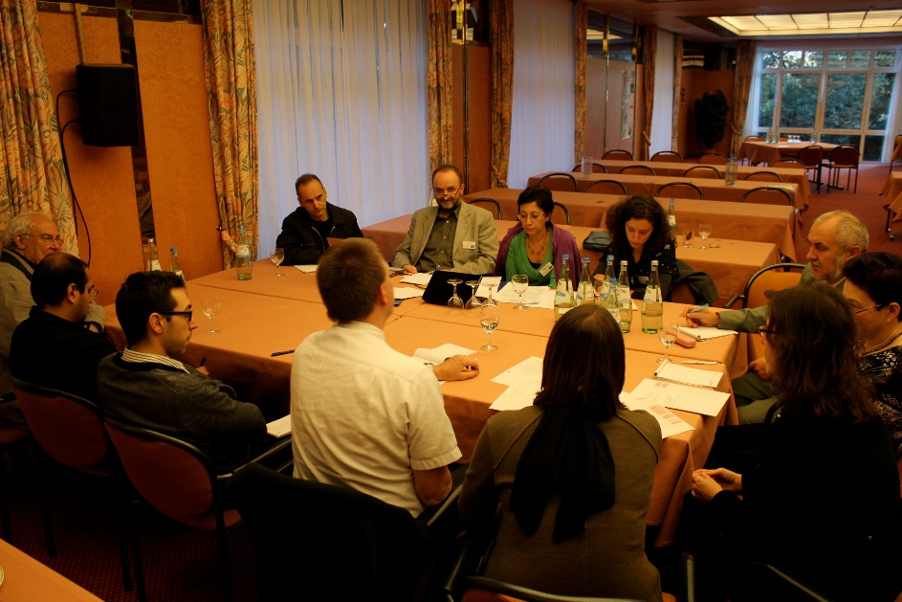
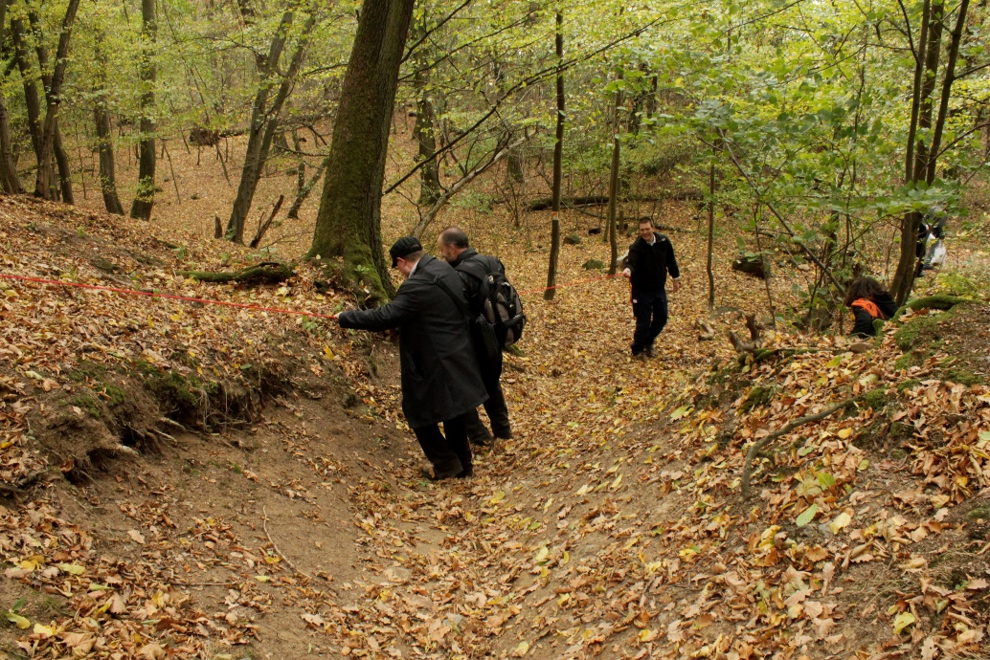
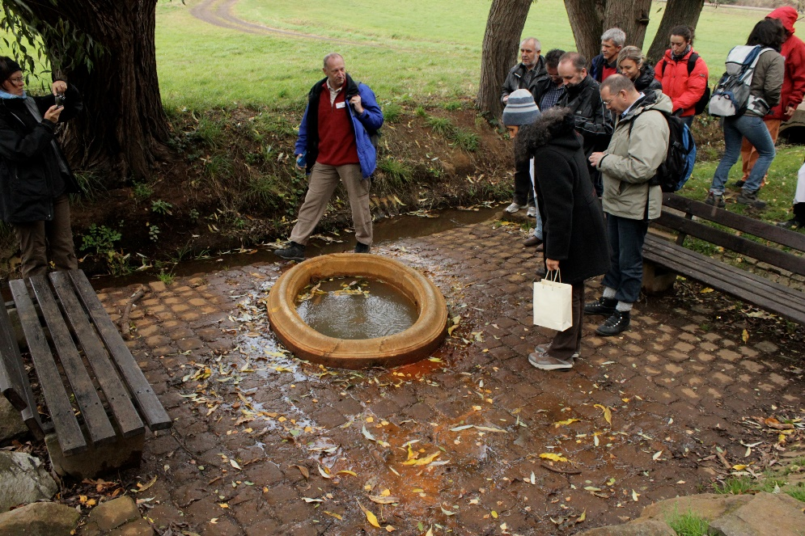
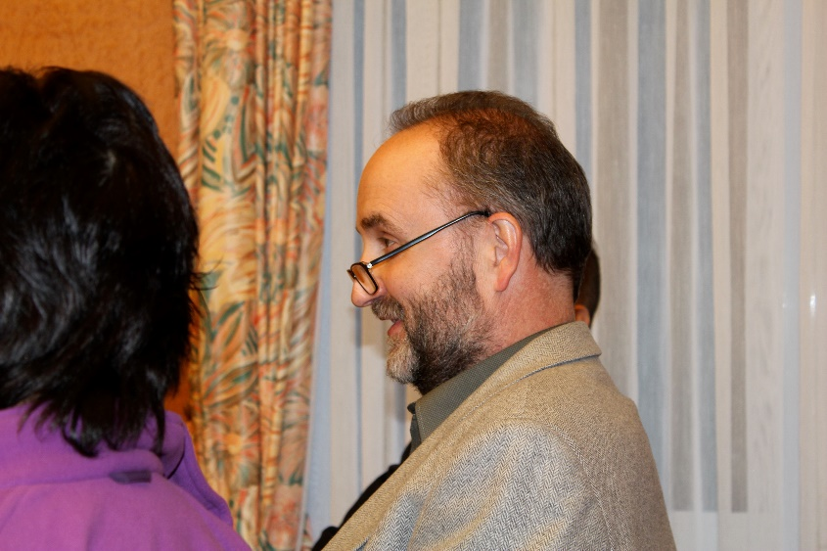
2nd CGS Europe Knowledge Sharing Workshop “Natural Analogues”
Maria Laach, Germany, Monday 17th - Wednesday 19th October 2011

Slide 20
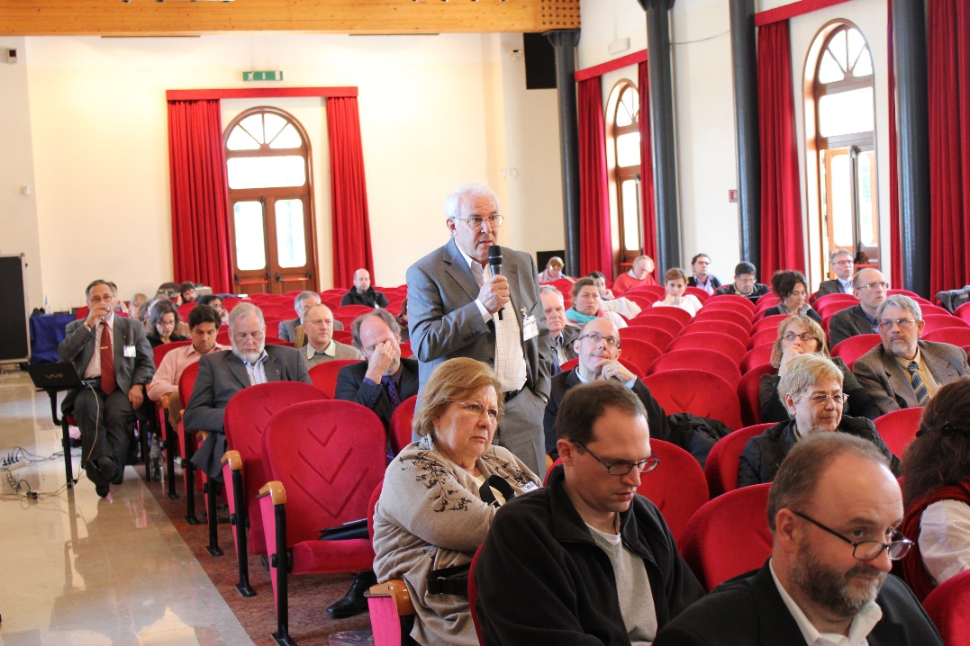
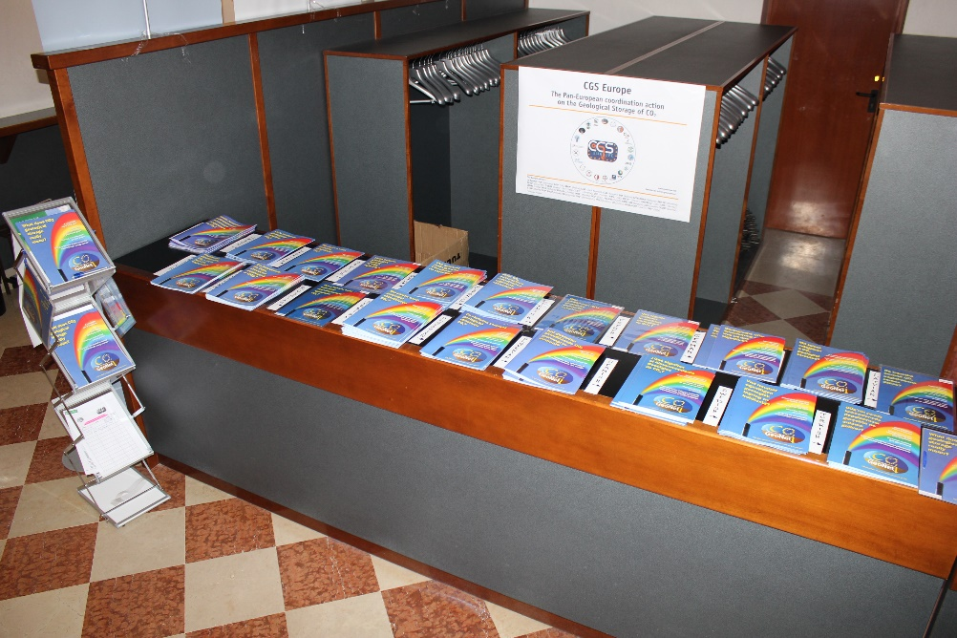
CGS Europe, Venice, Open Forum
CGS Europe, Venice, April 2012

Slide 21
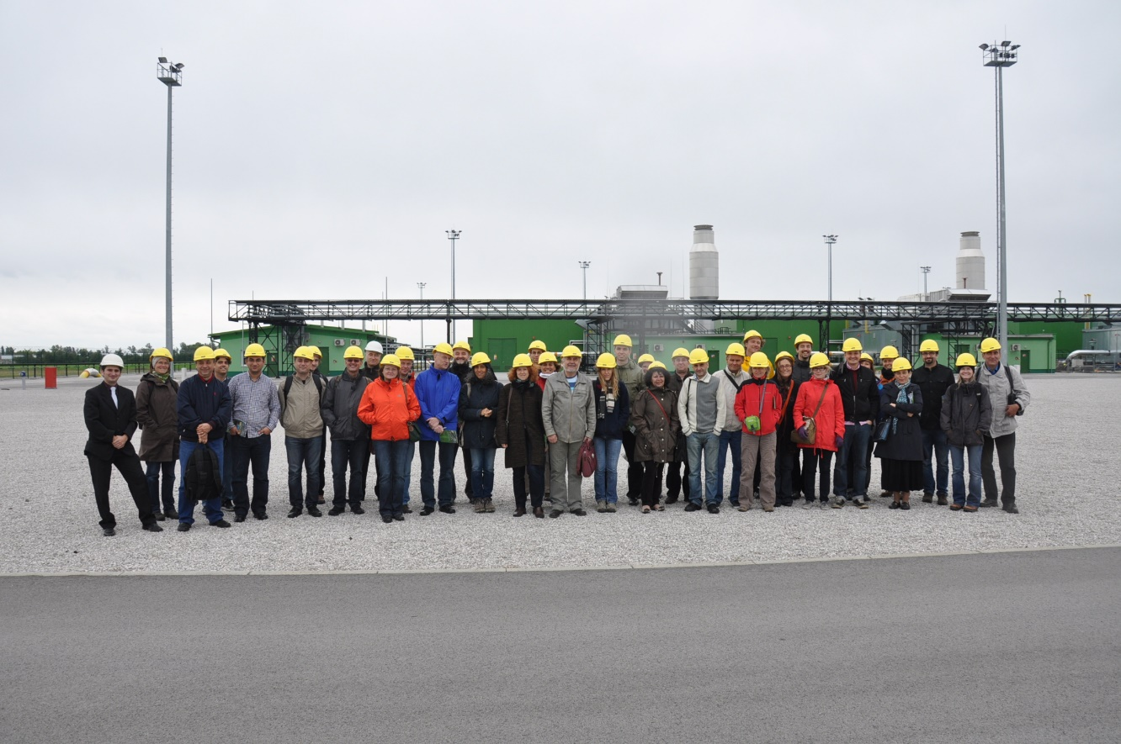
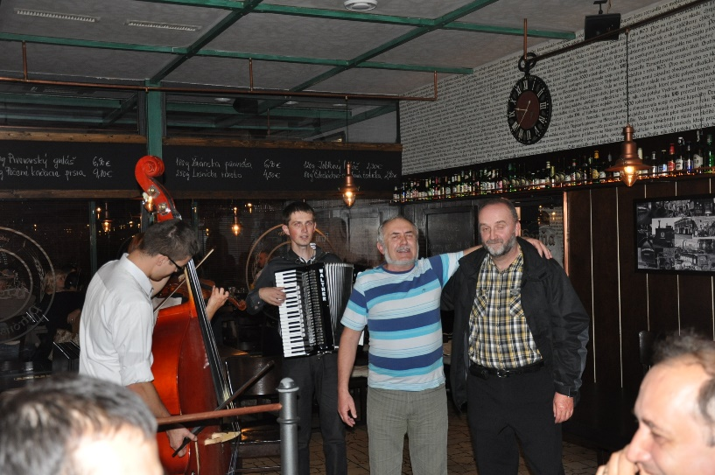
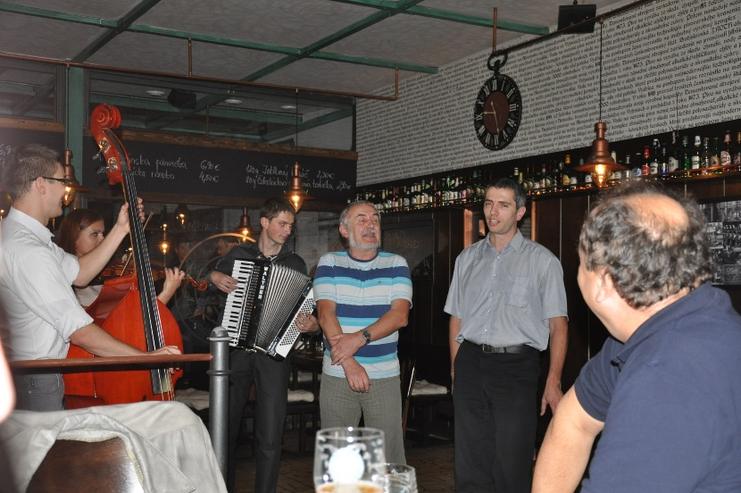
6th CGS Europe Knowledge Sharing Workshop: Other promising options for CO2 storage Bratislava, Slovakia, 16-17 September 2013 in Bartislava, 2013
Excursion to UGS in Slovakia
ENeRG Social event in the evening

Slide 22
Horizon 2020 project ESTMAP, Prague 2015

Slide 23
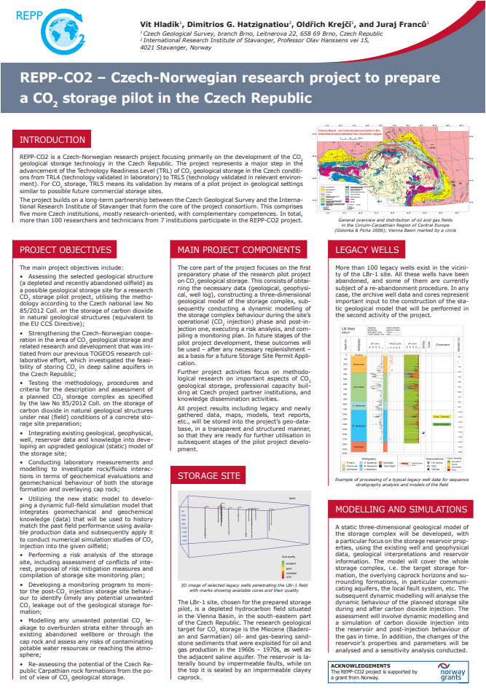
Horizon 2020 project ENOS

Slide 24
REP-CO2 project coordinated by Vit Hladik
BASRECCS-ENOS Workshop, Tallinn - 2018

Slide 25
Horizon 2020 project ENOS – Education activities – WP8

Slide 26
CO2 SPICER project coordinated by Vit Hladik
CO2 SPICER project coordinated by Vit Hladik
Presented in Lyon, 2022, GHGT6
Presented in Venice, 2022

Slide 27
CO₂GeoNet – STATE-OF-PLAY ON CO2 GEOLOGICAL STORAGE IN 32 EUROPEAN COUNTRIES
CO2GeoNet (2021): State-of-play on CO2 geological storage in 32 European countries — an update, CO2GeoNet Report, 325 p

Slide 28
Vit Hladik in
Vit was the ENeRG president for 2018-2019, when he organized, together with BRGM, the First European Underground Energy Storage (UES) Workshop in Paris.

Slide 29
COST Action GEOTHERMAL DHC
Workshop in Torino University, May 2022

Slide 30
The last social event we have spent together in Venice, October, 2022

Slide 31
Last memories from October 2022, Venice

Slide 32
Thank you for attention!

