Slide 1
2nd European Underground Energy Storage Workshop
﻿
﻿
Paris, 23 - 24 May 2023
This workshop is dedicated in the memory of our colleague from the Czech Geological Survey
Vit Hladik

Slide 2
Context
Building on the success of the 1st European Underground Energy Storage Workshop, held in Paris in 2019, the ENeRG network, COST Action Geothermal-DHC and EuroGeoSurveys are pleased to welcome you to the 2nd European Underground Energy Workshop
Organizing
committee
Alexandra Dudu, GeoEcoMar and ENeRG President 2023-2024
Alla Shogenova, TalTech, SHOGenergy, ENeRG President 2022-2023
Eleonora Manoukian, CERTH and ENeRG secretary
Jessica Chicco, University of Turin, MC member of Cost action "Geothermal DHC"
Barbara Merson, OGS
Gregor Goetzl, Geosphere Austria, Chair of the Cost action "Geothermal DHC„
Arnaud Reveillere, Geostock
Annamária Nádor, EuroGeoSurveys, chair of the GeoEnergy Expert Group
Gold Sponsor - AVALON INTERNATIONAL CORPORATION
www.avalon-int.com
Silver Sponsor
DEEP.KBB GmbH
www.deep-kbb.de

Slide 3
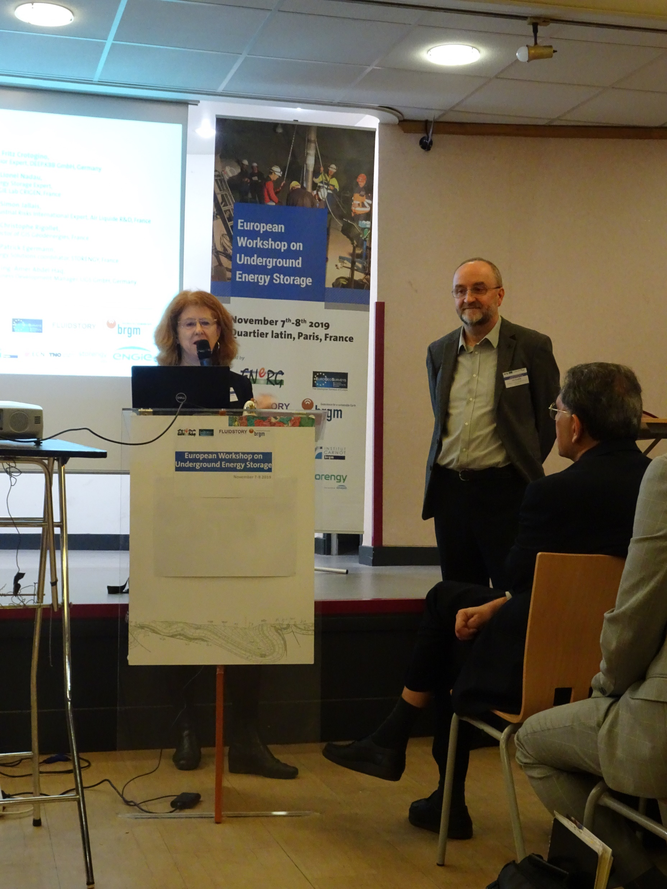
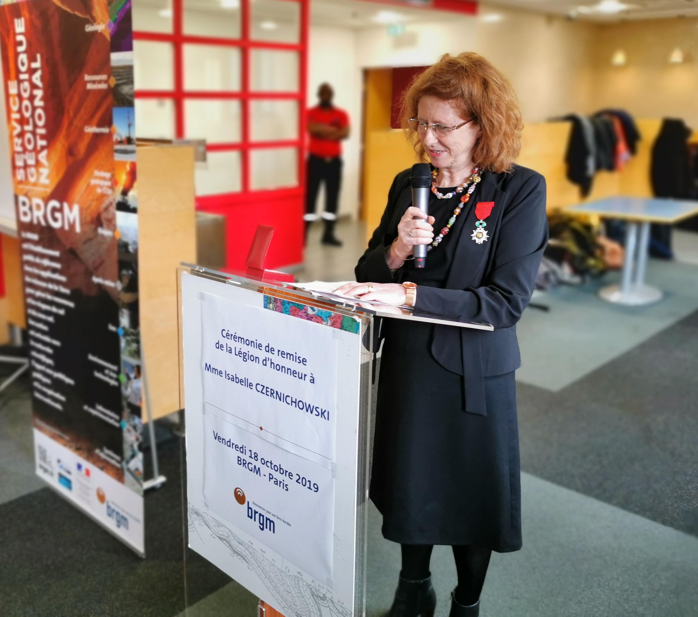
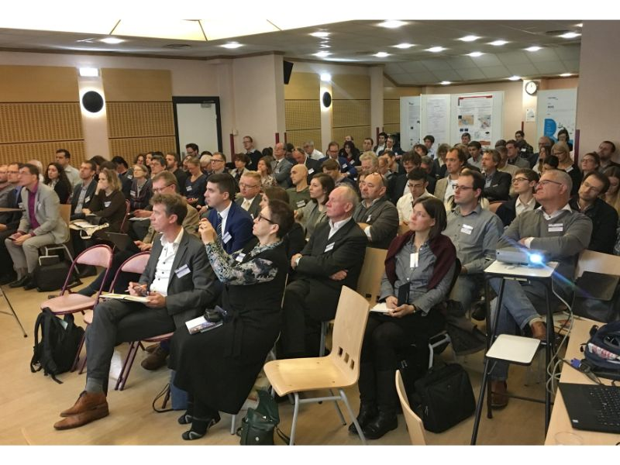
1st UES workshop
7-8 November 2019, Paris
First big EU event on Underground Energy Storage (UES) was organized by ENeRG together with EuroGeoSurveys’ GeoEnergy Expert Group, BRGM, and the ANR FLUIDSTORY project.
The workshop was a real success, both in terms of the number of participants (130 from 23 countries) representing research, policy and industry, and of the constructive scientific exchanges.

Slide 4
Program – Day 1
Time | Title
11:30 | Registrations
12:30 | Lunch buffet
13:30-15:00 | Session 1. Introductory session chair: Alexandra Dudu, ENeRG President
15:00 | Coffee break & posters
15:30-17:10 | Session 2. Advances in deployment of underground energy storage chair: Barbara Merson, ENeRG-OGS
17:10 | Discussion: Advances in the deployment of underground energy storage chair: Alla Shogenova, ENeRG-TalTech-DG
17:40 | End of the day

Slide 5
Program – Day 1
Session 1. Introductory session
Time | Title | Speaker | Affiliation
 | Session 1. Introductory session chair: Alexandra Dudu, ENeRG President
13:30 | Welcome and Introduction to the Workshop | Alexandra Dudu | ENeRG President
13:40 | In Memoriam Vit Hladik | Alla Shogenova | Ex-ENeRG President
14:00 | The need for underground energy storage | Kazbulat Shogenov & Alla Shogenova | TalTech and SHOGenergy (Estonia)
14:20 | Project Optimization for New Industrial Projects | Miguel Silva | Avalon (USA)
14:40 | The COST Action Geothermal DHC in a Nutshell | Jessica Maria Chicco | University of Torino (Italy)
15:00 | Coffee break & posters

Slide 6
Program – Session 2
 | Session 2. Advances in deployment of underground energy storage chair: Barbara Merson, ENeRG-OGS
15:30 | Hydrogen Storage in Salt Caverns – Current Status and Potential Future Research Topics | HeiKe Bernhardt | DEEP.KBB (Germany)
15:50 | Underground Storage of Ammonia (NH3): Review of Possibilities | Matthias Torquet | Geostock (France)
16:10 | Storing H2 in Aquifers using CO2 as Cushion Gas, the Thermodynamic Behavior of the System | Fernanda Veloso | BRGM (France)
16:30 | Identification of Promising CCUS Clusters in the Baltic and Mediterranean Regions (CCUS ZEN Project) | Catherine Ringstad | SINTEF (Norway)
16:50 | PilotSTRATEGY - EU project | Fernanda Veloso | BRGM (France)
17:10 | Discussion: Advances in the deployment of underground energy storage chair: Alla Shogenova, ENeRG-TalTech-DG
17:40 | End of the day

Slide 7
Posters
Title | Authors | Affiliation
Ranking of geological structures in deep aquifers for UHS | Leszek Lankof, Radoslaw Tarkowski, and Katarzyna Luboń | MEERI-PAS (Poland)
GIS-based analysis of rock salt deposits' suitability for underground hydrogen storage | Radoslaw Tarkowski, Leszek Lankof, and Katarzyna Luboń | MEERI-PAS (Poland)
New synergy concept of geothermal energy recovery, CO2 and green hydrogen geological storage in the Baltic offshore structure | Kazbulat Shogenov & Alla Shogenova | TalTech & SHOGenergy (Estonia)
Driven Geothermal Energy Pile: An innovative heating/cooling solution | Rao Martand Singh | NTNU (Norway)
Utilization of empty caverns in oil fields of Albania for the underground storage of natural gas arriving from TAP | Altin Maraj | Polytechnic University of Tirana (Albania)
A Successful ATES deployment in the UK Chalk Aquifer, London | Hayley Firth | Imperial College London (UK)

